Slide 1
EdgeStore: Leveraging Edge Devices for Mobile Storage Offloading
Elgazar, Ali, Mohammad Aazam, and Khaled Harras. "Edgestore: Leveraging edge devices for mobile storage offloading." In 2018 IEEE International Conference on Cloud Computing Technology and Science (CloudCom), pp. 56-61. IEEE, 2018.

Slide 2
Contribution
Propose EdgeStore, which utilizes user-owned devices at the edge, to automatically offload and retrieve files
It accounts for different networking infrastructures
Implement and evaluate EdgeStore
Users can offload up to 90% of storage and still have a high percentage of low latency access to offloaded files within 10 seconds

Slide 3
Motivation
User generated content (UGC) has exponentially grown
Centralized storage clouds (CSCs) are a major target for organized hackers
Distributed edge clouds (DECs) DECs provide increased privacy and security
Both CSCs and DECs require more stable network connections

Slide 4
EdgeStore
Offers an intelligent and automated data offloading solution
Addresses the security and privacy concerns
Accounts for different networking infrastructures
Requires little to no user intervention in offloading or retrieving files
It examines user access patterns, determines file popularity, and automatically offloads unpopular files to the user’s own underutilized private devices (PCs, un- used mobile phones, IoT devices, etc.)

Slide 5
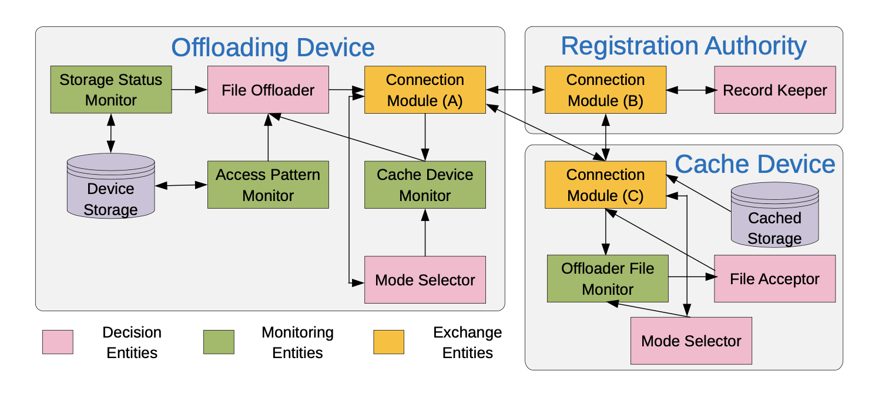
System overview
Decision Entities: Determine how files are offloaded, and where they are offloaded to
Monitoring Entities: keep track of different information in the system and deliver it to the decision entities
Exchange Entities: connect and authenticate devices, exchanging information

Slide 6
Monitoring Entities
Storage Status Monitor (SSM):
If storage space exceeds the amount of storage requested by the user, SSM triggers the offload process
Access Pattern Monitor (APM):
APM tracks the user’s access pattern in order to determine which files can be offloaded with minimum user intervention.
Cache Device Monitor (CDM):
Ranks cache devices for offloading purpose
Offloader File Monitor (OFM):
Ranks files rather than ranking devices.

Slide 7
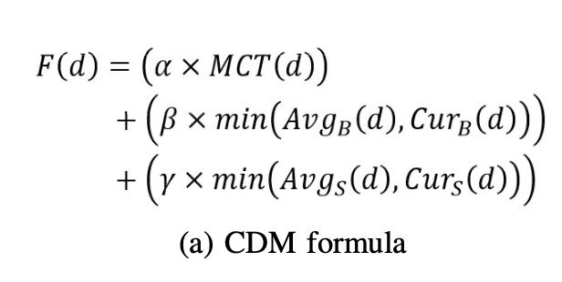
CDM
MCT: monthly contact time
B: battery
S: storage
Favorable Device:
More space, more battery, available for connection for longer periods of time
Notes:
monthly contact time of the device, and represents the probability of meeting the device given the average amount of time the offloader meets that device

Slide 8
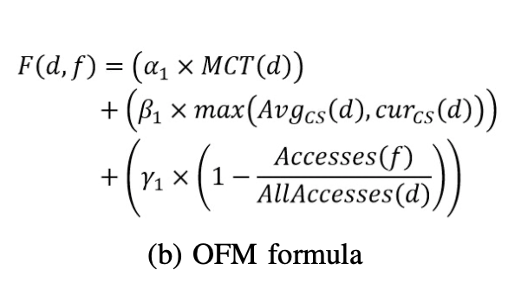
OFM
cs: consumed storage
Rank the file by its owner’s contact time and storage availability
Files which have low probability of being accessed are ranked higher as the cache device prefers to have the least amount of file exchanges.

Slide 9
Decision Entities
Record Keeper (RK):
Decides how connections are formed, and which devices are allowed in the service
File Offloader (FO):
Decides which cache device receives which files
File Acceptor (FA):
Accepts, rejects, and returns files to offloaders based on the amount of storage the cache device has
Mode Selector (MS):
MS determines a networking mode for the devices

Slide 10
FO
Divide the list of offload files into equal chunks (to ensure fairness)
Sort chunks from least to most popular
The most popular chunk is offloaded to the most favorable device
Recalculates the ranks of devices using data fed to it by CDM
Process of offloading the newly ranked most popular chunk to the most favorable device
If the most favorable device begins to be overloaded
->its rank will decrease and it will no longer receive any more chunks until its rank rises again

Slide 11
FA
Cache device’s storage is filled and files are incoming for offloading:
->Compares the new files’ OFM ranking with the files already stored
->If the new files have a higher OFM ranking:
return the files with the lower OFM ranking to their owners and accept the new files.
->Otherwise:
rejected

Slide 12
MS
Rural Mode:
When a stable (low interruption) WiFi network is not available in the past day, Rural Mode is selected
Suburban Mode:
When a stable WiFi network is available but a stable cellular network is not, Suburban Mode is selected
Metropolitan Mode:
When a stable WiFi and cellular network are available, Metropolitan Mode is selected

Slide 13
Results
Metropolitan: WiFi + 4G
Urban: WiFi
Rural: Bluetooth

Slide 14
Over time the storage oscillates, this is due to repeated cycles of files being created or retrieved from cache devices

Slide 15
Metropolitan: energy
Urban: energy
Rural: contact

Slide 16
Metropolitan: probability of not access
Urban: probability of not access
Rural: contact

