Slide 1
mID: Tracking and Identifying People with Millimeter Wave Radar
2019 15th International Conference on Distributed
Computing in Sensor Systems
Peijun Zhao¹, Chris Xiaoxuan Lu¹, Jianan Wang², Changhao Chen¹, Wei Wang¹, Niki Trigoni¹, and Andrew Markham¹
¹Department of Computer Science, University of Oxford, United ²Kingdom DeepMind, London, United Kingdom
Notes:
A System that identifies people by their unique characteristics as sensed by a millimeter-wave radar

Slide 2
Outline
Background of mmWave radar overview
Introduction
Motivation & Challenge
System Design
Implementation
Evaluation
Limitations
Conclusion

Slide 3
mmWave radar overview
Radar technology with high frequency and short-wavelength
Wavelength: 1-10 mm
Frequency: 30~300 GHz
By capturing the reflected signal, the radar system can determine the distance, velocity, and angle of the objects
Existing applications:
Car radar, gesture/gait/activity recognition, tracking, face verification, 5G
 | Infrared Radar | Untrasonic Radar | mmWave Radar | LiDAR | Camera
Cost | low | very low | median (US $300) | High | median
FoV | ~30。 | 120。 | 10~70。 | 15~360。 | 30。
Distance | median | short | long (~30m) | very long (> 100m) | long
Night Vision | Strong | Strong | Strong | Strong | Week
Environment limitation | temperature | Wind, Dust | little | Fog, rain, snow | Light

Slide 4
Introduction
Knowing "who is where" is a key requirement for many applications in smart places
Personalized heating, security, light adjustment, background music selection…
Inseparable device-based identification methods are inconvinent.
Device-free based is more general and increasingly being adopted.
Vision based (e.g., RGB-D camera) method has privacy concern
Radio frequency based is less intrusive, e.g., Wifi, RFID, mmWave

Slide 5
Motivation & Contribution
mmWave is a transceiver that requires only a single device for tracking and identification
Wifi or RFID require separated transmiters and a receivers
mmWave provides high precision by analyzing the reflection from obstacles in environment
Allow to be concealed behind different kinds of material
Contribution
Implement a human tracking and identification system using mmWave radar (the first one)
median tracking accuracy of 0.16 m and identification accuracy of 89% for 12 people

Slide 6
System Design
Create a new track if it cannot be associated with an existing track
If a track object undetected for some continuous frames, mark it inactive
Use location and velocity to estimate the new position, avoid missing tracking objects
Voxelize the points
LSTM-based network for sequential data classification
Identifiy the tracking object as the specified person
Transmitting an RF signal and recording its reflection
Generated point cloud and remove the static objects (i.e., appears in the previous frame)
Merging individual points of potential human object into clusters
DBScan: density-aware clustering that spearates cloud points based on 3D distance

Slide 7
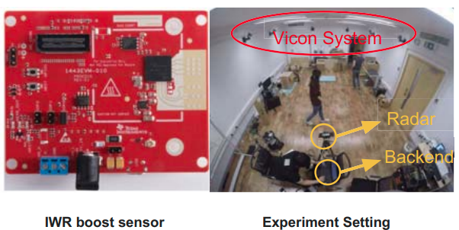
Implementation
Commercial, off-the-shelf millimeter wave radar
Vicon optical tracking system provides ground-truth position and marker
IWR1443Boost boost sensor:
LSTM:
hidden layer size: (256,128)
Optimizer: Adam
Data augmentation: shifting voxel and rotating frame by different degrees
f_{c} : 77-81 GHz
Bandwidth B: 4 GHz
Chirp cycle time T_{c}: 162.14 𝞵s
range resolution: 4.4 cm
max unambiguous range: 5 m
max object radial velocity: 2 m/s

Slide 8
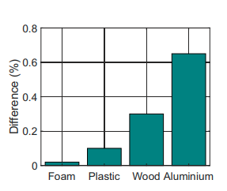
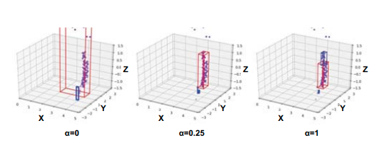
Evaluation - Sensitivity Analysis
Non-Line-of-Sight Conditions
Compare the percentage of change in point cloud density for mID
Testing the robustness of mmWave under occluded conditions
Foam, plastic, wood, and aluminium (each 3 mm of 10⁵ mm², 1 cm away)
Robustness to thin obstructions
Capable of working under the furnitures
Self-defined distance function in DBScan:
𝛂 = 0.25 results in the best clustering performance

Slide 9
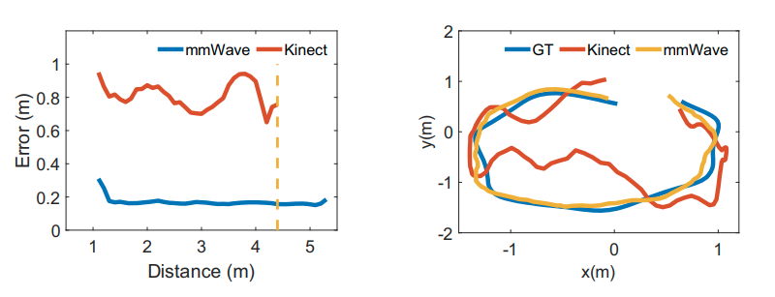
Evaluation - User tracking
Compare the distance error with the Kinect v2
Kinect v2 uses the start-of-the-art tracking algorithm [1]
The median of tracking error:
mmWave: 0.16 m
Kinect: 0.9 m
Tracking range:
mmWave: 5.5 m
Kinect: 4.5 m
More accurate along the whole trace
[1] https://github.com/mcgi5sr2/kinect2_tracker

Slide 10
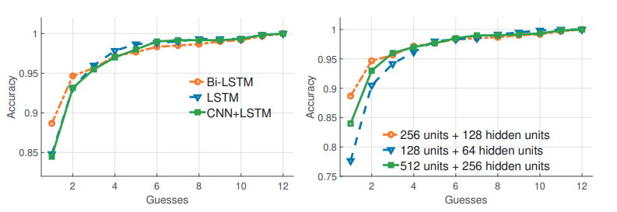
Evaluation - Identification
Identification performance reach 89 % for 12 people
Different network architecture comparison:
Bi-LSTM converges faster and outperforms than the other 2 network
Bi-LSTM is good at model the rich temporal correlations in a long sequence of frames from both ends
(256,128) is the fine-tuned hidden layer size

Slide 11
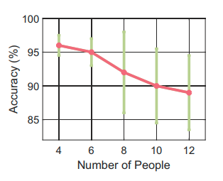
Limitation
Number of users
Sparsity of point cloud distrub the human detection and tracking
Accuracy degrades as the number of user increase
Monitor range
Larger range, larger SNR, and lower precision
Flat or planar surface
Affected by the different material of the reflection profile, such as windows

Slide 12
Conclusion
Propose a highly accurate tracking and identification system for smart space based on mmWave
Point clouds and RNN based methods associate the objects to their trajectories and recognize the objects.
Overall performance
Recognition accuracy ~89% with 12 people
Position Error: ~0.16 m
mID can be highly unobstrusive and gain acceptance by smart home users
Can be concealed inside furniture or walls
Less privacy concern than camera sysytems

