Slide 1
A Overview of Omnidirectional MediA Format (OMAF)
Miska M. Hannuksela and Ye-Kui Wang
(https://ieeexplore.ieee.org/abstract/document/8712670)

Slide 2
What’s OMAF?
The frist VR system standard (from MPEG)
Provide basic support for 360° video, images, audio,timed text
OMAF v1 was finalized in 2017, OMAF v2 is ongoing

Slide 3
OMAF Architecture

Slide 4
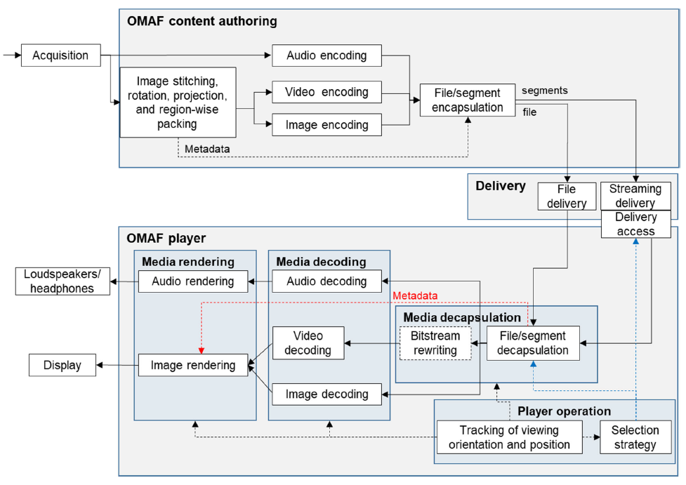
Notes:
There are three part in OMAF. Frist is content authoring …..

Slide 5
Agenda
OMAF content authoring
Representation
File format and Media encapsulation
Delivery
360 video streaming
OMAF player
video & image profile

Slide 6
Representation

Slide 7
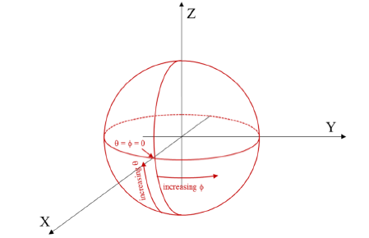
Coordinate system
Global & local coordinate system
Each video or image may have its own local coordinate system
They can convert to each other by the following equation

Slide 8
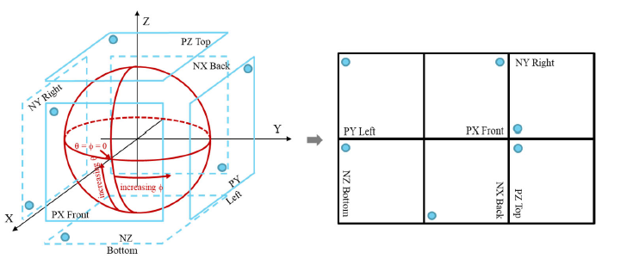
Projection Format
OMAF support two types of projection:
equirectangular projection (ERP)
cubemap projection (CMP)

Slide 9
Region-Wise Packing (RWP)
It’s the optional step
It enable manipulations of any rectangular region of packed picture before encoding.
(resize, reposition, rotation...)

Slide 10
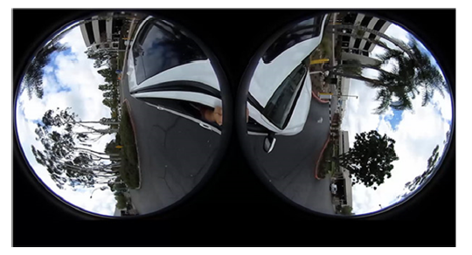
Fisheye Video and Images support
OMAF also specifies the support of omnidirectional media with fisheye video or image.

Slide 11
File Format and Media Encapsulation

Slide 12
File Format for File Deliver
Based on ISO Base Media File Format (ISOBMFF), which is a popular meida container format
A basic building block in ISOBMFF is called a box
OMAF defines many types of box to stroge important information. (content coverage, projection format, RWP information...)

Slide 13
File Format for Streaming Deliver
Based on Dynamic Adaptive Streaming over HTTP (DASH)
DASH specifies a MPD format for describing the content available for streaming and Segment formats for the streamed content.
OMAF add some extension to stroge extended information for 360 video (RWP information, projection format, quality ranking...)

Slide 14
Region-Wise Quality Ranking (RWQR)
Quality ranking metadata can be provided for sphere regions and for rectangular regions on decoded 2D pictures.
Quality ranking values are given for indicated regions and describe the relative quality order of the regions
Notes:
For example, when region A has a non-zero quality ranking value less than that of region B, region A has a higher quality than region B.

Slide 15
360 video streaming

Slide 16
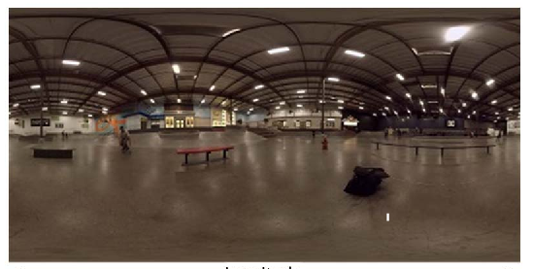
360 video streaming
Viewport-independent
Viewport-dependent
Viewport-specific
Tile-based

Slide 17
Viewport-Specific Viewport-Dependent Streaming
Several 360° streams of the same input video content are encoded for a pre-defined set of viewport orientations.
Each stream also covers areas other than the targeted viewport, though at lower quality.

Slide 18
The approaches of Viewport-Specific
VS low-pass filtering [20]
Asymmetric projection [17]
VS region-wise mixed resolution packing [17]
VS varibale-quality encoding [OMAF Annex D]

Slide 19
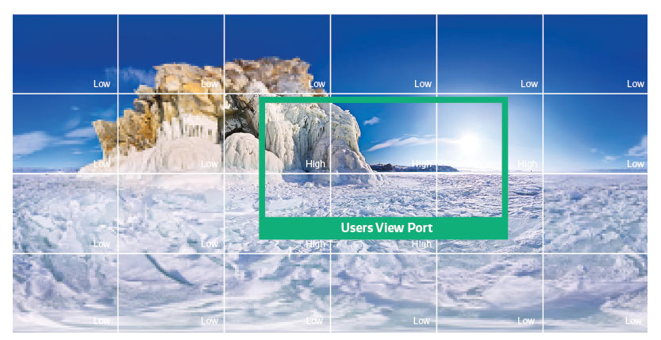
Tile-based Viewport-Dependent Streaming
Split the video into a lot of tiles
For tiles in viewport, use high quality

Slide 20
The approaches of Tile-based
Region-wise mixd quality [16]
Viewport + 360 video [13]
Region-wise mixed resolution (RWMR) [19] [24]

Slide 21
Video & Image Profile

Slide 22
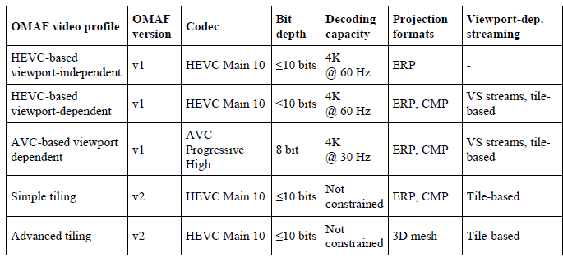
Video profile

Slide 23
Image Profile
Notes:
Support two codec, one is HEVC codec and the other is JPEG codec

Slide 24
OMAF v2

Slide 25
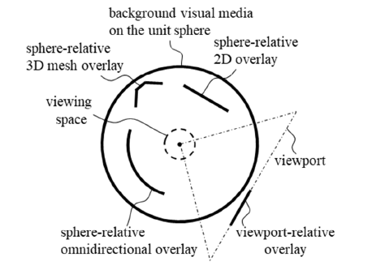
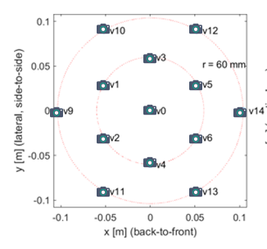
New ferture in OMAF v2
Multi-viewpoint
Overlay
More mechanism for tile based streaming (Tile index, Tile data segment)
Support 3D mesh

Slide 26
Conclusion
OMAF is the frist virtual reality standard.
This overview focus on 360 video and image. It mention the OMAF architectrue, file format, representation, and OMAF video and image profiles.
The OMAF group of MPEG is working towards the second version of OMAF.
Implementation

