Slide 1
Textured Mesh vs Coloured Point Cloud: A Subjective Study for Volumetric Video Compression Emin Zerman, Cagri Ozcinar, Pan Gaoy, and Aljosa Smolic
2020 Twelfth International Conference on Quality of Multimedia Experience (QoMEX)

Slide 2
Introduction
Volumetric video (VV) is a new form of immersive visual media
Various VV compression works are ongoing (MPEG, JPEG)
Two popular VV formats:
Textured polygonal Mesh
Point cloud
This paper aim to understand perceptual differences between:
Mesh and Point cloud
Various point cloud compression algorithms

Slide 3
Related Work
Including:
Methods capture the real-life 3D content from the scene
Mesh and point cloud compression
Quality assessment (QA) of mesh and point cloud
In QA papers, only some of them consider state-of-the-art compression algorithms
Studies consider QA of VV are rather limited

Slide 4
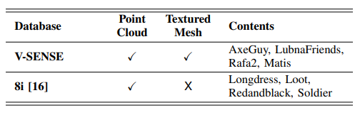
Using Datasets
V-SENSE
Generated by authors
Have mesh and point cloud
8i
Point cloud dataset
V-SENSE
8i

Slide 5
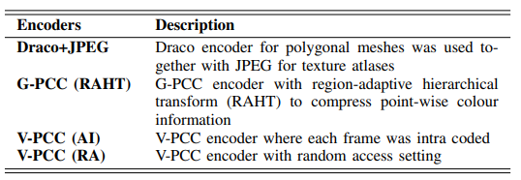
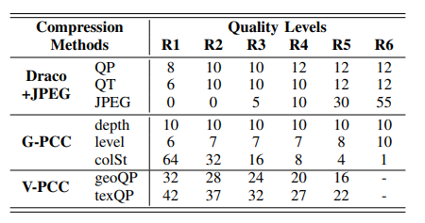
Compression Algm.
For mesh
Draco+JPEG
For point cloud
G-PCC
V-PCC (AI)
V-PCC (RA)
Because Draco and G-PCC do not consider temporal redundancies, they include V-PCC (AI) to compare them in fair way

Slide 6
Visualization and Experiment Setup
The compressed VVs were rendered using Blender with “point cloud visualizer” add on
Stored as traditional videos (using ffmpeg,X264 codec,-crf 15)
Render on 24’’ LCD Display
The distance between the viewers and the screen was set to three times of the stimulus height, which was around 1 metre
The experiment was conducted in a dark room as recommended by ITU [1]
[1] ITU-T, “Subjective video quality assessment methods for multimedia applications,” ITU-T Recommendation P.910, Apr 2008.

Slide 7
Experiment Procedure
The participants were first trained on ‘Rafa’ sequence with different V-PCC compression levels
Adopt Absolute Category Rating (ACR)
Each stimulus was 10 seconds long, and participants voted for each stimulus in 1.5 sec on average
Include two sessions:
First session (30 mins): compare mesh and point cloud
Second session (30 mins): compare different point cloud compression algorithm

Slide 8
MOS Calculation
Each subject had different understanding of scale during rating
To reduce subject variability and keep the overall mean, following equation be applied [2]
Calculate the z-score of raw opinion scores
($i$: subject, $j$: stimulus, $s_{ij}$: raw opinion scores)
2. Using following equation to calculate new MOS
($rmos$: raw opinion scores, $zmos$: calculated z-scores,
${MOS}_{j}^{z}$: mean of z-scores for the stimulus )
[2] S. Athar, T. Costa, K. Zeng, and Z. Wang, “Perceptual quality assessment of UHD-HDR-WCG videos,” in IEEE International Conference on Image Processing (ICIP). IEEE, 2019, pp. 1740–1744.

Slide 9
Compare Mesh and Point Cloud
The mesh have higher maximum MOS value compare to point cloud, but need higher bandwidth
Point cloud is a better choice for scenario with limited bandwidth
Point cloud have a good balance between perceive quality and bitrate

Slide 10
Compare Point Cloud Compression Algorithm
V-PCC is better than G-PCC in any case
V-PCC (RA) is more effective than V-PCC (AI)

Slide 11
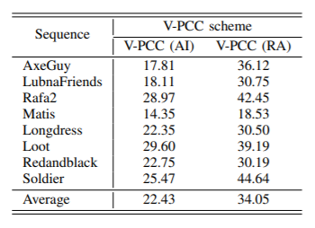
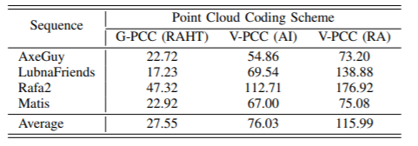
BD-MOS
Similar with BD-PSNR, was developed in [3]
V-PCC (RA) performs the best
[3] P. Hanhart, M. Rerabek, F. De Simone, and T. Ebrahimi, “Subjective quality evaluation of the upcoming HEVC video compression standard,” in Applications of Digital Image Processing XXXV. SPIE, 2012

Slide 12
Conclusion
Textured mesh can provide the best visualization quality, and are more suitable for high bandwidth scenario
Point cloud is suitable for limited bandwidth scenario
V-PCC is more efficiently than all other compression methods

