Slide 1
Characterization and selection of light field content for perceptual assessment
Token Hung

Slide 2
Outline
Introduction
Characterization
2D
LF
Generic Procedure for content selection
Conclusion
Notes:
Introduction of 1. Motivation of the paper and main contribution for the paper
2. Main contribution for Characterizing the content of LF images
Some characteristics are already studied in conventional 2D contents
LF with some contain some further info
Based on the Characterization, this paper gives a concept of content selection procedure
Conclusion

Slide 3
Introduction
For QoE study, the content selection should be based on visual characteristics and the purpose of the experiment.
Main application for LF
Multi-angle view – camera array
Refocus – LF camera
The contribution of this paper:
LF content characterization
Discussing what could be a suitable content selection procedure
Notes:
For QoE study of image or video, the content selection should be based on visual characteristics and the purpose of the experiment instead of personal preference or convenience.
So, for choosing content with suitable characteristics for application, this paper provides
LF content characterization
Content selection procedure
Source Sequences selection for QoE
SRCs ("Sources", i.e. original video sequences)

Slide 4
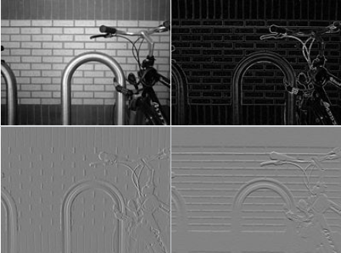
Characterization of 2D visual content
Space (SI)
Spatial information for edge energy
Contrast
Relative luminance in the scene
S. Winkler, “Analysis of public image and video databases for quality assessment,” IEEE Journal of Selected Topics in Signal Processing, vol. 6, no. 6, pp. 616–625, Oct. 2012.

Slide 5
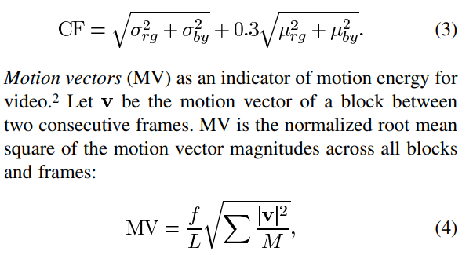
Characterization of 2D visual content
Color (CF)
Variety and intensity of colors
Time
Motion energy of the video
S. Winkler, “Analysis of public image and video databases for quality assessment,” IEEE Journal of Selected Topics in Signal Processing, vol. 6, no. 6, pp. 616–625, Oct. 2012.
Notes:
motion vector: a two-dimensional vector used for inter prediction that provides an offset from the coordinates in the decoded picture to the coordinates in a reference picture.

Slide 6
Characterization of LF visual content
Depth
Object’s distance from camera (normalized)
Disparity range
Distance of nearest and farthest objects
Occlusion
Items blocking each other
Refocus range
Notes:
The depth map is generated by Lytro Desktop software
difference in image location of an object seen by the left and right eye
The light field image set provide the capability to refocus within a range

Slide 7
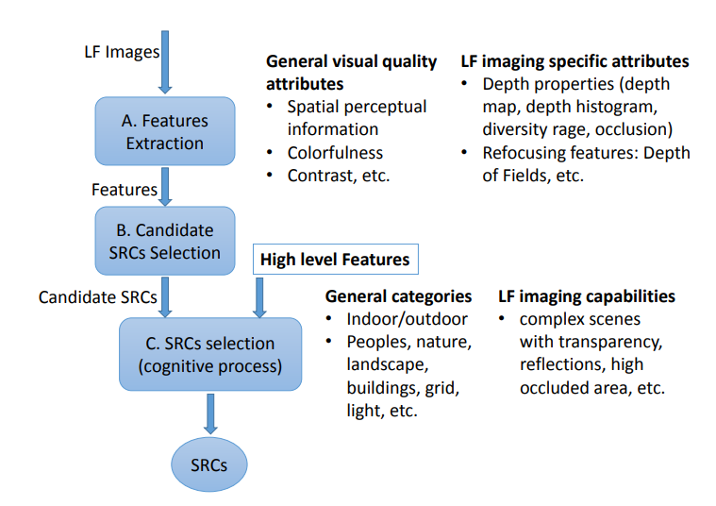
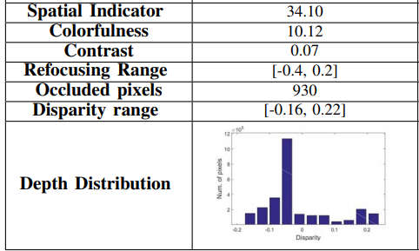
Generic Procedure for content selection
Feature extraction
Compute image quality attributes
Candidate SRCs selection
SRCs selection
Notes:
Variety and intensity of colors

Slide 8
Conclusion
This paper propose:
LF image characterization method
2D: Space, color, time
LF: Depth, disparity range, occlusions
Concepts of selection procedure
Result:
Indicator for refocusing: the refocusing ranges together with an equitable distribution of the disparities
Indicator for multi-view: Depth range, depth histogram, occlusions
Future work: Automation of the selection process
Notes:
Future clustering

Slide 9
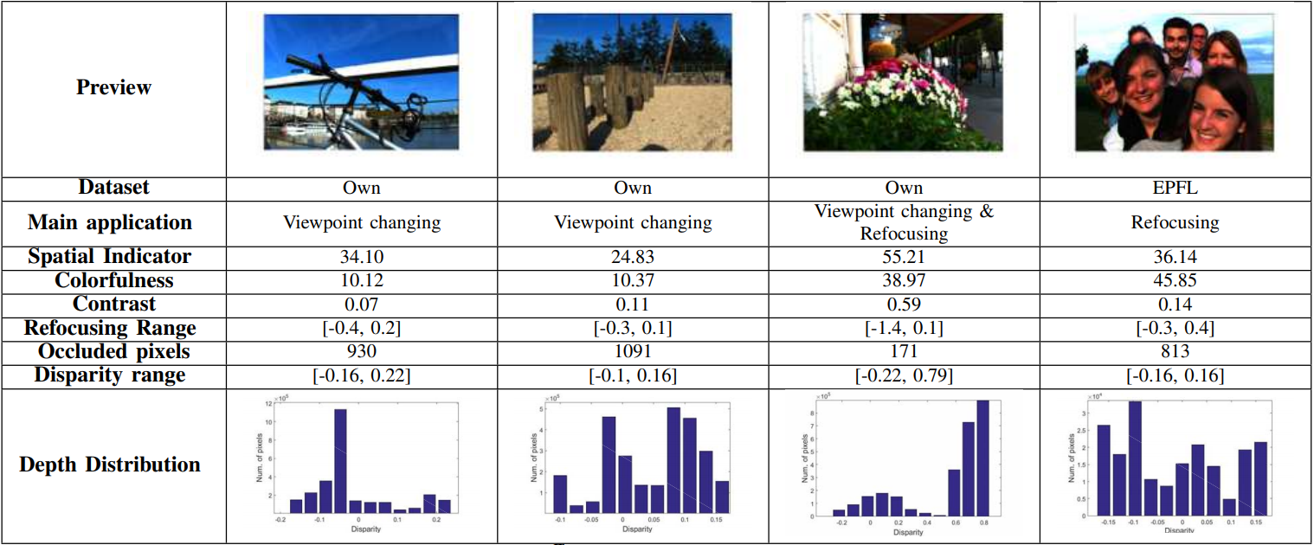

Slide 10
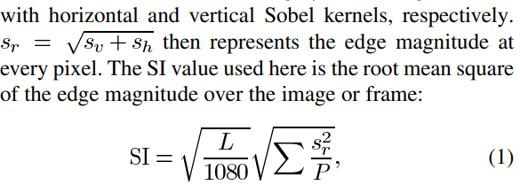
Notes:
motion vector: a two-dimensional vector used for inter prediction that provides an offset from the coordinates in the decoded picture to the coordinates in a reference picture.
M is number of block

