Slide 1
Early fire detection using convolutional neural networks during surveillance for effective disaster management
Khan Muhammad, Jamil Ahmad, Sung Wook Baik Intelligent Media Laboratory, Digital Contents Research Institute, Sejong University, Seoul, Republic of Korea

Slide 2
Problem
Detect early fire by surveillance
the complexity of the scenes
the irregularity of lighting
the low quality of captured images
an alert of fire and its associated keyframes need an autonomous and reliable communication medium for transmission

Slide 3
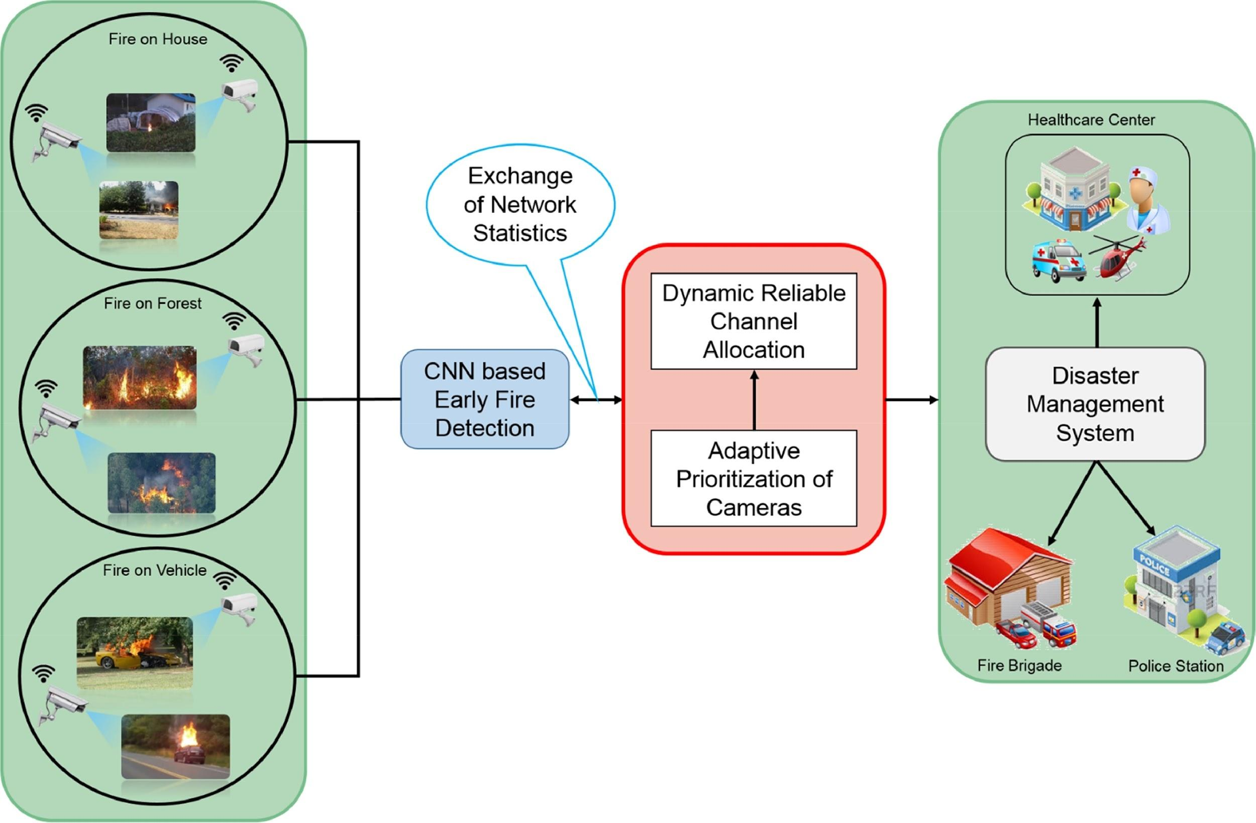

Slide 4
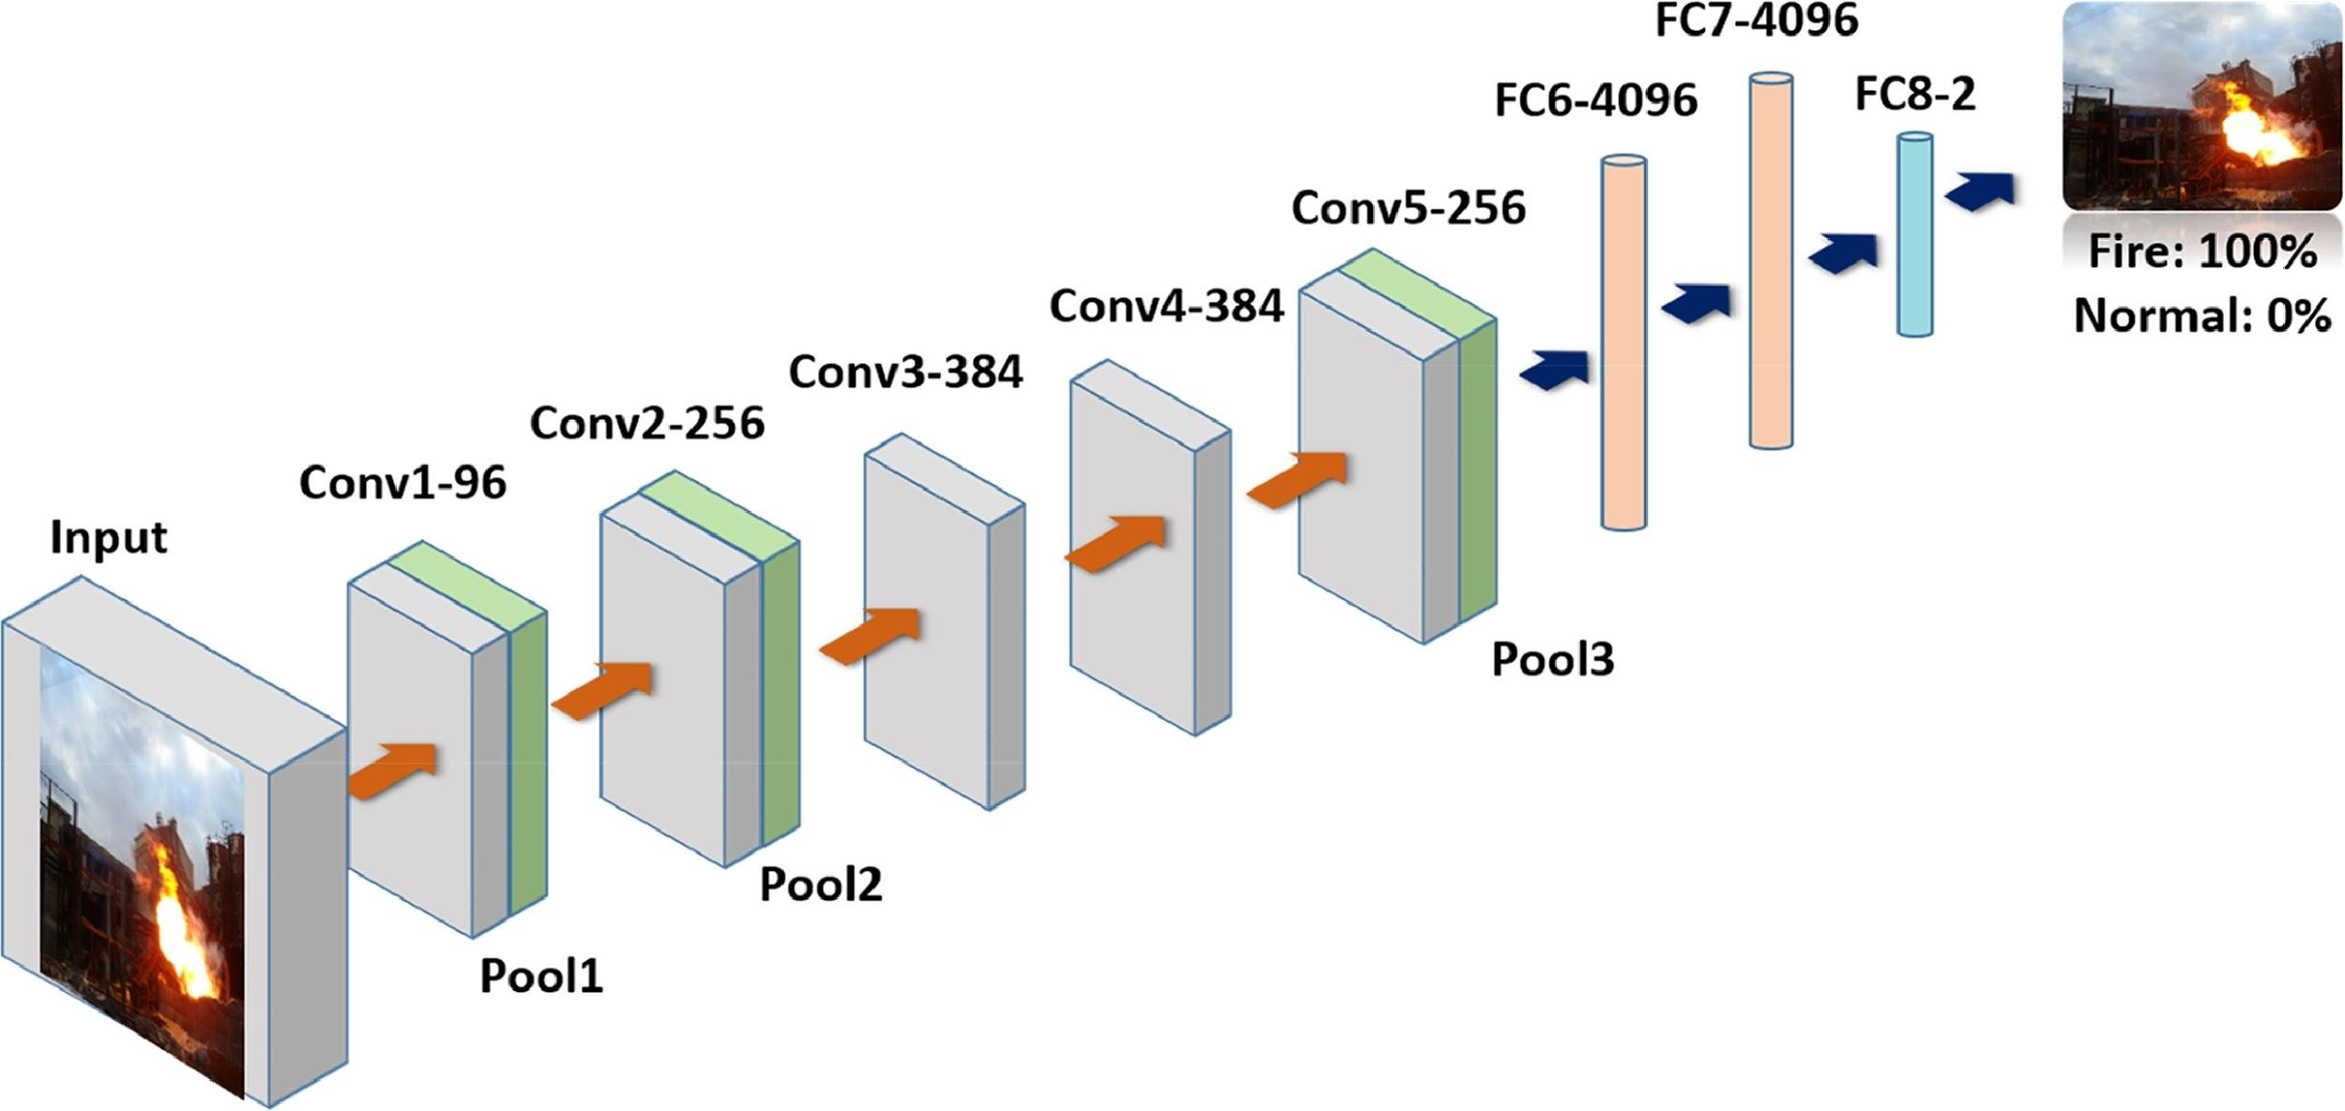
CNN-based fire detection

Slide 5
CNN-based fire detection
Use a pre-trained AlexNet model
Modify the last fully connected layer and keep a slower learning rate to fine-tune the model with their dataset
Evaluate the transfer learning approach
Learn very powerful features automatically from the provided data in raw form
Learn details at small scale

Slide 6
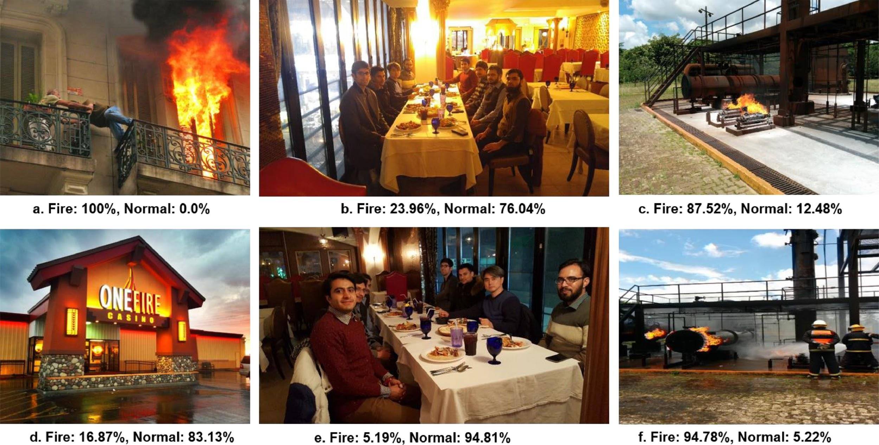
CNN-based fire detection

Slide 7
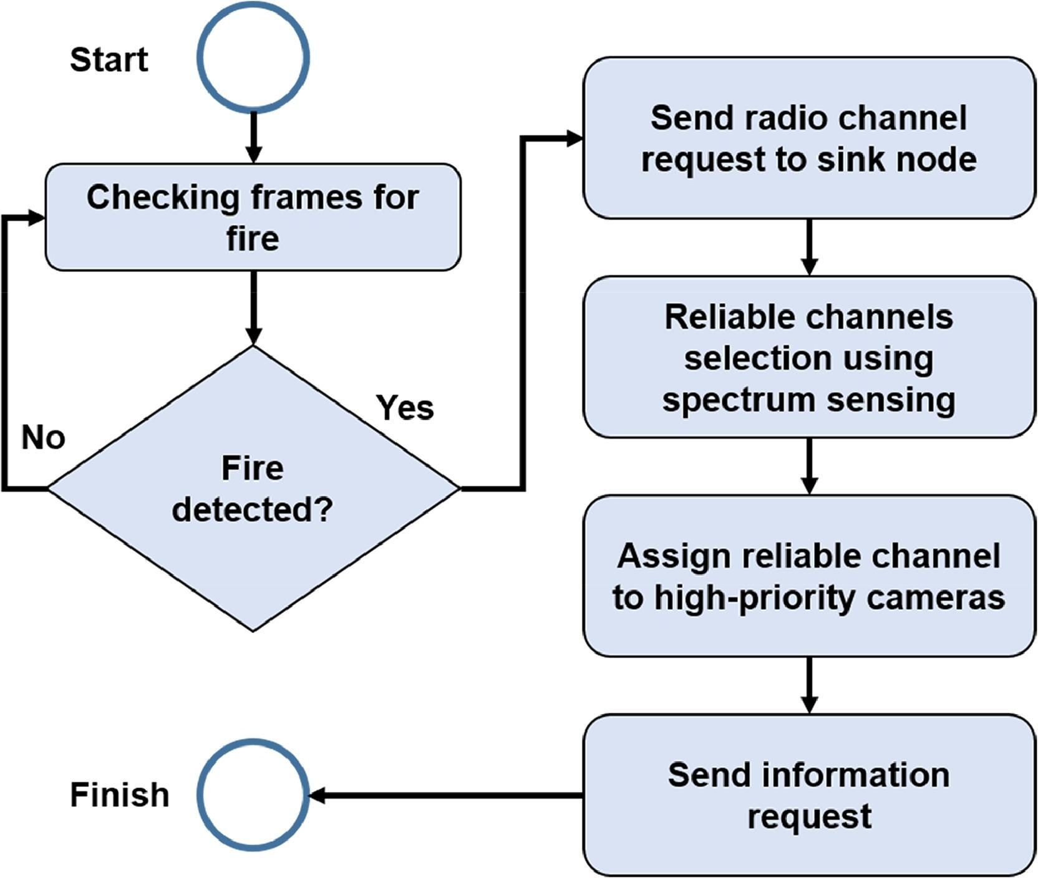
Dynamic channel selection using cognitive radio networks

Slide 8
Dynamic channel selection using cognitive radio networks
Cognitive radio + Specular sensing
Cognitive radio:
preserve the limited resources of surveillance system
improve spectrum utilization

Slide 9
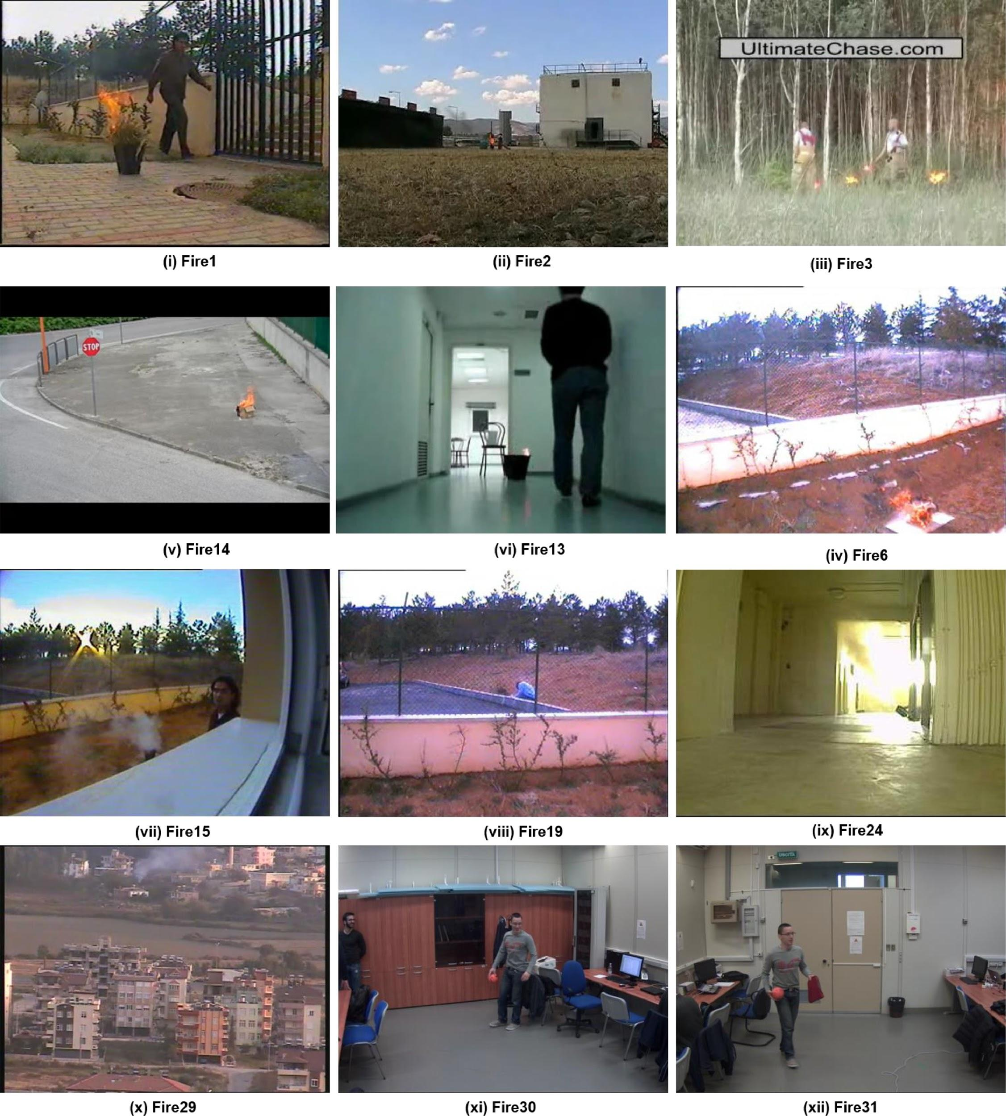
Dataset
Foggia’s video dataset
31 videos (14 with fire, 17 without fire)
contain indoor and outdoor
fire-like situation

Slide 10
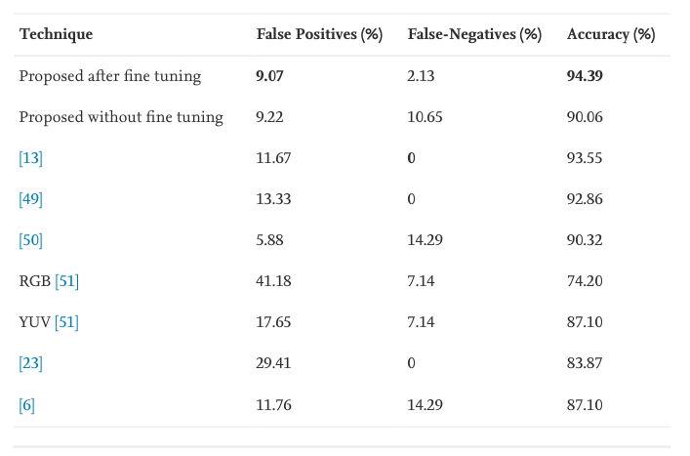
Result

Slide 11
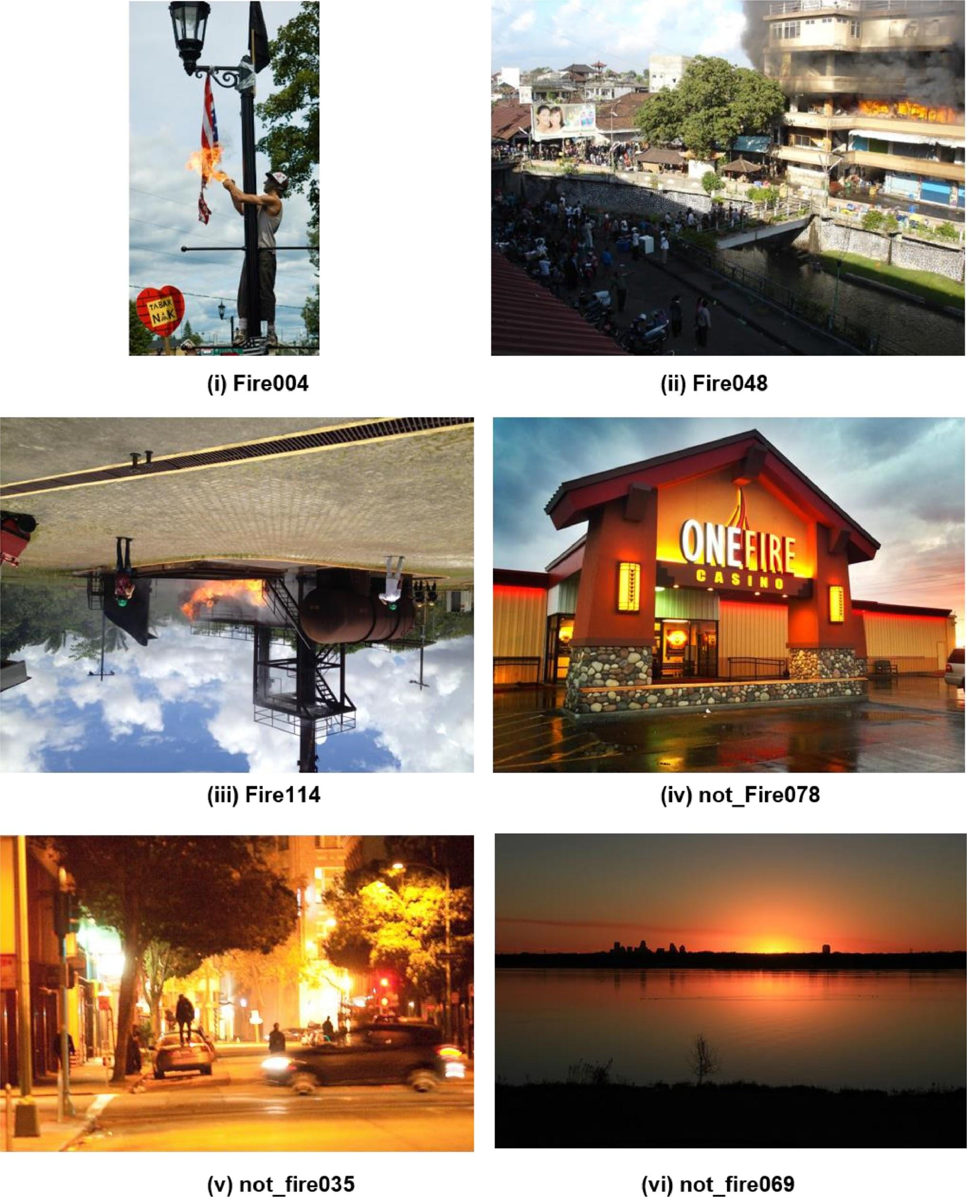
Dataset
Chino’s dataset
226 images(119 with fire, 107 fire-like image)

Slide 12
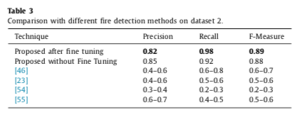
Result

Slide 13
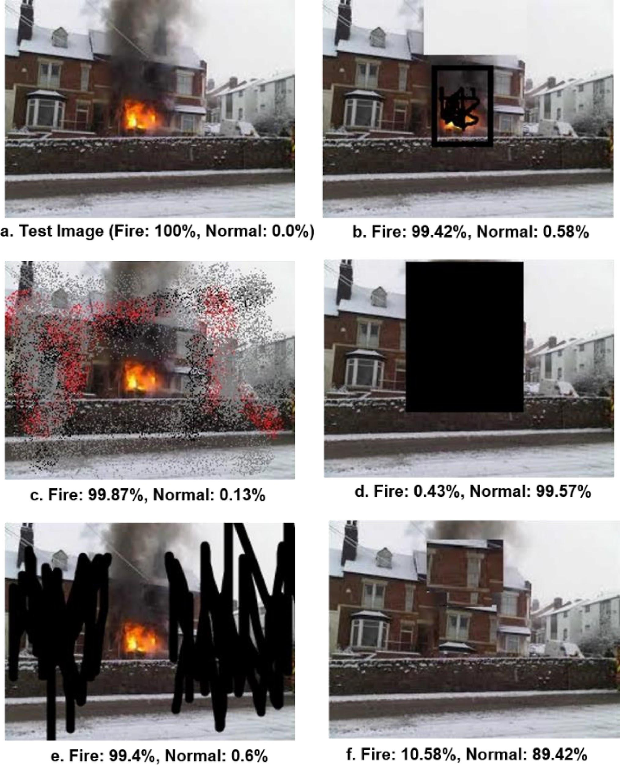
Robustness evaluation
prove to detect fire at early stages under varying conditions

Slide 14
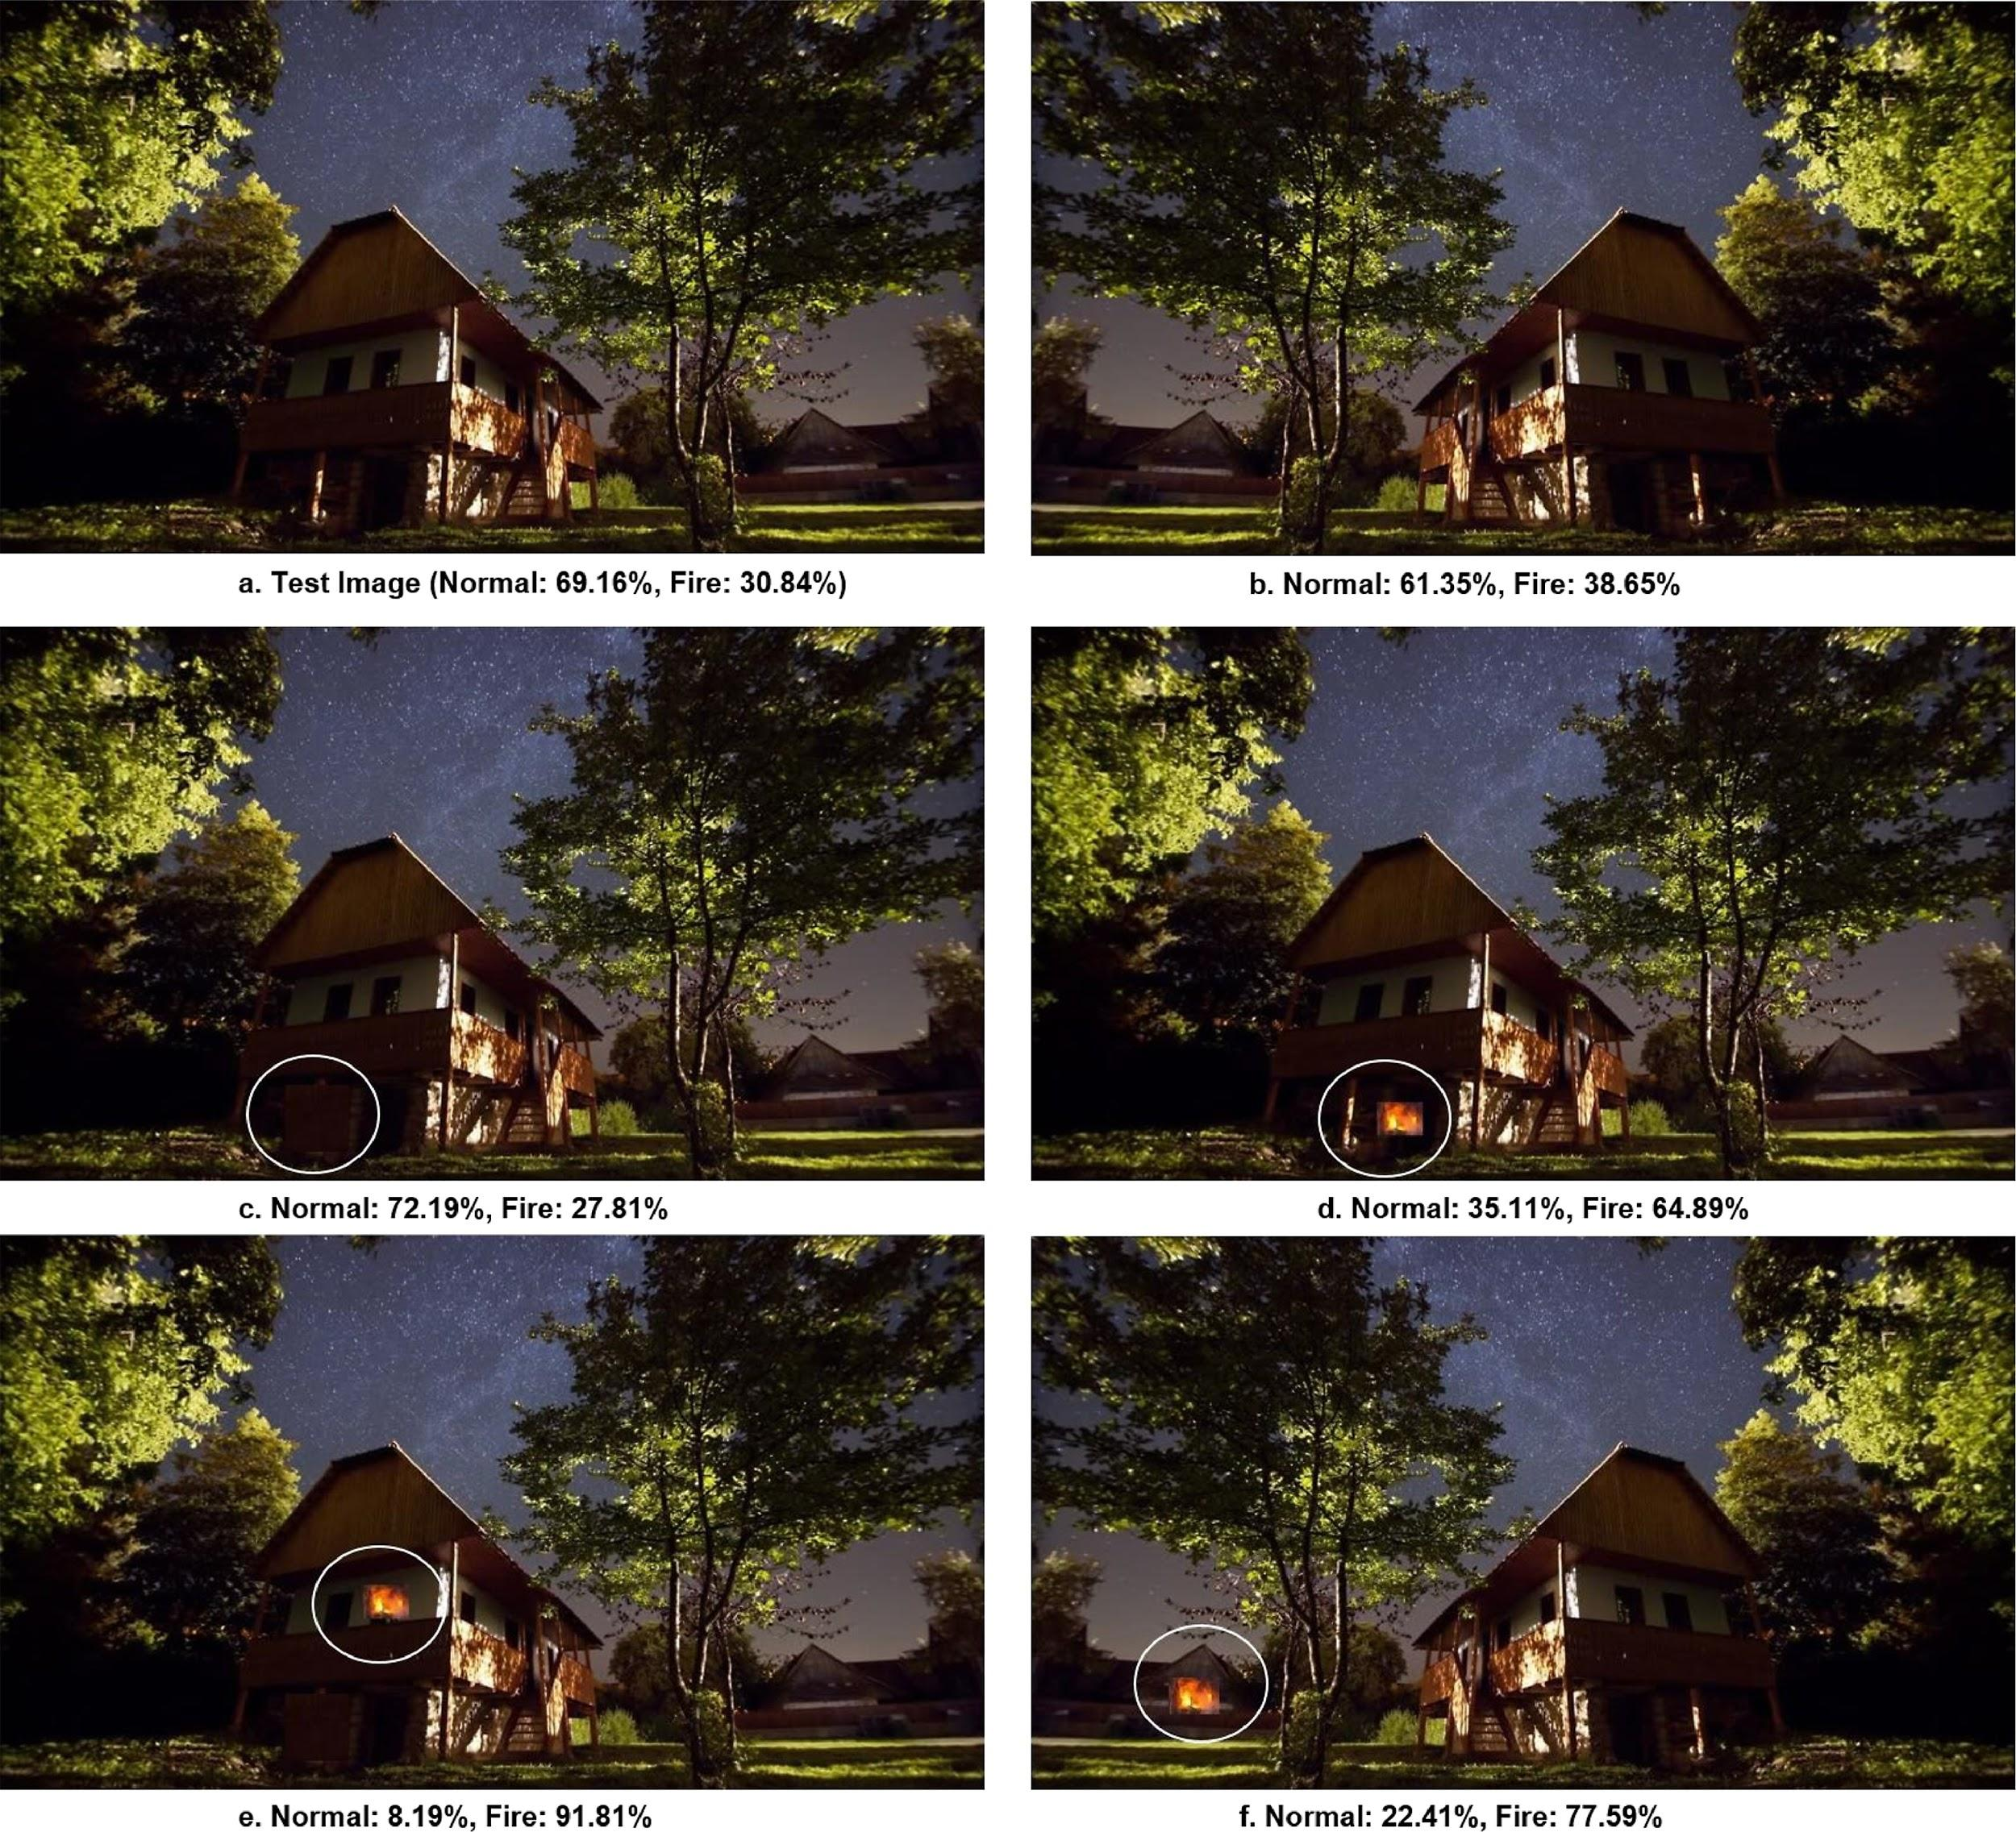

Slide 15
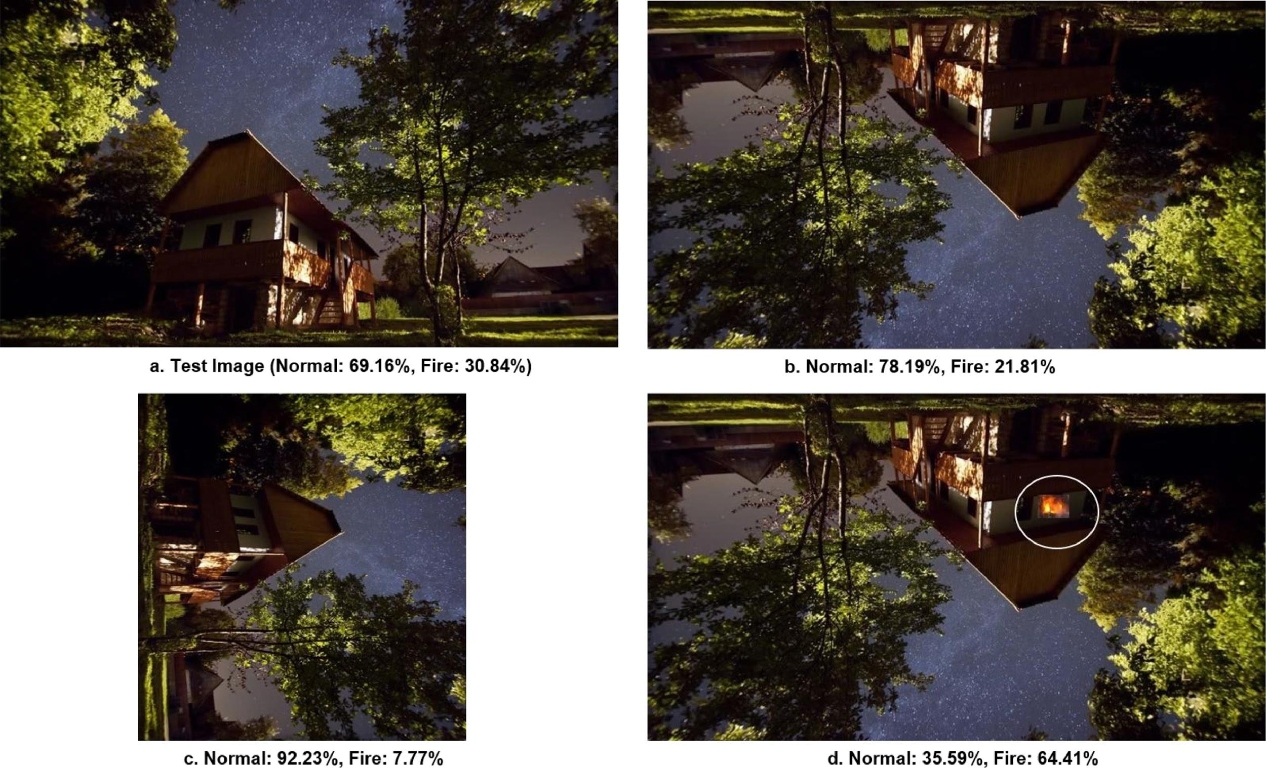

Slide 16
Conclusions
An early fire detection method based on fine-tuned CNNs during CCTV surveillance
Prioritization mechanism that can adaptively change the priority of camera nodes based on the importance of the contents it perceives
➜ Good accuracy, minimum false fire alarm, autonomous response and reliable transmission

Slide 17
Future work
Explore light-weight CNNs
Data hiding approaches

