Slide 1
Resilinet: failure-Resilient Inference in Distributed Neural networks
Ashkan Yousefpour et. Al.
FL-ICML 2020 accepted

Slide 2
Motivation
Why deploy from edge to Cloud?
IoT devices are resource-constrained
Cloud suffers from
Network resources cost, high latency, privacy concerns
Distribute DNN over physical Edge-fog-cloud nodes
What happen if one of the node is down?
Node needs to be recovered
Performance is unpredictable, mostly worse

Slide 3
Distributed neural networks
A DNN split according to a partition map
Distributed over a set of physical nodes
Privacy improvement, resource preservation
Hyperconnections
Transfer information via TCP socket
Transfer a vector of scalar instead of a scalar among DNN layers

Slide 4
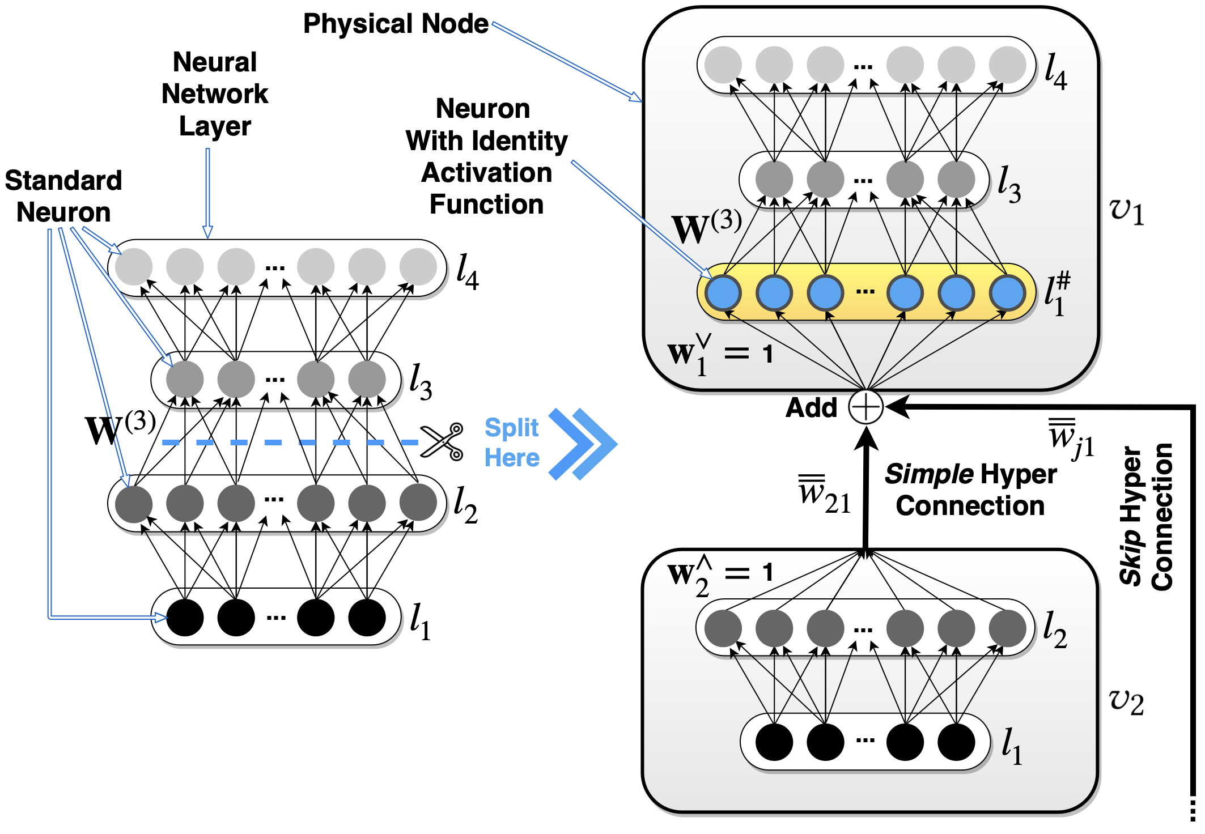
Skip hyperconnections
Similar to skip connections in residual networks (ResNets)
Allow upstream physical node receive information from more than one downstream
Connections are not activated if no failure
Information of fail nodes are not aware

Slide 5
Failout regularization
The learned weights are not more prepared for failures
Simulates inference-time physical node failure conditions during training
Force the information passage through the skip hyperconnections during training
Difference from dropout [1]
Dropout randomly remove neurons
Failout removes the whole whole physical node
Dropout multiply the weight by the probability of survival
Failout doesn’t multiply since the node may fail while inferencing
[1] Nitish Srivastava, Geoffrey Hinton, Alex Krizhevsky, Ilya Sutskever, and Ruslan Salakhutdinov. 2014. Dropout: A Simple Way to Prevent Neural Networks from Overfitting. JMLR 15 (2014)

Slide 6
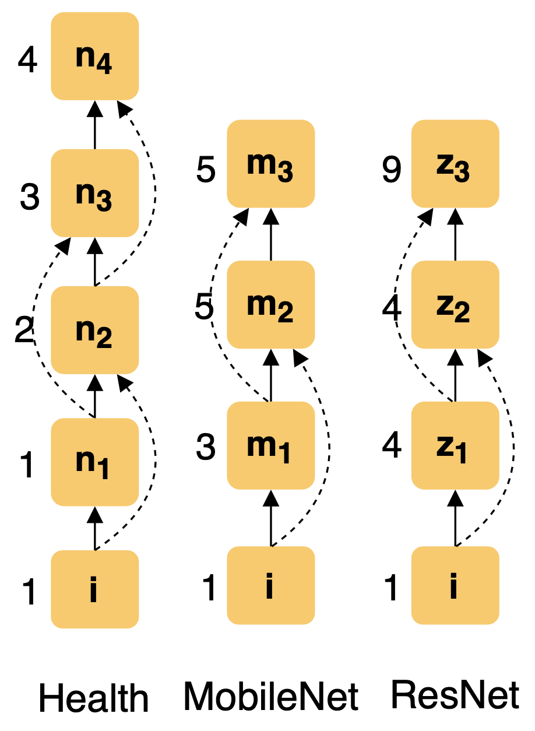
Experiment datasets
Vertically distributed MLP
UCI health activity classification dataset (health)
Vertically distributed CNN
ILSVRC
CIFAR-10
Data augmention

Slide 7
Experiment settings
Implement using TensorFlow
Deploy on AWS EC2 instances
Failure settings

Slide 8
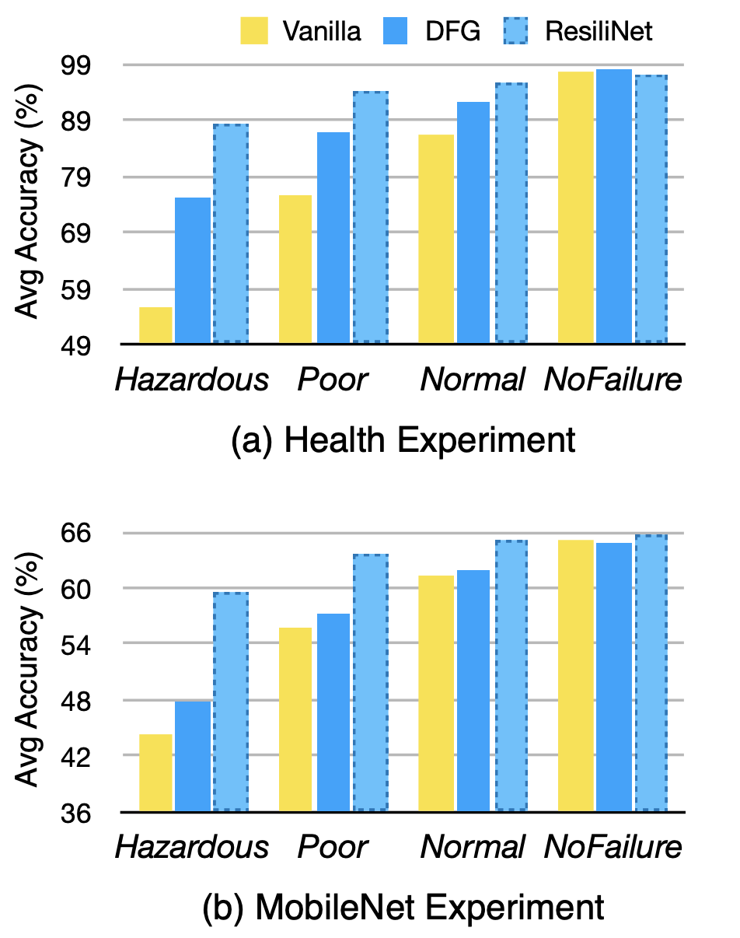
Performance evaluation
Average accuracy of 10 iterations
ResiliNet overall outperforms DFG and Vanilla
High performance of ResiliNet is more evident in severe node failure conditions

Slide 9
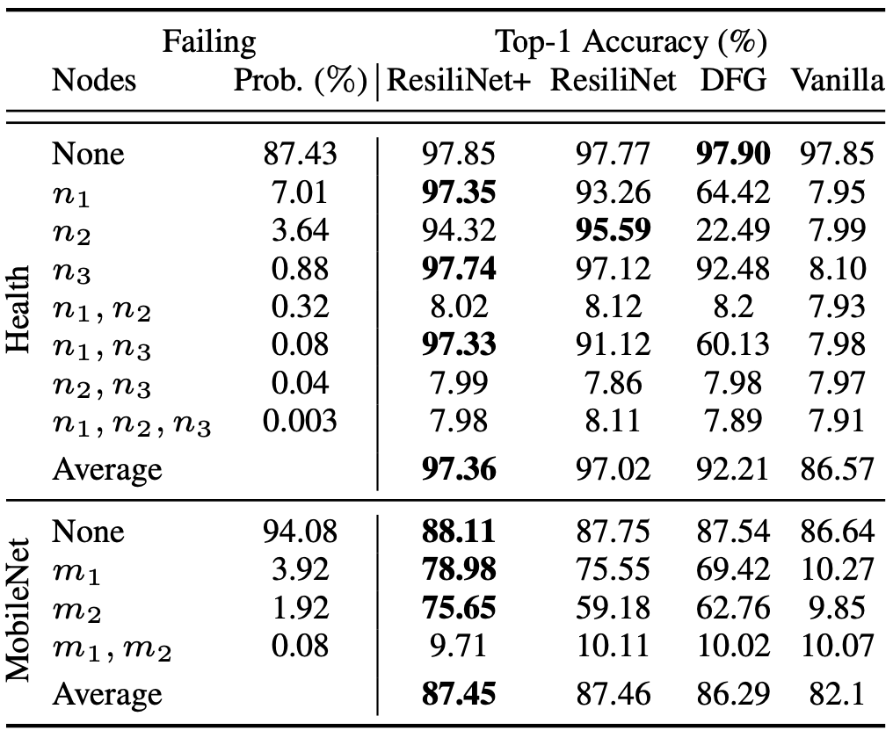
Performance evaluation
Health
Vanilla suffers from random guessing even only one node failure
ResiliNet and ResiliNet+ greatly outperform others
All schemes don’t provide high accuracy in {n1,n2}, {n2, n3} failure settings
MobileNet
ResiliNet overall maintains a higher accuracy than DFG and vanilla

Slide 10
Broader impact
Energy and Resource
ResiliNet may take longer to converge
Needs to retrain a trained DNN with skip-hyperconnections and failout
Some hyperparameter tuning are necessary during training
ResiliNet+ consumes more network bandwidth
Bias
Model over-fit
Bias to particular settings

Slide 11
Conclusion
ResiliNet is presented to provide failure-resiliency of distributed DNN inference
Skip hyperconnections and failout are proposed to improve performance
Experiment results show that ResiliNet can improve distributed MLPs and CNNs
Rate of failout should be seen as a hyperparameter and be tuned
Some skip hyperconnections are more critical than others

Slide 12
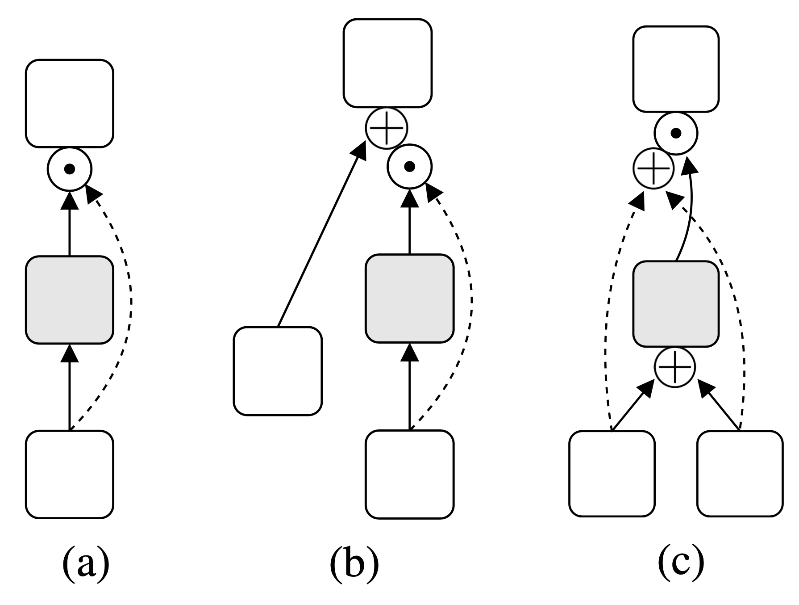
Different config of hyperconnections
Distribute DNN vertically and horizontally
In
y = x1 if x1 does not fail
y = x2 otherwise

Slide 13
What is the best choice of weights of hyperConnections?
Default value = 1
Setting weight related to the reliability of their source physical nodes
Reliability ri = (1 – pi) where pi is the failure probability of ith node
Randomly choose from 0 ~ 10
The weight scheme is negligible

Slide 14
What is the optimal rate of failout?
ResNet (R) seems to favor Failure failout rate
MobileNet (M) favors higher failout rates
The failout rate should been seen as a hyerparameter and be tuned

Slide 15
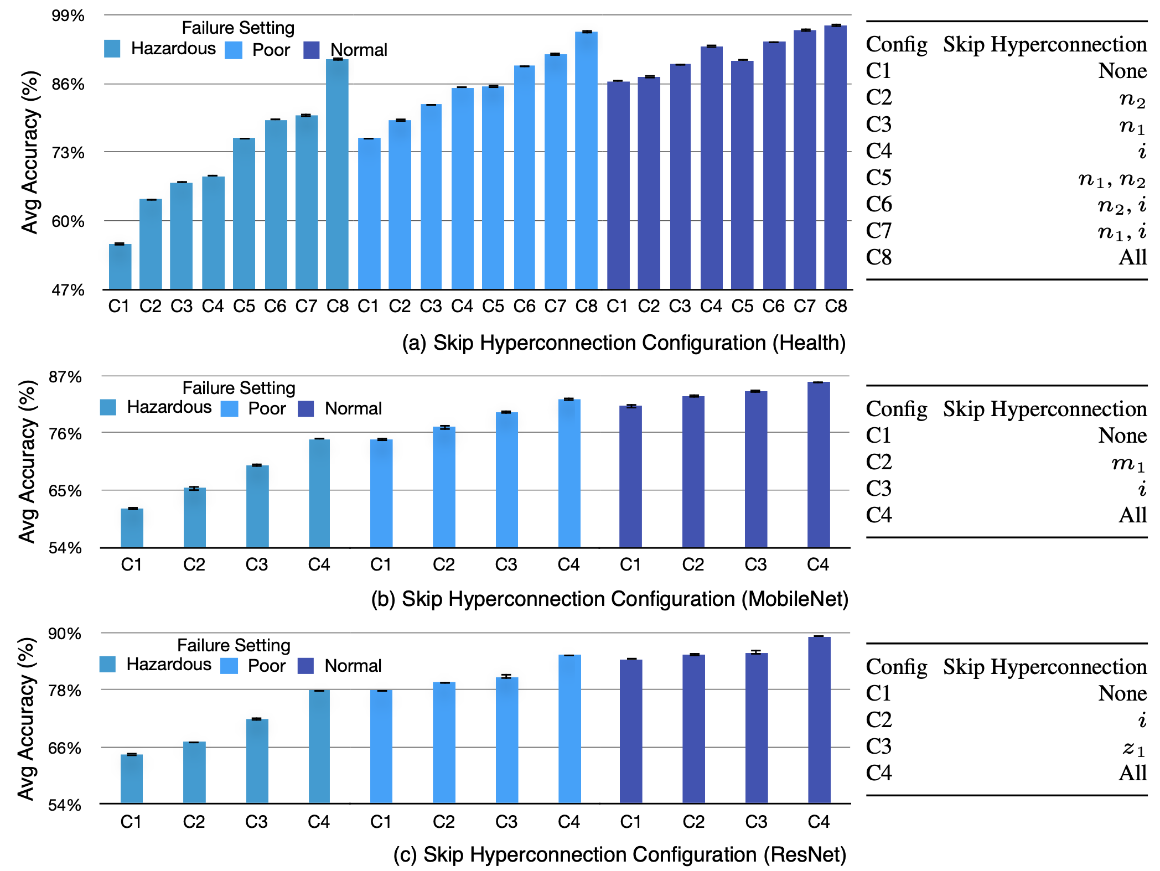
Which skip HyperCOnnection is more critical?
Shows the average top-1 accuracy of 10 runs under different configs
Health dataset
An uniform gain is observed from c1 to c8
If only one HC is allowed, it should be HC I
MobileNet
Also a uniform acc gain
HC I if more critical than HC m1
ResNet
HC z1 is more critical than HC i

Slide 16
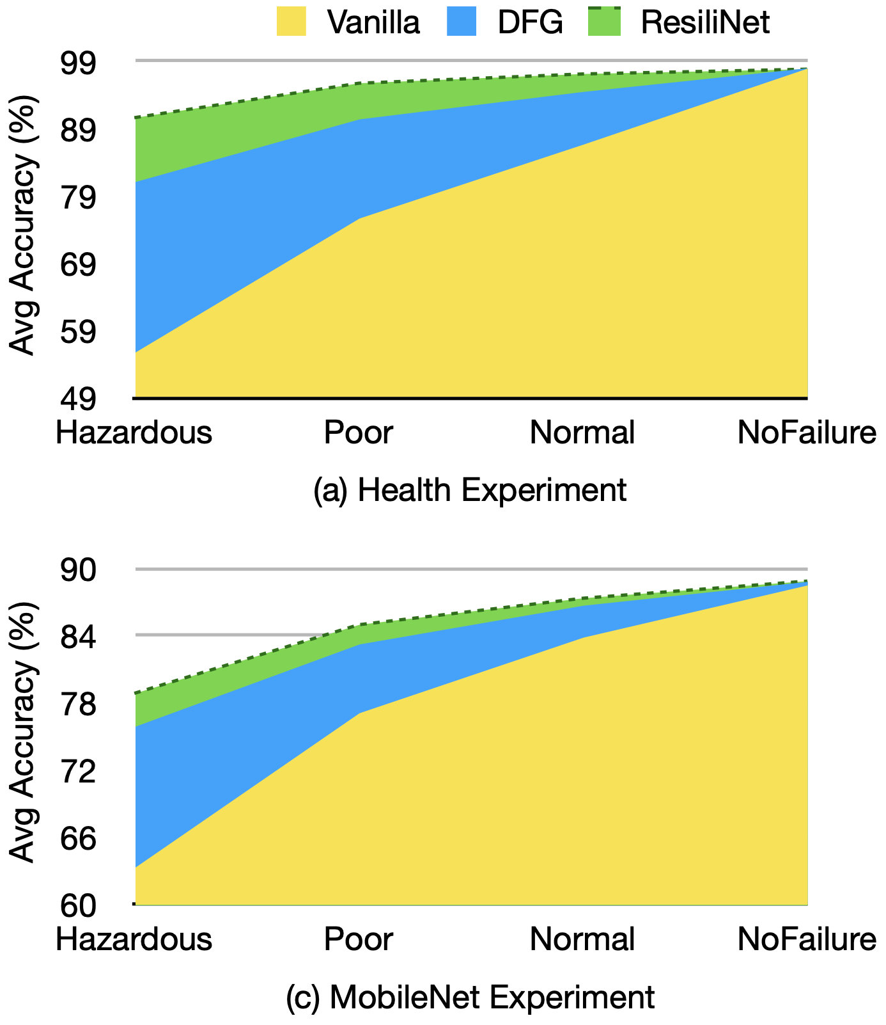
Does different partitions of distributed DNN matter?
Consider different partitions of DNNs onto distributed nodes
ResiliNet consistently outperforms both DFG and vanilla

Slide 17
Questions?

