Slide 1
TOWARDS CODING FOR HUMAN AND MACHINE VISION: A SCALABLE IMAGE CODING APPROACH
Yueyu Hu, Shuai Yang, Wenhan Yang, Ling-Yu Duan
and Jiaying Liu∗ Peking University, Beijing, China
2020 IEEE International Conference on Multimedia and Expo (ICME)

Slide 2
Introduction
Why we need image compression?
Preserve as much signal fidelity with the bit-rate constraint
JPEG , JPEG2000
Sift , CDVS
Transformation, Quantization, Entropy coding
Human vision
Machine vision
Feature coding for machine != Signal encoding for human
Notes:
This paper is focus on a well known problem, why we need image compression.
The typical goal of image compression is to preserve as much signal fidelity with the bit-rate constraint
Traditional codec like JPEG and JPEG2000 include transformation, quantization and entropy coding and benefit human vision
Since we know that human is insensitive to high frequency data.
However, those codec may not benefits machine vision
And the reason is that feature coding like SIFT or other edge detections for machine != signal encoding for human
That is to say, machine would take such high frequency data into consideration
Actually their work is to build up a new encoding framework to pay attention to both aspect

Slide 3
Related work
Feature based image coding :
explore encoding representative image features for reconstruction
Latent code + RCGAN : “Towards conceptual compression. In Proc. of Advances In Neural Information Processing Systems, 2016”
VAE + GAN : ”Layered conceptual image compression via deep semantic synthesis. In Proc. IEEE Int’l Conf. Image Processing, 2019”
The ideal targets of VCM:
First satisfied to provide the fast analysis for machine
More bit-rates are additionally used to further improve the visual quality for human
Notes:
In the related work, they mentioned the concept about feature based image coding
Which is they encode an image into low-bit-rate feature code and reconstruction it after streaming.
However, they said that those works are still far from the video coding for machine (VCM)
That the ideal targets of VCM is first satisfied to provide the fast analysis, and more bit-rates are additionally used to further improve the visual quality in the reconstruction.

Slide 4
PROPOSED METHOD
1. Extract sparse edges
3. Train GAN to reconstruct
2. Extract vision-driven compact representations
Notes:
Here comes their proposed method, this figure is just a quick overview of their structure.
They first extract sparse edges to depict the key structure information of the input image
Then extract vision-driven compact representations through some compressive analysis over the edges and the original images
Finally, we train a deep neural network to reconstruct the original image from those compact representations

Slide 5
Sparse Edge Extraction
Fast edge detection based on structured forests
“Structured forests for fast edge detection. In Proc. Int’l Conf. Computer Vision, 2013.”
Post process : Binarize the edge maps and discard trivial edges
Notes:
We know that edges depict the key structure information of the images
Also humans are able to identify the objects from several lines, so it is reasonable to build the compact representation using sparse edges
Here what they do is they use fast edge detection based on structured forests
Actually this method is well known and can be done by OpenCV now
They also do the post processing about binarize the edge maps and discard trivial edges

Slide 6
Compact Representation Extraction
How to coding edge maps into compact bit-streams
RCGAN, SCC (Screen Content Coding) : not designed to trace edge
Trace the edges into vector graphics :
AutoTrace - a program for converting bitmap to vector graphics
The edges are approximated into straight lines and Bezier curves,
following the Scalable Vector Graphics (SVG) syntax
Notes:
Here, the main problem is focus on how to …
They mentioned that in related work, there are paper using RCGAN or SCC
However, they are mostly based on pixel-level partitioning, not designed to trace edge.
So they think it is very inefficient since every edges is of uniform width
So what the authors propose is to trace the edges into vector graphics
They adopt an online tool called AutoTrace - a program for converting bitmap to vector graphics …

Slide 7
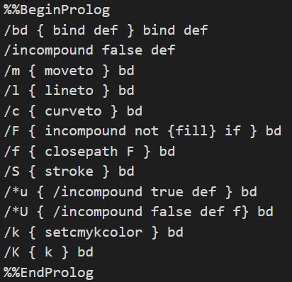
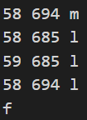
SVG and AutoTrace
SVG stand for Scalable Vector Graphics
It is usually used to define vector-based graphics for the Web
Notes:
Here we need to quickly introduce what is SVG
SVG stand for Scalable Vector Graphics
It is usually used to define vector-based graphics for the Web
The most advantage of using SVG over other image formats is that SVG images are scalable
As you can see in the example images, the left hand side are originals and the right hand side are the SVG format image after
feeding original images into AutoTrace
So what actually in the svg file is that first the file would have many kinds of operation markers, like MOVE, LINE, CURVE
The just like you are drawing a line, first you would move your pen to (58, 694), then draw a line to (58, 685) …
So with this method, they can use very few parameters to represent the edge maps
You can see that right hand side are more smooth and scalable

Slide 8
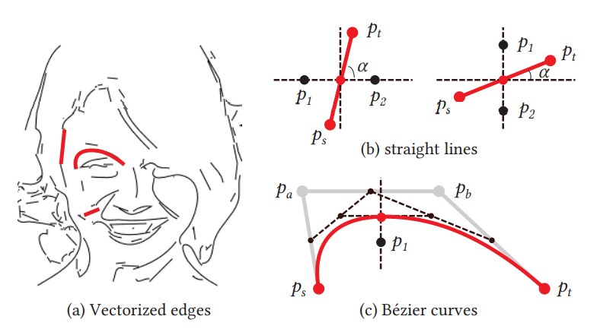
Restore color representation
Sparsely sample pixels near the lines and curves
Notes:
Next is to restore color representation, and what they do is that they sparsely sample pixels near the lines and curves
For a straight line, they sample two points near the midpoint
Here the slope of the line is calculated to determine whether the two points are chosen horizontally or vertically
For the curve they do the same thing and here they only consider the point at the inner side of the curve
Then all the pixels represented in RGB value are signaled to the decoder side

Slide 9
GAN image reconstruction
The main idea is to leverage GAN to map sparse representation back to the original image spaces
Let generator and discriminator denoted as G and D, respectively.
Reconstructed image:
Reconstruction loss:

Slide 10
Experiment
Human vision : Visual Quality Evaluation
1. Qualitative evaluations
2. Quantitative evaluations
Machine vision : Landmark Detection
Dataset : VGGFace2, 2018
Notes:
They evaluate their method with different metrics for different visions

Slide 11
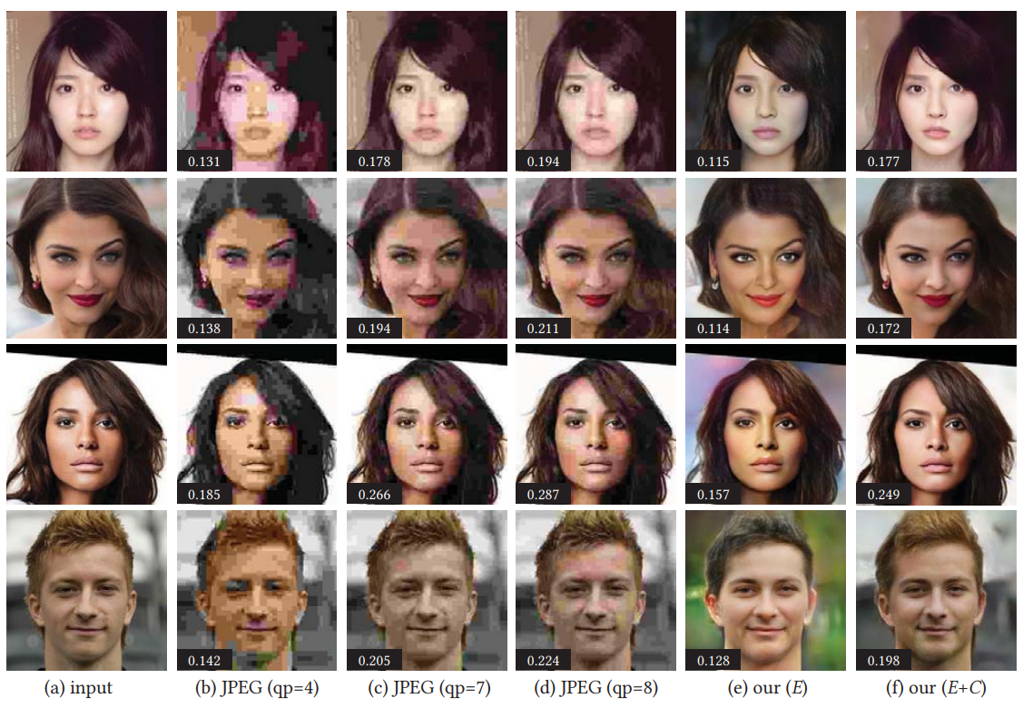
Qualitative evaluations

Slide 12
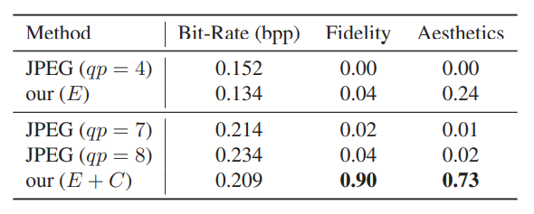
Quantitative evaluations
Each participants is asked to select one from the five results that best matches the original image (Fidelity) and has the best visual quality (Aesthetics)

Slide 13
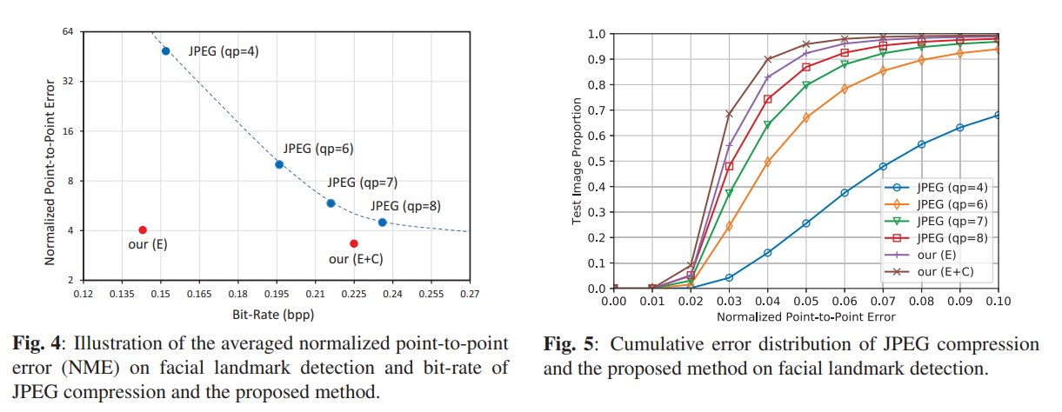
Facial Landmark Detection
Notes:
Detection results on the original data are served as ground truth
They then calculate the normalized point-to-point error between the detection results on the compressed data and the ground truth.

Slide 14
Conclusion
They present a new image coding framework to facilitate both human vision and machine vision.
Experimental results show the superiority of the proposed
method in both human visual quality and facial landmark detection.

