Slide 1
Smart Guiding Glasses for Visually Impaired People in Indoor Environment
Jinqiang Bai, Shiguo Lian, Member, IEEE, Zhaoxiang Liu, Kai Wang, Dijun Liu IEEE Transactions on Consumer Electronics, Vol. 63, No. 3, August 2017

Slide 2
Problem
Proposed Method
Many visually impaired persons nowadays
Drawbacks of some navigation systems or tools:
Cane: can not perceive all the necessary info (volume or distance) → ETA (Electronic Travel Aid): integrate mulitiple electronic sensors
RGB-D: limited working range, bad at detecting transparent things
Auditory or tactile sensor: high power consumption and large size, too complicated
AR technique on eyeglasses for displaying the surroundings and the feasible direction
Three kinds of auditory cues

Slide 3
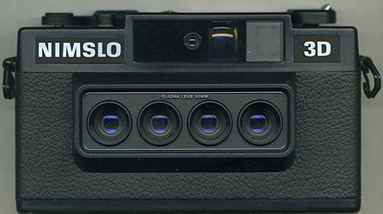
Related Work-Obstacle Avoidance
Ultrasonic sensor
no exact direction of going forward
interference problem
Laser scanner
expensive, heavy, and with high power consumption
Camera based
mono-camera
cost much computation → not for real time
hard to measure the distance of the obstacle
stereo-camera
fail under low-texture or lower-light scenarios
RGB-D camera
be constrained to non-transparent object scenarios

Slide 4
Relater Work- Guiding Information Feedback
Haptic feedback
vibration on a belt, helmet, or in a backpack
less interference
hard to represent complicated info
more training and concerntration
Audio feedback
acoustic patterns, semantic speech, different intensities sound, spatially localized auditory cues
misunderstand them under noisy environment
Visual feedback
partially sighted people
LED→ the distance of the obstacle
low resolution→ only show large obstacle
Notes:
map the depth img to semantic speech for telling the blind some info

Slide 5
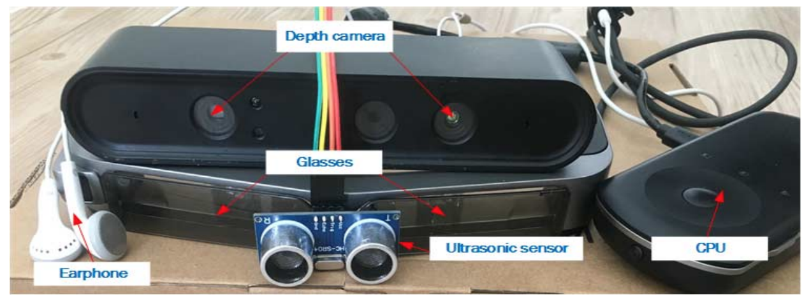
Hardware System

Slide 6
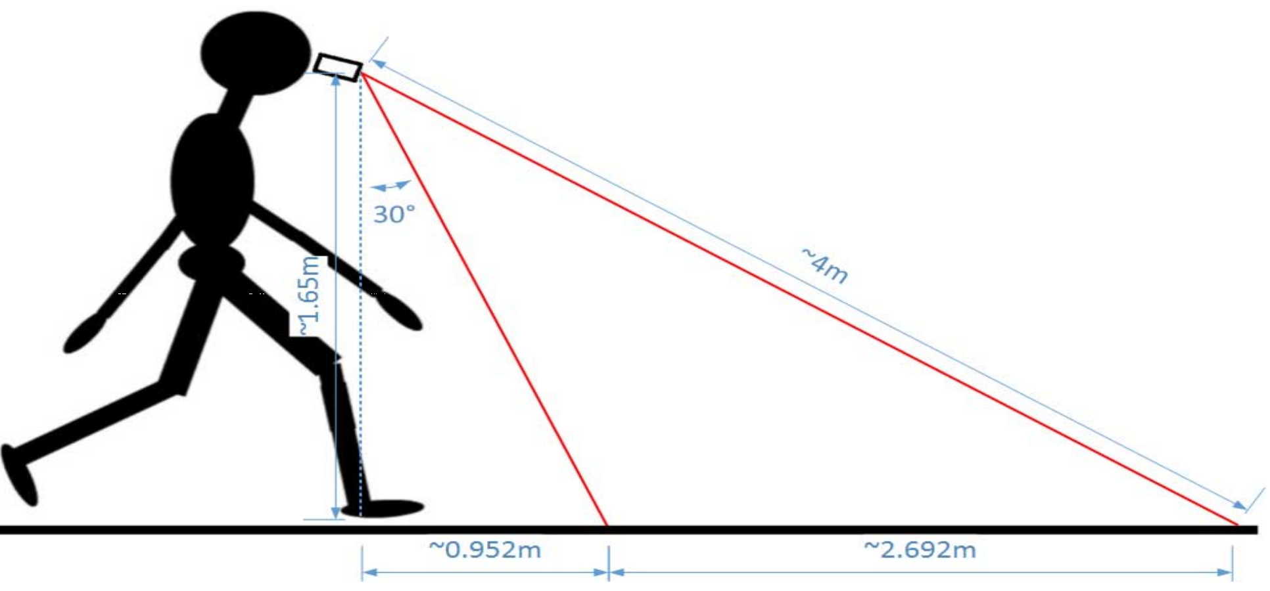
Depth Information Acquisition
RGB-D camera
infrared laser that project light with a coded pattern
monochromatic CMOS image sensor capture reflected light and decipher it to images
depth sensor is mounted on the glasses with inclinaiton of 30 degree

Slide 7
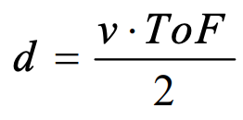
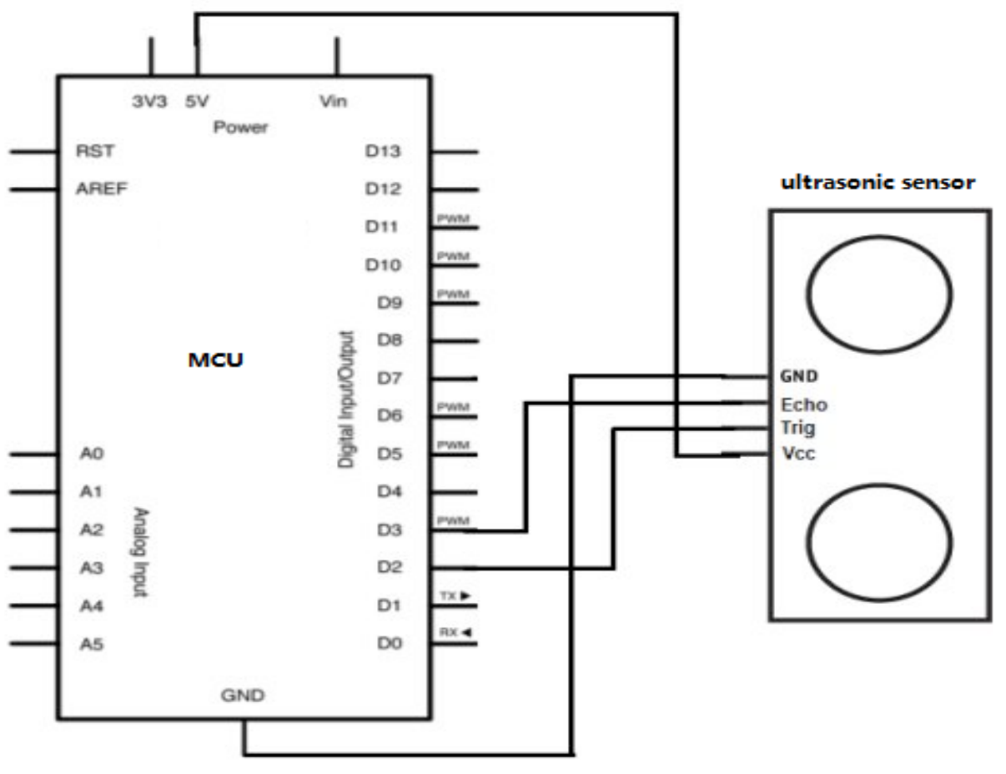
Ultrasounic Rangefinder
time interval between Trig and Echo, propotional to the time interval
MCU: control the ultrasound
a pulse of high (5V) → Trig pin → start (transmit 8 cycles of ultrasonic burst at 40 KHz) → Echo pin is set to high
receive reflected burst → Echo pin is set to low
no receive→ Echo stays high→ distance very large
Notes:
v: sound speed in the air
tof: time interval between Trig and Echo, propotional to the time interval

Slide 8
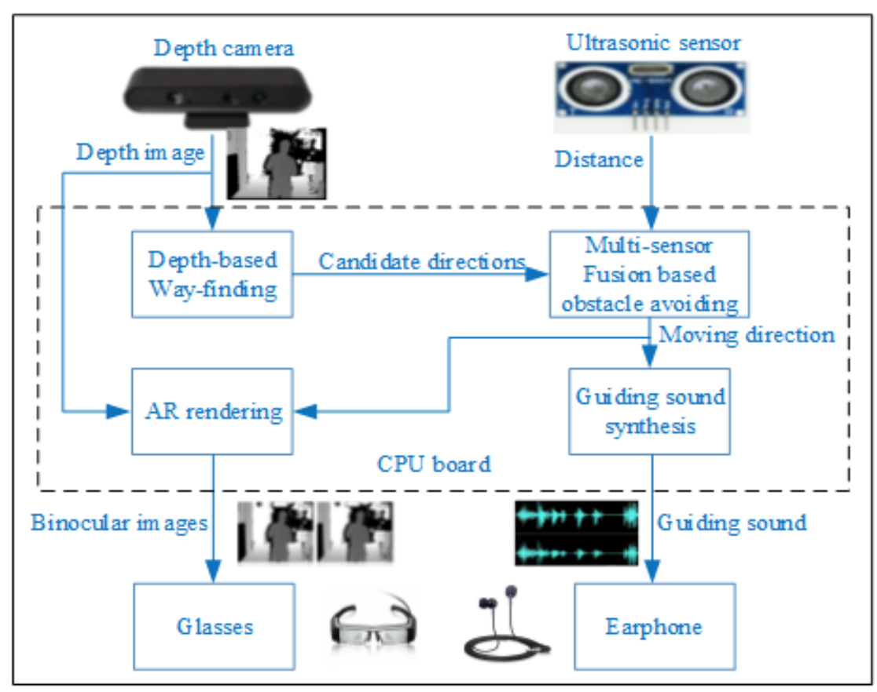
The Steps
Depth-based Way-finding: outputs several candidate moving directions
Multi-sensor Fusion based obstacle avioding: select optimal directions from candidates
AR rendering: depth images + moving direction
Guiding sound synthesis

Slide 9
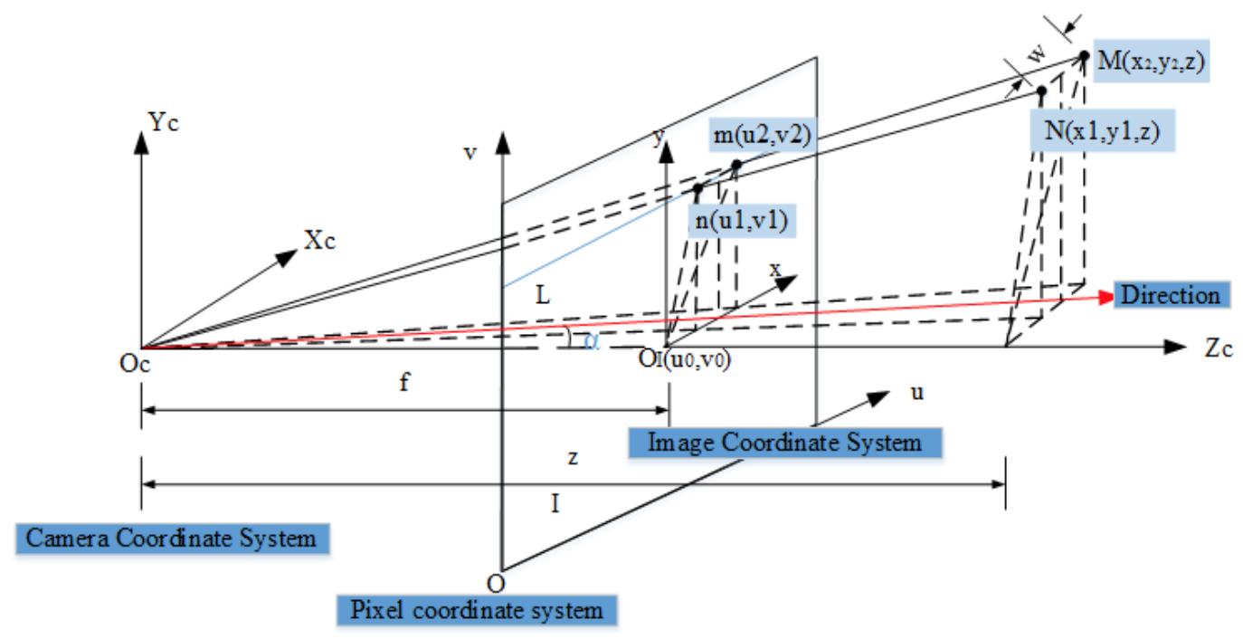
Depth-based Way-finding
nearest obstacle is always at the bottom of the depth image → only select a line in the bottom of the image as input
traversable threshold w + adaptive sliding window (1 x D(z))
D(z): adaptive width depending on the depth z
Notes:
similar triangle law

Slide 10
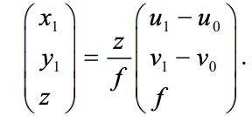
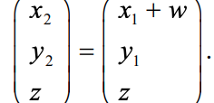
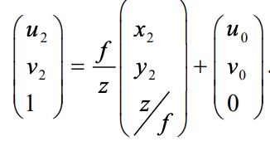
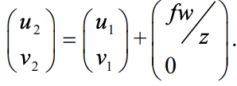
Find D(z): u2 - u1
find D(z)
judge if the region between D(z) is traversable
computing the steering angle 𝞪
find N:
find M:
find m:
do some subsitution
Notes:
angle only calculated when the l(z) is 1
four steps continually until all the inputs points were traversed

Slide 11
Multi-sensor Fusion based obstacle avioding
compute the optimal moving direction based on the depth image → minimize the cost function steering angle↓ ➔ the faster the user can turn traversable area ↑ ➔ safer
fuse ultrasonic data
steering angle
maximum traversable width
distance measured by the ulrasonic sensor
view field of ultrasonic

Slide 12
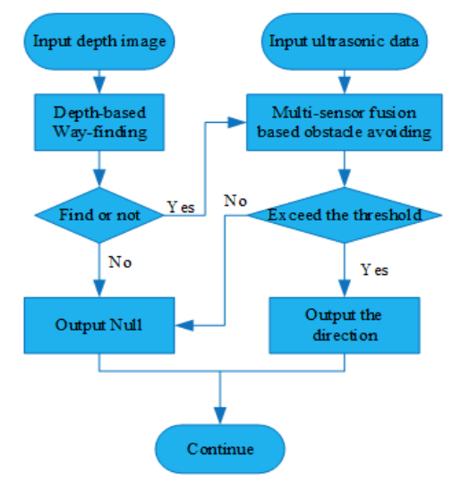
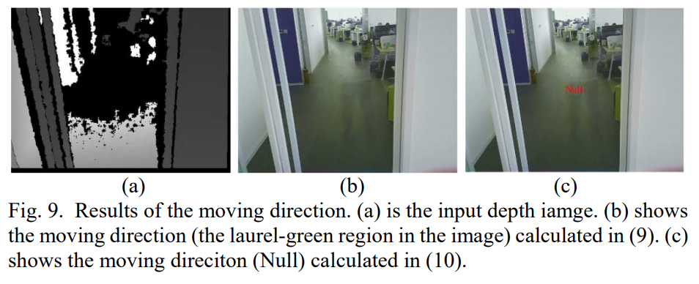

Slide 13
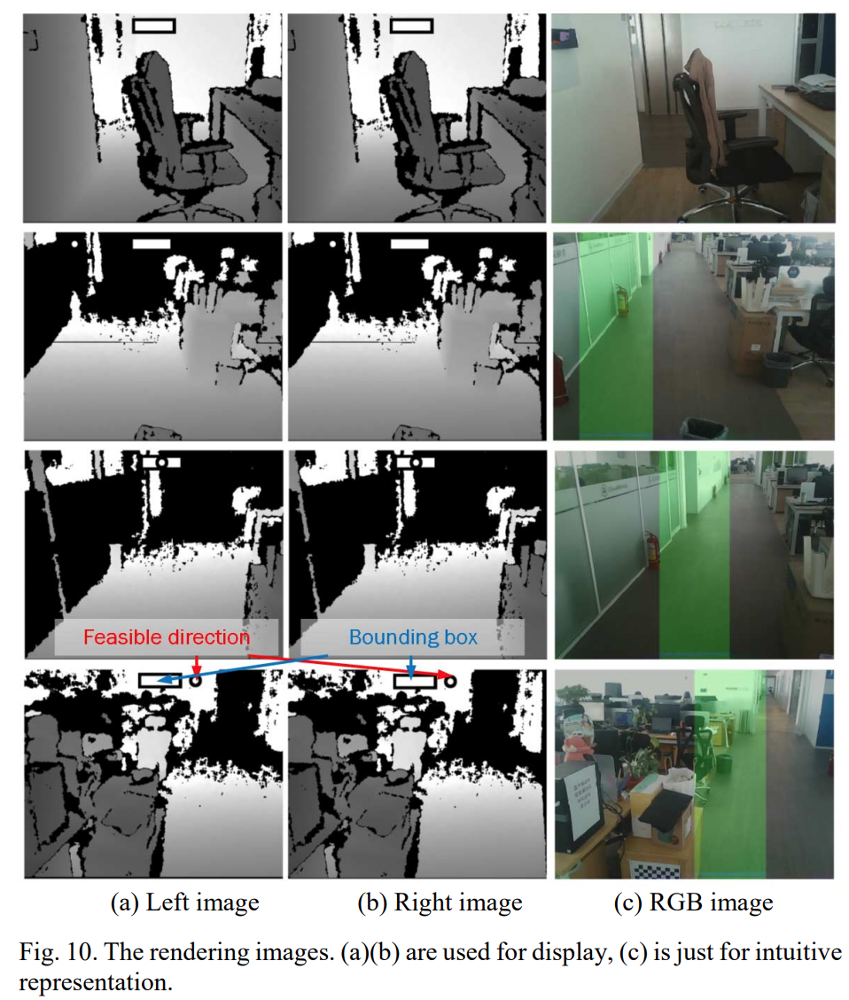
AR rendering
generate binocular parallax images by Unity3D
circle: feasible direction
bounding box: user direction

Slide 14
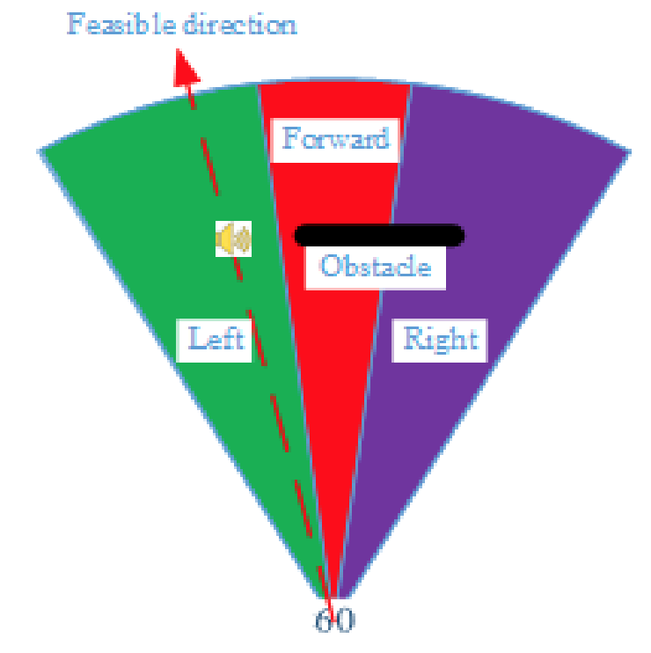
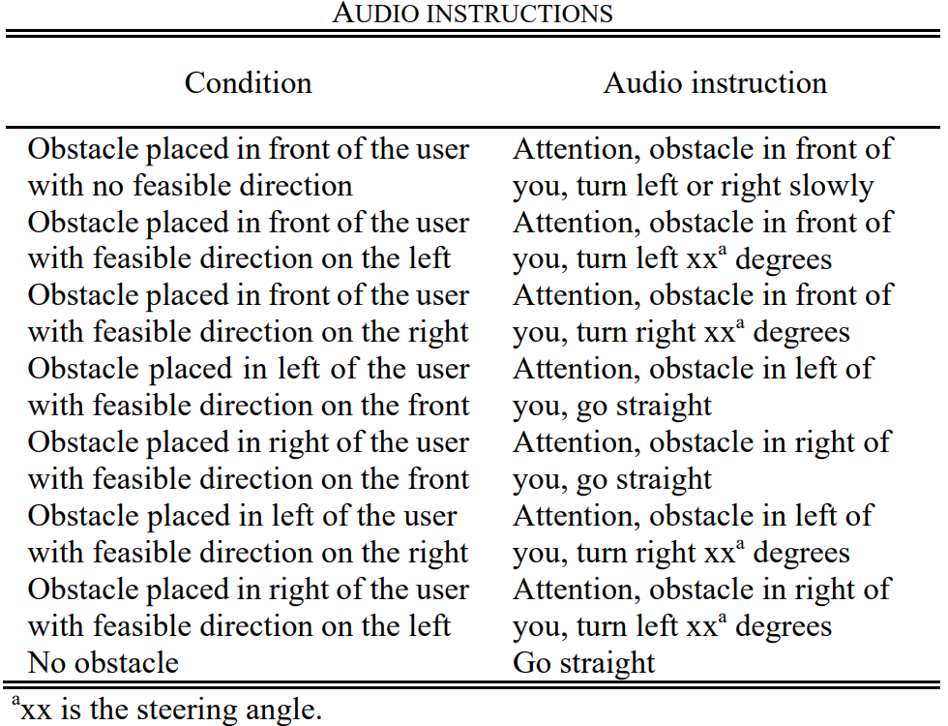
Guiding sound synthesis
Stereo tone: a person in the right direction to tell the user come
Recorded speech: tell the direction
Different frequency beep: propotional to the steering angle

Slide 15
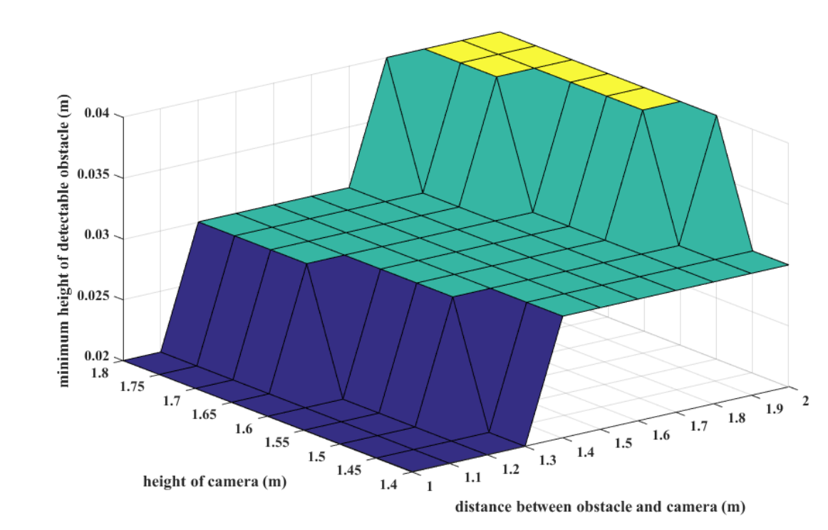
Experimental Results and Discussions
Adaptability for Different Height
camera height: 1.4m ~1.8m
the height of the camera↓ ➔ detect smaller obstacles
obstacle’s distance to the camera↓ ➔ detect smaller obstacles

Slide 16
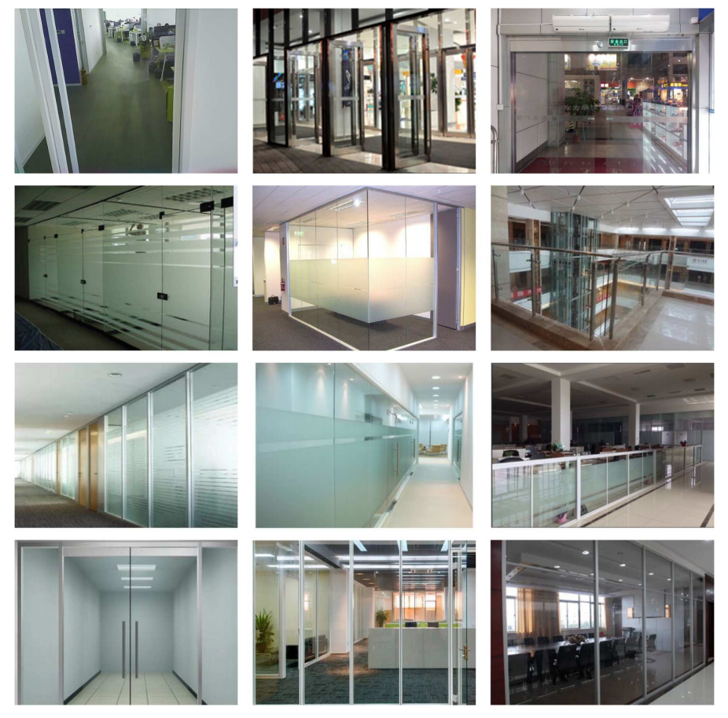
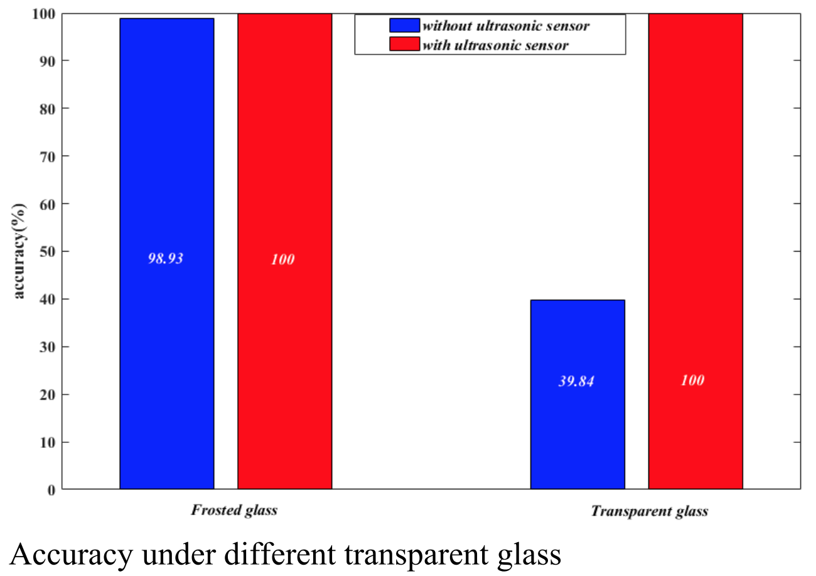
Correctness of Obstable Avoiding Algorithm

Slide 17
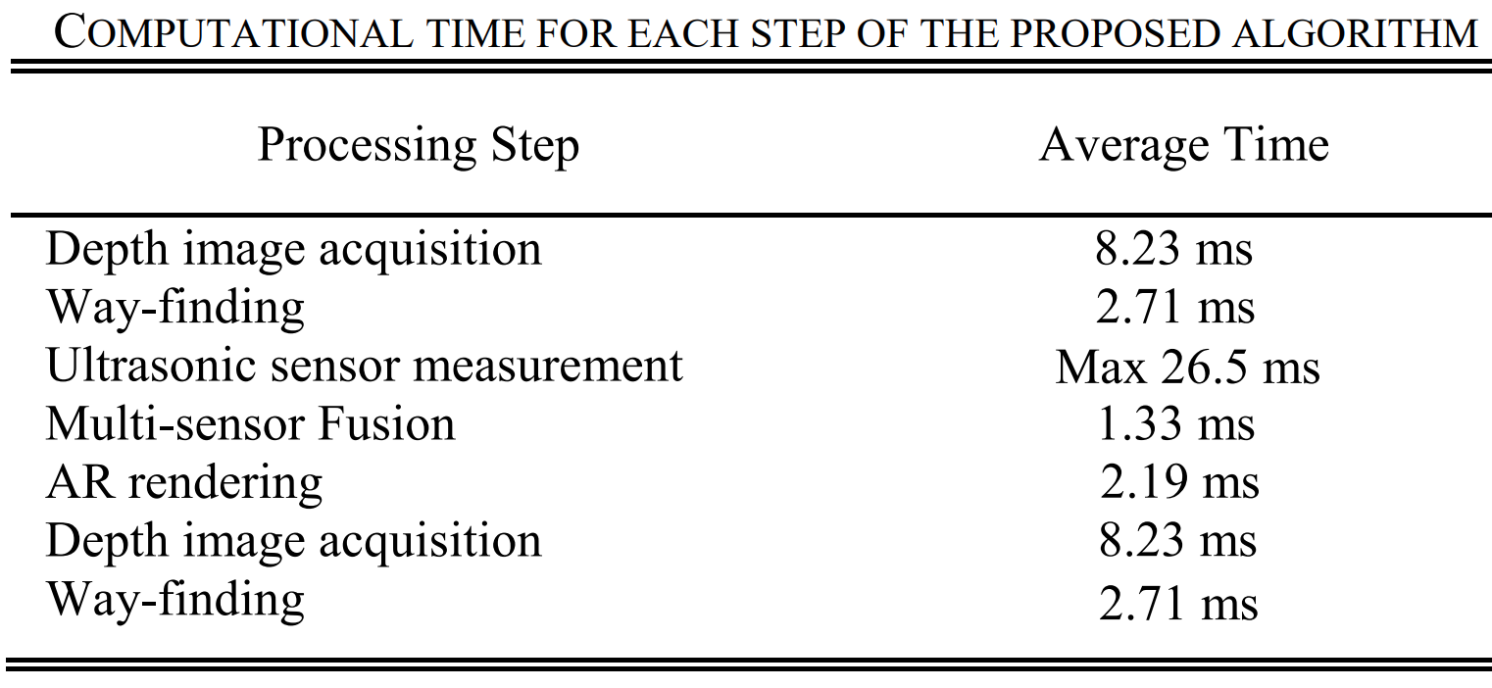
Computation Cost
short → real time
maximum cost for processing each frame is about 30.2ms

Slide 18
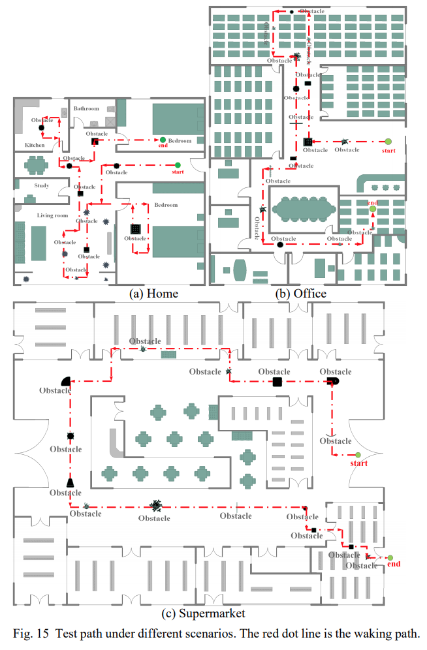
Interactive Experience
house, office, supermarket
totally blind: with glasses vs. with cane
recorded instructions: hard to turn the accurate angle
cane: users are familiar with their home and office
supermarket works

Slide 19
Interacctive Experience
weak sighted users: with glasses vs without glasses
Home, office: time close, wearing glasses with lower collisions
Supermarket: wearing glasses takes less time

Slide 20
Conclusion
visually impaired users: AR rendering
totally blind: guiding sound
depth + ultrasound solve the problem of small and transparent things
computation is fast enough to meet real-time requirement
sensors used are simple and with low cost

