Slide 1
Don’t Hit Me! Glass Detection in Real-world Scenes
Haiyang Mei, Xin Yang, Yang Wang, Yuanyuan Liu, Shengfeng He, Qiang Zhang, Xiaopeng Wei, Rynson W.H. Lau; Proceedings of the IEEE/CVF Conference on Computer Vision and Pattern Recognition (CVPR), 2020, pp. 3687-3696

Slide 2
Introduction
Glass detection
Challenges
Glass does not have a fixed pattern → X State-of-the-art segmentation methods
Not all glass regions are salient → X Salient object detection methods
Weak content discontinuity → X Mirror segmentation
Weak/partial reflections or ambiguous boundary → X Reflection/boundary detector
Contributions
The first large-scale glass detection dataset (GDD): 3916 images + glass masks
Glass detection network (GDNet): + large-field contextual feature integration module (LCFI)
Outperform state-of-the-art models fine-tuned for glass detection

Slide 3
Related Work
Semantic/scene/instance segmentation: arbitrary objects can appear behind the glass
Salient object detection (SOD): multiple salient things behind the glass
Specific region detection/segmentation
Shadow detection: no obvious intensity difference between inside and outside of the glass
Watar hazard detection: water → vertical direction, glass → arbitrary directions
Mirror segmentation: less content discontinuity
Single image reflection removal (SIRR): partial/weak reflections

Slide 4
A New Dataset for Glass Detection - GDD
Data construction
Images + Glass masks
Taken by cameras and smartphones
Cover diverse daily-life scenes
Indoor: 2827 images, outdoor: 1089 images
Training: 2980 images, testing: 936 images

Slide 5
A New Dataset for Glass Detection - GDD
Data analysis
Glass type
Aim to detect relatively large transparent glass
+ small glass → Diversity
Glass location
Locate at different positions of the images
Overall spatial distributions: centered
Glass area
(0, 0.2]: easily cluttered with diverse background objects/scenes
(0.8, 1.0): dominated by the scene behind the glass
[0.2, 0.8]: > mirror dataset → more scene behind the glass → more challenging
small glass/ glass corners
glass close to the camera
√

Slide 6
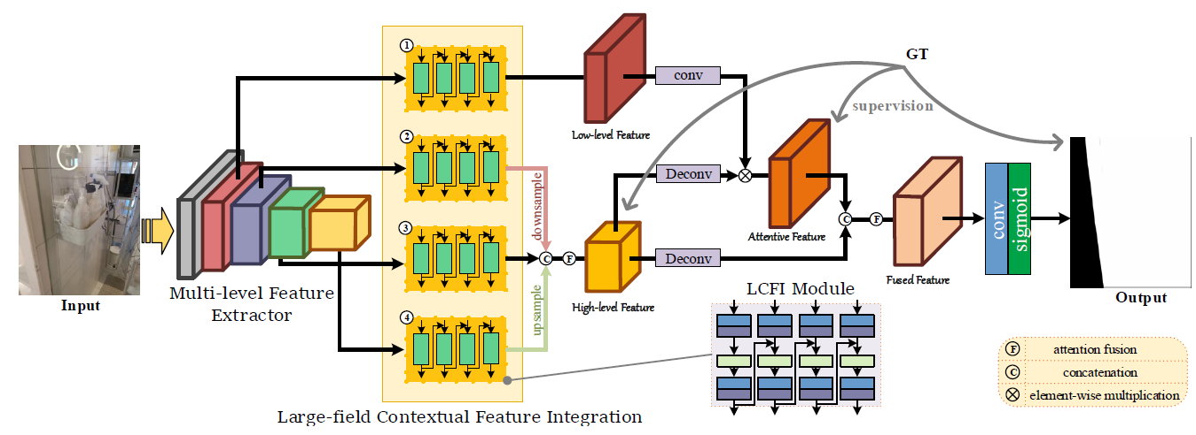
Methodology--- Network Overview
Harvest features of different levels
Focus more on the glass regions

Slide 7
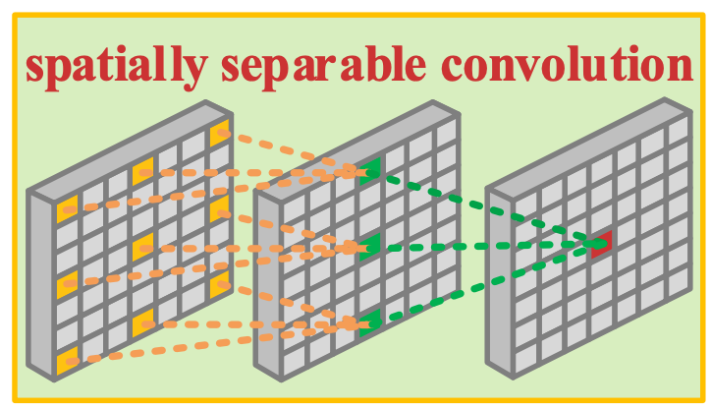
Methodology--- LCFI Block
Extract contextual info from a large field → context inference, glass location
Spatially separable convolutions → Extract abundant contexts from a large field
Spatially separable convolutions with reverse order → Eliminate the ambiguity
batch normalization
Input features
extracted large-field contextual features

Slide 8
Methodology--- LCFI Module
LCFI blocks extract features from a large field of a fixed size
To address different scale glass → Four parallel LCFI blocks with different kernel size (k = 3, 5, 7, 9) and the dilation rate (dr = 1, 2, 3, 4)
To explore more contextual features → Information flow between adjacent LCFI blocks

Slide 9
Methodology --- Loss Function
l_{bce}: binary cross-entropy (BCE), I_{edge}: edge loss, I_{iou}: IoU loss
L_{h} (high-level large-field contextual features) = l_{bce} + l_{iou} → Complete glass detection
L_{l} (low-level large-field contextual features) = l_{bce} + l_{edge} → Predict glass maps with clear boundaries
L_{f} (final output) = l_{bce} + l_{iou} + l_{edge}
Loss = w_{h}L_{h} + w_{l}L_{l} + w_{f}L_{f}

Slide 10
Experiments --- Settings
Implementations
Pytorch
Training images: 416 X 416, horizontally random flipping
Multi-level feature extractor: pre-trained ResNeXt101
SGD: momentum 0.9, weight decay 5 x 10⁻⁴, 200 epochs
Learning rate: 0.001^{0.9}
batch size: 6
w_{h}, w_{l}, w_{f}: 1
NVIDIA GTX 1080Ti
Evaluation metrics
Intersection of union (IoU)
Pixel accuracy (PA)
F-measure: harmonic mean of average precision and average recall β² = 0.3 → emphasize on precision
Mean absolute error (MAE)
Balance error rate (BER)
Semantic segmentation
Salient object detection
Shadow detection
glass pixels
non-glass pixels

Slide 11
Experiments --- Compariason with the State-of-the-arts
Compared methods (18)
Semantic segmentation ICNet [45], PSPNet [46], DenseASPP [37], BiSeNet [39], PSANet [47], DANet [7] and CCNet [12]
Salient object detection DSS [10], PiCANet [19], RAS [2], R 3Net [4], CPD [34], PoolNet [17], BASNet [24] and EGNet [48]
Shadow detection DSC [11] and BDRAR [52]
Mirror segmentation MirrorNet [38]
Retrained on the GDD training set

Slide 12
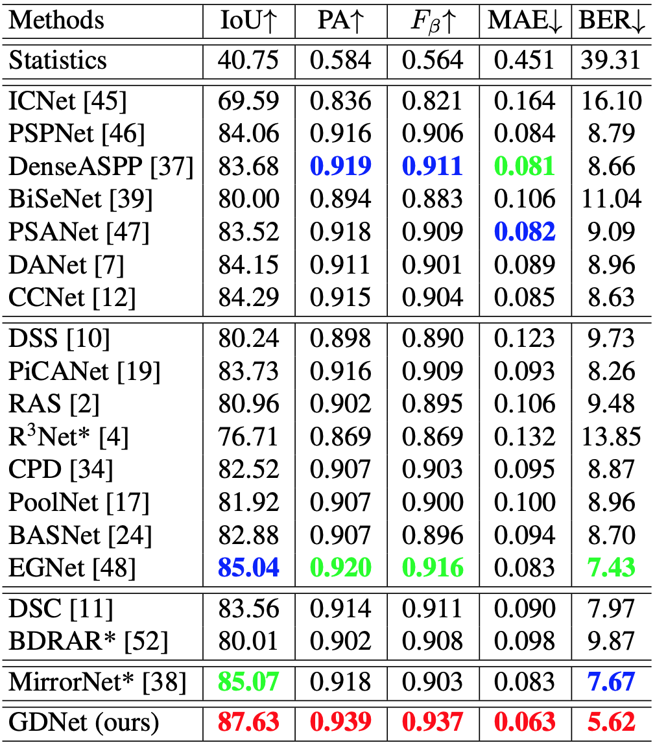
Experiments --- Compariason with the State-of-the-arts
Outperform all other methods

Slide 13
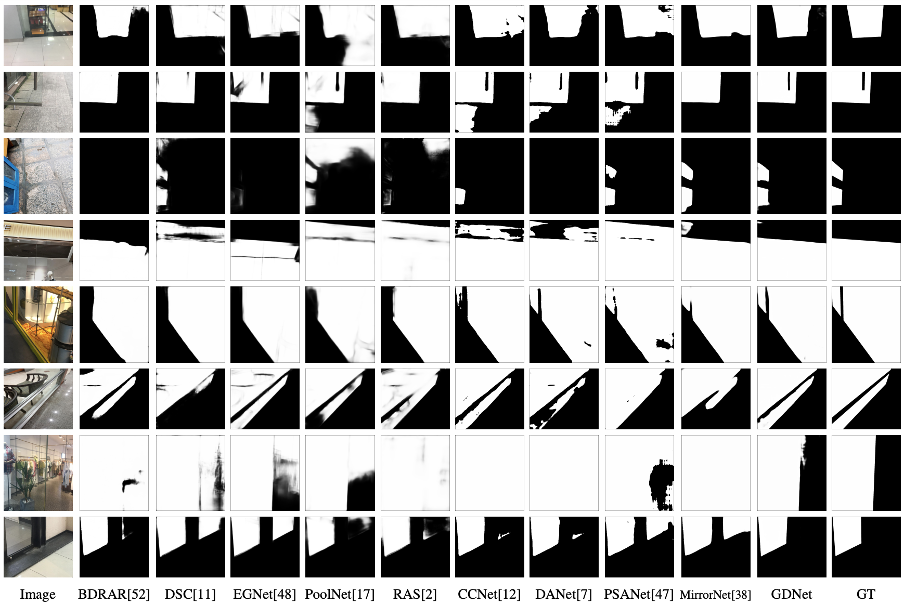
Experiments --- Compariason with the State-of-the-arts
Detect small and large glass accurately → Multi-scale contextual features
Not confused by the non-glass regions → LCFI: contextual info

Slide 14
Experiments --- More Glass Detection Results
Images beyond the GDD test set
ADE20K
Internet

Slide 15
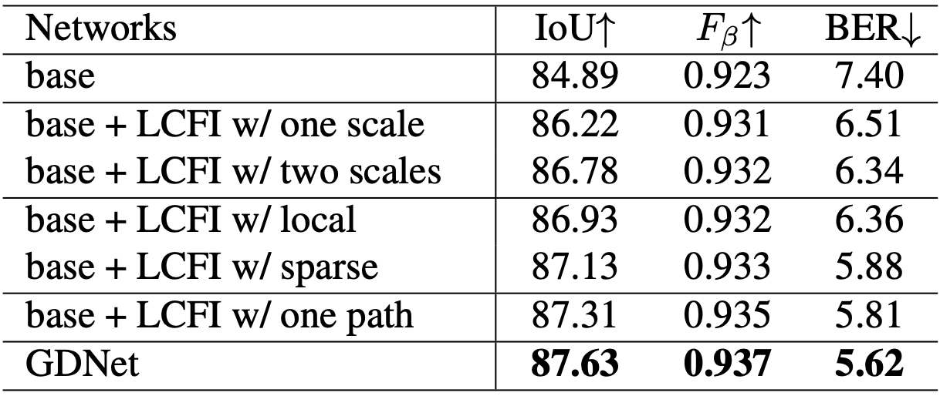
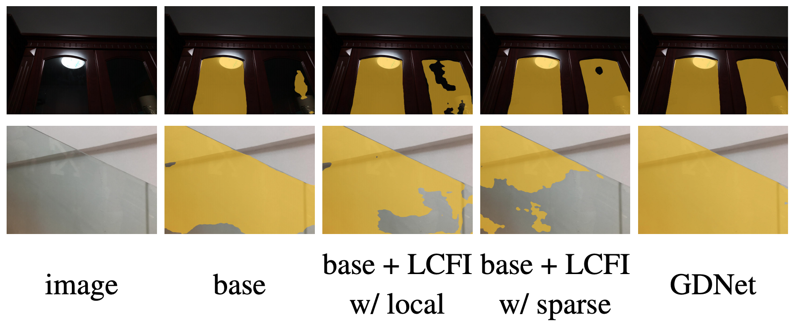
Experiments --- Component Analysis
Evaluate the effectiveness of the proposed LCFI
LCFI w/ sparse: dilated convolution > LCFI w/ local: local → larger receptive field
LCFI w/ one path: spatially separable convolution → more context
GDNet: two parallel spatially separable convolution

Slide 16
Experiments --- Mirror Segmentation
Explore abundant contextual information from a large field → Handle other vision tasks
re-train GDNet on the mirror segmentation dataset
LFCI → Boost the performance of mirror segmentation

Slide 17
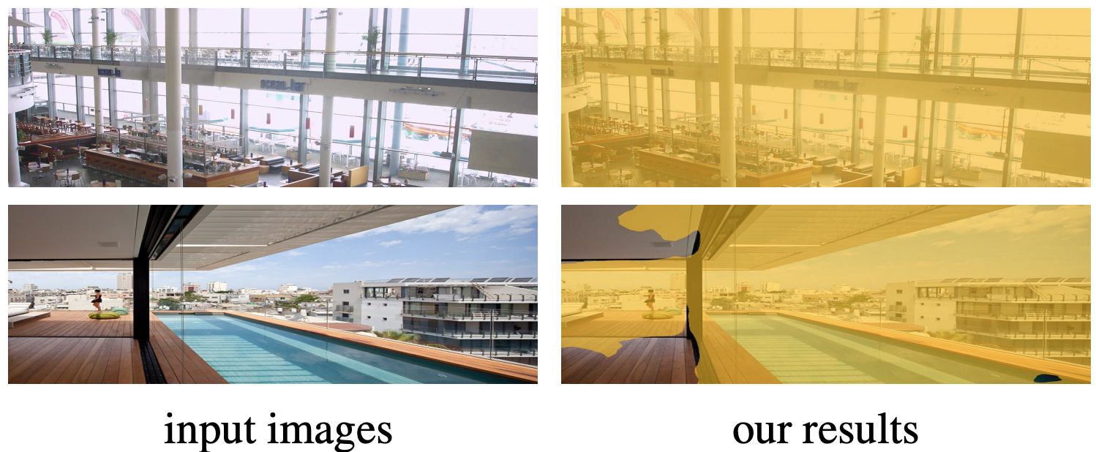
Conclusion
Provide a large-scale glass detection dataset (GDD)
GDNet:
Combine low-level and high-level contexts from a large field
Detect glass of different sizes
Test images in and beyond the GDD test set
Fail in complex scene

