Slide 1
Client Selection for Federated Learning with Heterogeneous Resources in Mobile Edge
ICC 2019 - 2019 IEEE International Conference on Communications (ICC)
Takayuki Nishio; Ryo Yonetani

Slide 2
Report list
Base architecture of FL（skipped）
Main problem
Difference between basic algorithm with FedCS
Parameter introduction
Core algorithm
Experiment
Conclusion

Slide 3
Problem
computing speed
network environment
amount of data
efficiency of federated learning
How to select better client for training?
Notes:
The main issue to be discussed is how to choose better customers for training when the calculation speed, network environment and the amount of data are uncertain

Slide 4
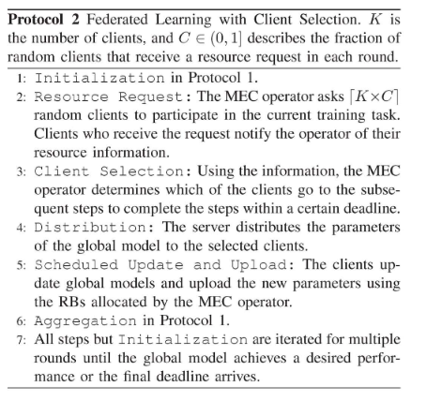
FedLim and FedCS
K = number of total clients C = hyperparameter about training client proportion
Notes:
Added the steps of resource acquisition before selecting customers, and calculate the update and upload time based on the resources feedback from customers

Slide 5
Algorithm variable
Prerequisite: client upload bandwidth is certain
K (all client set) K’ = K * C(oecn training max client set)
S (client selected by Client Selection algorithm)
$T_{round} (round time limit)$
$T_{final} \left(final deadline\right)$
$T_{cs}$(client selection time) $T_{agg}$(server aggregation time)
$T_{S}^{d}$(Distribution time)
$t_{k}^{UD}$(k-th client update time) $t_{k}^{UL}$ (k-th client upload time)

Slide 6
Algorithm variable
Every client update model parallelly
Every client upload model sequential

Slide 7
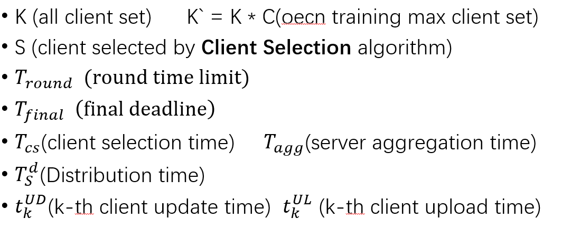
Core algorithm
Greedy algorithm
K-th client update time
K-th client upload time
K-th client distribution time
$T_{round}$ is a system variable

Slide 8
Experiment design
Prove that FedCS algorithm is valid
1000 max clients in same network environment and different performance
Selection of ${ T}_{round}$
Iid and non-iid dataset， two common datasets
limited computing resources
Notes:
They hope to prove that FedCS is effective in different data environments and calculation limits, and select appropriate parameters

Slide 9
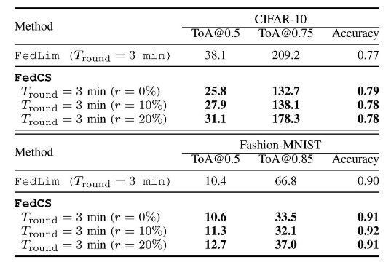
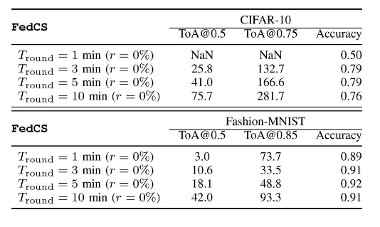
Experiment result
Iid-setting

Slide 10
FedCS achieved higher accuracy than FedLim
Among the four choices, ${ T}_{round}$= 3 is the best
Low ${ T}_{round}$：small number of clients to train
High ${ T}_{round}$：Fewer aggregation times

Slide 11
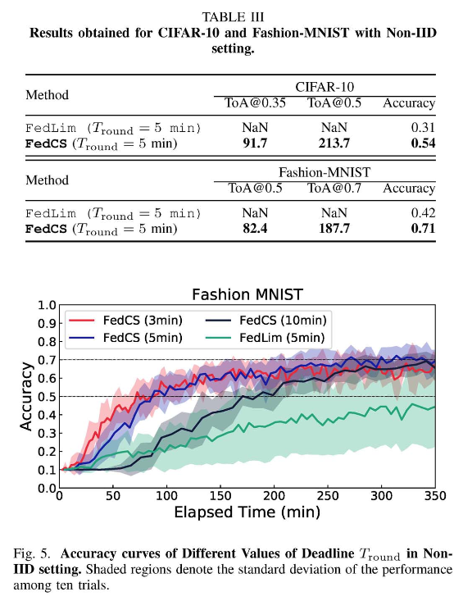
Experiment result
Non-iid setting

Slide 12
Conclusion
FedCS significantly improve performance in uncertain clients
Add more devices to FL training

