Slide 1
Joint Layout Estimation and Global Multi-View Registration for Indoor Reconstruction

Slide 2
Introduction
low-cost consumer depth camera > image-based approaches in 3D reconstruction applications
a new approach for accurate indoor reconstruction to resolved the scene layout estimate problem and global registration problem using detasets created by low-cost consumer depth camera.
Notes:
In 3D reconstruction applications, a low-cost consumer depth camera would be a more reliable choice compared to image-based approaches which are frequently depth estimated to fail.
In this paper, they proposed a new approach for accurate indoor reconstruction to resolved the scene layout estimate problem and global registration problem using low-cost consumer depth camera..

Slide 3
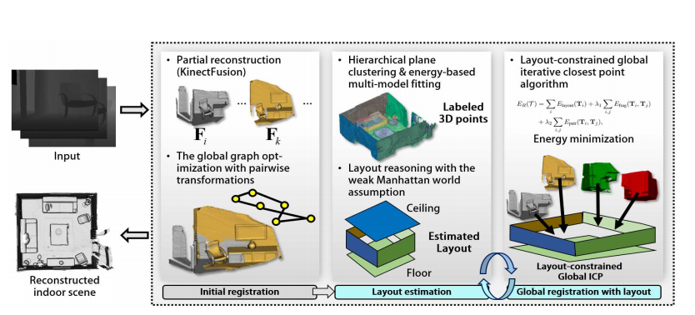
Architecture of propose method
Notes:
As shown in Fig. 2, the overall of proposed method consist 3 main step.
In the first step, we sequentially construct scene fragments from range data and then align them into world coordinate system
They alternate between layout estimation and global registration procedures in an iterative fashion using scene fragments.
Then it can get the model reconstructed by global registration.

Slide 4
Initial Registration
To construct a scene fragment for every n frames (e.g. 50 )with KinectFusion.
we find pairwise transformations for all pairs of the consecutive fragments and align all the fragments in the world coordinate system based on sequential multiplication of the pairwise transformations
Loop closure detection
Pose graph optimization
Notes:
firstble we have to construct several scene fragments
we symbol it to the Fi belong to this set.
and every n frames can build 1 fragment.

Slide 5
Loop closure detection
To minimize accumulate error, we have to detect loop closures to align all pairs of the inconsecutive fragments using the FPFH descriptor and check the overlap ratio of the aligned fragments.
If the overlapping ratio between the fragments Fi and Fj exceeds a predefined percentile, e.g. 30%, we determine the fragment pair as a loop closure and define its pairwise transformation as Ti,j .
Notes:
Each scene fragment contains a negligible amount of accumulation errors, so that the large scale 3D reconstruction problem turns into the problem of aligning all the scene fragments.

Slide 6
Pose graph optimization
Choi, Sungjoon, Qian-Yi Zhou, and Vladlen Koltun. "Robust reconstruction of indoor scenes." Proceedings of the IEEE Conference on Computer Vision and Pattern Recognition. 2015.
Optimization though minimize
We adopt the line process to handle spurious loop closures obtained by low distinctiveness of 3D local descriptors. is a parameter of a line process
For a set of fragments F = {F0, ..., Fn} , we define a set of transformations T = {T0, ..., Tn}
A pairwise transformation from Fj to Fi is expressed as
f(Ta, Tb, Tˆ a,b) measures the difference between the pre-computed pairwise transformation Tˆ a,b and the pairwise transformation computed from Ta and Tb.
is a constraint to maximize the number of inlier loop closures.
Notes:
to optimize pose graph, they use this method propose by the paper , and the paper’s topic is Robust reconstruction of indoor scenes.
so thet want to minimize this thing, and it is combine by these three items.
base on the method in previos page, we know how to get loop closure, but it won’t always detect correct.
so we adopt line process parameter. it’s like a kind of confidence index of correctness correspond to the loop closure.
Ti is a transformation from a fragment Fi to world reference coordinates
This things express the measures difference between the pre-computed pairwise transformation and the pairwise transformation computed from and it didn’t mention how they get the pre-computed value.

Slide 7
Layout Estimation
To estimate the scene layout, which consists of a set of planes such as a ceiling, a floor, and walls, we find the dominant planes Pdominant in the scene and then determine layout planes Playout from Pdominant.
To extract a set of dominant planes, we compute and cluster plane parameters from supervoxels of each fragment and merge similar plane parameters in the world coordinate system.
Dominant plane extraction
Layout plane estimate

Slide 8
Dominant plane extraction
Magri, Luca, and Andrea Fusiello. "T-linkage: A continuous relaxation of j-linkage for multi-model fitting." Proceedings of the IEEE conference on computer vision and pattern recognition. 2014.
Boykov, Yuri, Olga Veksler, and Ramin Zabih. "Fast approximate energy minimization via graph cuts." IEEE Transactions on pattern analysis and machine intelligence 23.11 (2001): 1222-1239.
To divide a fragment into a set of supervoxels
we compute a plane parameter from the center points of three adjacent supervoxels to generate a plane hypothesis, there might be a lot of similar planes correspond to the same planar
we cluster initial plane hypotheses through two plane clustering steps:
Some supervoxels with similar plane hypotheses are grouped together via the hierarchical agglomerative clustering method and used to recalculate plane parameters.
we assign the recomputed plane hypotheses to each 3D point by minimizing an energy function via graph cuts
is defined the distance between a point and a plane parameter ,
αp,q is a penalty weight and T is 1 if the argument is true and otherwise 0
represents neighboring points of p. The neighboring points are determined as points within a predefined distance among points obtained by the k-nearest neighbor algorithm.
Notes:
firstable we have to divide a fragment into several supervoxel.
then compute a plane parameter from the center points of three adjacent supervoxels to generate a plane hypothesis
a mapping function h from a point p ∈ Fi onto a plane parameter πl ∈ Pi

Slide 9
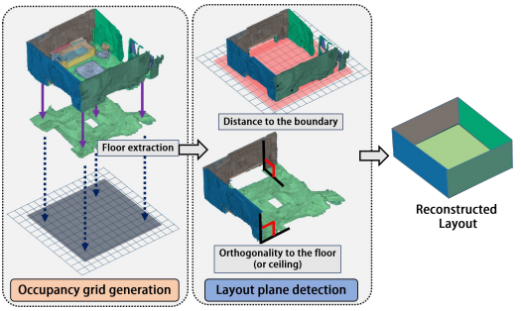
Layout plane estimation
assume a weak Manhattan world
We find the scene layout planes Playout through two steps:
Find the ceiling or ground floor, called a base plane. Generate a 2D occupancy grid map on the dominant plane and project labeled 3D points onto the grid map.
Fill each cell of the grid map, we determine the boundary of occupied grids, denoted by ∂O
Notes:
1. weak Manhattan world means all the walls are orthogonal to the ceiling and the ground floor, but the walls are not necessarily orthogonal to each other.
2.1we could assuming that one of them is the largest planar region among all the plane hypotheses to find the ceiling or ground floor, as a base plane,
Finally, we select the set of planes by following criteria
3.1where ~ni and ~nbase are normal vectors of a selected dominant plane and base plane, the first criterion checks the perpendicularity between two planes,the second criterion checks the distance between the plane πi and the boundary ∂O, τ1 and τ2 are two userdefined parameters.
3.2pproj is the projected point of p on to the base plane and Sπi denotes a set of 3D points that belong to the plane πi . |Sπi | is the cardinality of Sπi .
If two criteria are satisfied, we regard the corresponding dominant plane as a layout plane.

Slide 10
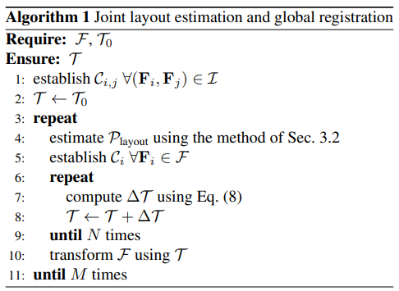
Global registration with scene layout
Objective function
Notes:
The first term is to minimize the distance between correspondence points of the layout and each fragment.
The second term is to minimize the distance between correspondence points of each pair of fragments.
where T˜i,j is a pairwise transformation estimated by the iterative losest point (ICP) algorithm and δ is the sum of the norms of elements.
The pairwise transformation constrains the feasible solution space to avoid a degenerate situation
Initially, They have initial transformations T0 and fragments F are given. Here, they set the coordinates of the first fragment to the world reference coordinates so that T0 is fixed to an identity matrix.
Afterward, they repeatedly estimate the scene layout and minimize the objective function.
They experimentally confirmed that the inner and outer loops in Algorithm 1 generally converge commonly within 10 and 20 iterations, respectively.

Slide 11
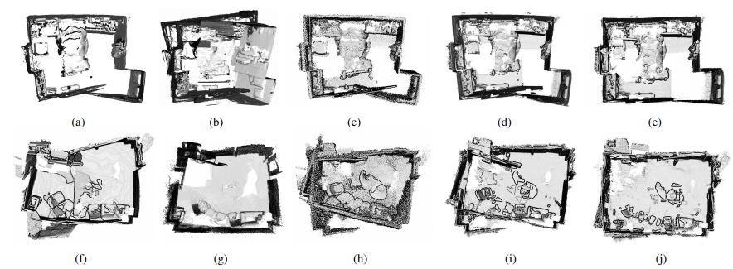
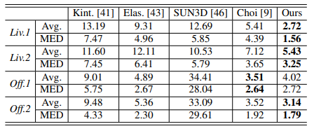
Experiment result
verified the proposed method in the augmented ICL-NUIM dataset and the SUN3D dataset
Reconstruction quality:
Notes:
They experimentally verified the proposed method in quantitative and qualitative ways by using publicly available datasets: the augmented ICL-NUIM dataset [9] and the SUN3D dataset
In most cases, the proposed method shows more accurate results than others
It is worthy of note that the global registration without the layout information frequently shows bent walls and floors owing to noisy measurements as shown in Fig, while the proposed method preserves largely planar structures with the aid of scene layout information. (From the left to the right; Kintinuous [41], ElasticFusion [43], SUN3D SFM [46], Choi et al. [9], and the proposed method)

Slide 12
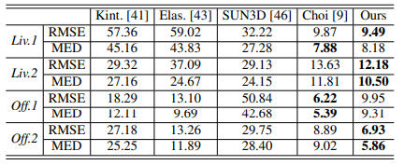
Experiment result
Trajectory accuracy:
Computational complexity:
extraction step:O(nml)
Notes:
Trajectory accuracy: Since an accurate camera trajectory implies the accurate registration of scene fragments, we use this metric to evaluate various indoor reconstruction methods.
(The trajectory error is measured in terms of the root mean squared error (RMSE) and median error between the ground-truth trajectory and an estimated camera trajectory. )
Table 2 shows the trajectory errors of the proposed method and other methods, and the proposed method outperforms other methods.
The largest burden in the process is the dominant plane extraction step.
The process of the dominant plane extraction has a complexity of O(nml) since it computes the distance between n plane hypotheses and m points in l fragments.

Slide 13
Conclusion
Author proposed an indoor 3D reconstruction algorithm
It through hierarchical clustering and energy-based multi-model fitting to find a minimum set of planes
It exploit the scene layout information to obtain globally consistent reconstruction results
It is more reliable, robust, and accurate.
Notes:
Given initially registered scene fragments, they estimate the envelope of a scene through hierarchical clustering and energy-based multi-model fitting and find a minimum set of planes that best describe the entire scene.
. They exploit the scene layout information to obtain globally consistent reconstruction results
Although the proposed method is slower than other methods, they claim that their method offers more reliable, robust, and accurate indoor 3D reconstruction results

