Slide 1
PST900: RGB-Thermal Calibration, Dataset and Segmentation Network
Shreyas S. Shivakumar, Neil Rodrigues, Alex Zhou, Ian D. Miller, Vijay Kumar and Camillo J. Taylor
2020 IEEE International Conference on Robotics and Automation (ICRA)

Slide 2
Introductions
Why RGB + thermal?
+ thermal: environments with visibility and illumination limitations, ex. tunnels, mines
+ RGB: for objects that do not have unique thermal signatures
Existing problem
Hard to find large datasets of annotated thermal images
Contributions
A method of RGB and LWIR (thermal) camera calibration
PST900:
a datasetof ~900 annotatied RGB + LWIR images (raw 16-bit and FLIR’s AGC 8-bit format)
3416 annotated RGB
A dual-stream CNN architecture
RGB stream re-usability
fast, real-time inference on GPU platforms
Proposed method also works for the dataset from MFNet

Slide 3
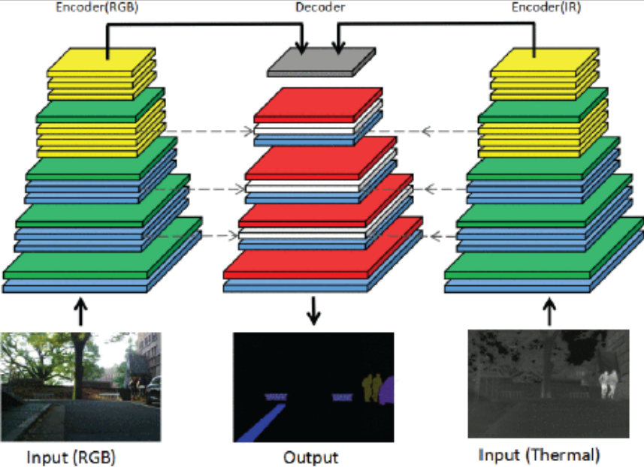
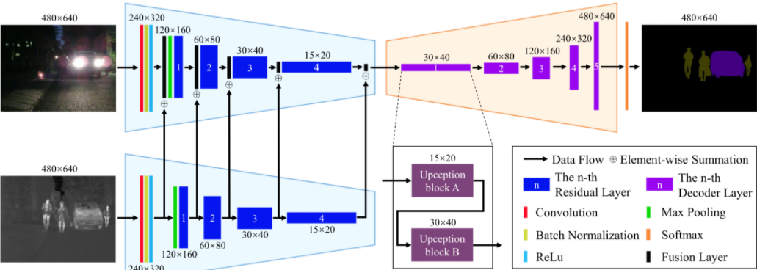
Related Work: Semantic Segmentation with Thermal Images
MFNet
RGBT dataset in urban scene settings
Applications: autonomous vehicles
Architecture: a dual encoder architecture for RGB and thermal
Contributions:
dual encoder > an extra channel for thermal
slightly misaligned RGB-T images < only RGB
RTFNet
Architecture: a dual ResNet encoder + a small decoder
Encoder: an element-wise summation of feature blocks from both the RGB and Thermal
Decoder: Upception block
alternatingly preserve and increase spatial resolution
reduce channel count
Contributions: RTFNet > MFNet on the MFNet dataset

Slide 4
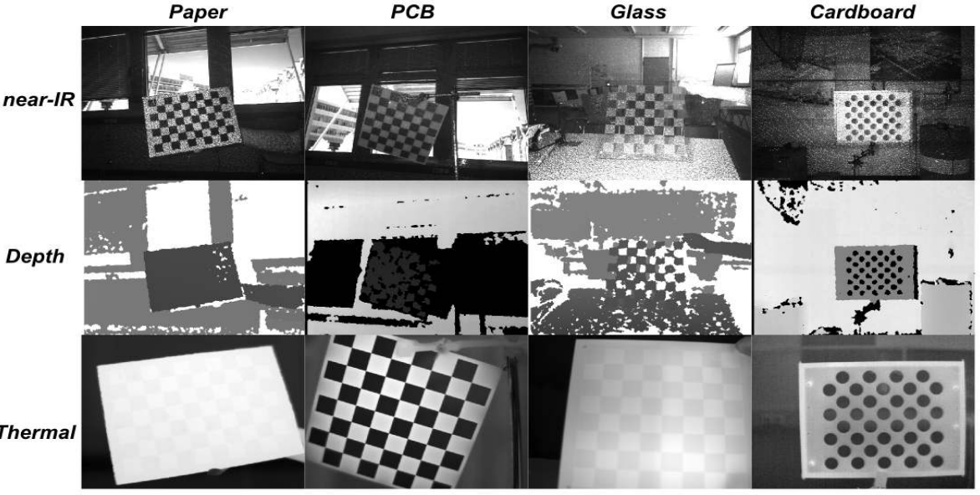
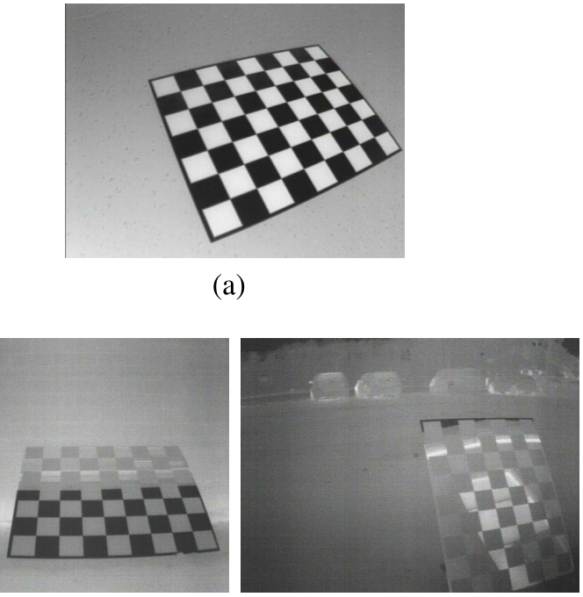
Related Work: Calibration
Active
the calibration target: i) a thermal emitter, ii) an objects externally heated
Drawbacks:
hard to ensure the amount of heat is sufficient
the fast cool-down time of the heated elements
require a large heat source
Passive
not require explicit heat, use the emissivity of different materials
Method: a board + highly polished aluminum + matte black squares
aluminium reflects the cold sky → high temperature contrast
Drawbacks: in subterranean environments, X cold sky effect

Slide 5
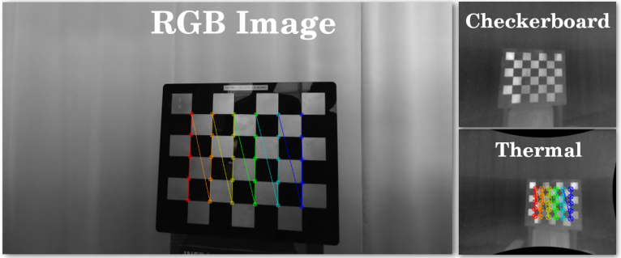
Method: RGB-D-T(LWIR) Calibration---Reflectivity Based
LWIR reflections from metallic surfaces have much lower emissivities
A checkboard: sand blasted aluminum squares + a black acrylic/ sliver background
Not polish surfaces → not interfere with corner detection in RGB imagery
Corner detection: libcbdetect (C++)
Detect the checkerboard → OpenCV’s fisheye camera calibration toolbox
Notes:
The extrinsic parameters represent the location of the camera in the 3-D scene. The intrinsic parameters represent the optical center and focal length of the camera
The world points are transformed to camera coordinates using the extrinsics parameters. The camera coordinates are mapped into the image plane using the intrinsics parameters
The extrinsic parameters represent a rigid transformation from 3-D world coordinate system to the 3-D camera’s coordinate system. The intrinsic parameters represent a projective transformation from the 3-D camera’s coordinates into the 2-D image coordinates.

Slide 6
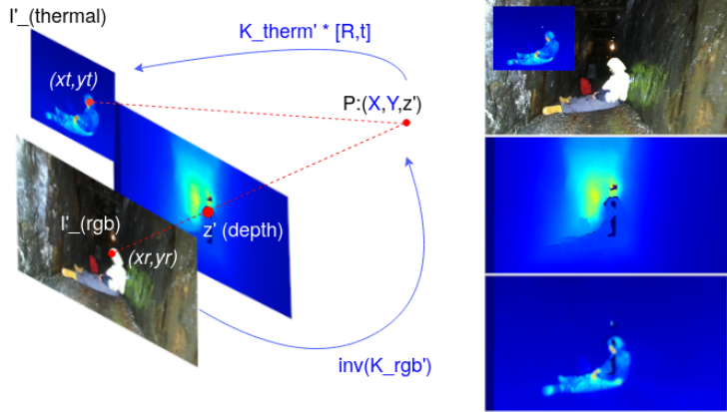
Method: RGB-D-T(LWIR) Calibration---Thermal-RGB Alignment
K_{rgb,} K_{thermal}: camera matrices
D_{rgb,} D_{thermal}: distortion coefficients from intrinsic calibration
K_{rgb}’, K_{thermal}’: undistorted camera matrices
RGB → Depth → Thermal
RGB → Depth (2D to 3D):
Depth → Thermal:
Problem of parallax and the many-to-one mapping: choose the closest 3D point
PST900:
aligned thermal imagery with holes
interpolation script to perform hole filling
(xr, yr, 1), a point in the undistorted RGB img
calibrated extrinsics
Notes:
The extrinsic parameters represent the location of the camera in the 3-D scene. The intrinsic parameters represent the optical center and focal length of the camera
The world points are transformed to camera coordinates using the extrinsics parameters. The camera coordinates are mapped into the image plane using the intrinsics parameters
The extrinsic parameters represent a rigid transformation from 3-D world coordinate system to the 3-D camera’s coordinate system. The intrinsic parameters represent a projective transformation from the 3-D camera’s coordinates into the 2-D image coordinates.

Slide 7
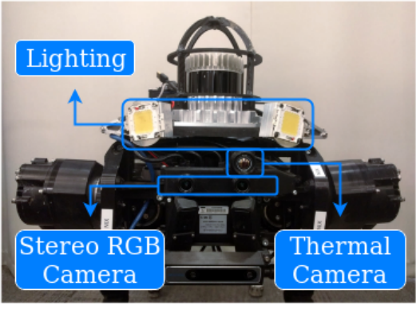
Method: Penn Subterranean Thermal 900 Dataset (PST900)
Targeted usage scenario: DARPA Subterranean Challenge (underground environments), no guarantees of visibility
A: 894 aligned pairs of RGB and Thermal images + per-pixel human annotations
Label: 4 visibel artifacts fire extinguisher, backpack, hand-drill, survivor
Data collection platform: a Stereolabs ZED Mini stereo camera + FLIR Boson 320 camera
Collect data from multiple environments (coal mine, cluttered indoor and outdoor spaces) + varying degrees of lighting
B: 3416 annotated RGB-only data
Notes:
We intentionally opted for a wider field of view thermal camera for a greater overlap between the two sensors

Slide 8
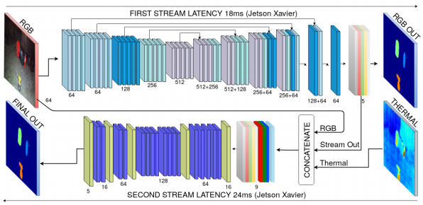
Method: Segmentation
Motivation: large amounts of RGB with annotations < calibrated and aligned RGB-T data → an independent RGB stream → + thermal modality to the output of the RGB stream
Efficient: real time presentation
Flexible: early exit to get coarser prediction
Accurate:
outperform other methods on PST900
show competitive performance on the MFNet dataset

Slide 9
The Details of the Segmentation Model
RGB stream: ResNet-18 + encoder-decoder skip-connection scheme (UNet)
Weighted negative log-likelihood loss
Use mean Intersection-overUnion (mIoU) to select the model
The dramatic imbalance between background and foreground classes → Use the weighting scheme to calculate the the weights for the loss functions
Fusion stream:
Inputs: a per-pixel confidence volume for the different classes + thermal imagery and color image
ERFNet-based encoder-decoder
a larger set of initial feature layers to account for the larger input
use fewer layers at the end of the encoder
freeze the RGB stream
Notes:
we remove the final softmax operator which results in what is intuitively a per-pixel confidence volume for the different classes in our dataset.

Slide 10
Results and Analysis
Baseline
MFNet
RTFNet
Naive RGB-T fusion implementations on relevant segmentation networks (ERFNet, MAVNet, Fast-SCNN, UNet) Concatenate the thermal images as a fourth channel Compare RGB and RGB-T performance
Metrics: mIoU
Train models in Pytorch on NVIDIA DGX-1
Measure inference latency in milliseconds on an NVIDIA AGX Xavier embedded GPU device (the CPU of the robot)
Dataset: MFNet RGBT data (city), PST900 RGBT data (underground)
Notes:
we in-troduce the thermal modality by concatenating the thermal image as a fourth channel to the original RGB inpu

Slide 11
Results and Analysis: MFNet Dataset
RTFNet > Proposed method > ERFNet > … … > MAVNet
The largest increase in class IoU between RGB and RGB-T: Person

Slide 12
Results and Analysis: PST900 Dataset
The proposed method is faster than RTFNet
Proposed method > ERFNet > RTFNet
(UNet, Fast-SCNN) + thermal = decrease, ERFNet + thermal = increase
PST900:
objects that have very strongly identifiable cues from RGB alone, ex. red backpack, orange hand-drill
same object in situations where it is both above and below the ambient air temperature
→ difficult to learn an info correlation between RGB and thermal, ex backpack vs survivor
→ A late fusion strategy

Slide 13
Conclusions
A RGB + thermal calibration technique that is portable and easy to use
PST900: 894 RGB + thermal, 3416 RGB
A dual-stream CNN for RGB and thermal guided semantic segmentation
Real-time on embedded GPUs
Can be used in mobile robotic systems
Compare the method on MFNet and also be competitive
Objects that only have strong cues from RGB → Late fusion > Naive fusion

