Slide 1
LoAdaBoost: Loss-based AdaBoost federated machine learning with reduced computational complexity on IID and non-IID intensive care data
Li Huang1,2, Yifeng Yin3, Zeng Fu4, Shifa Zhang5,6, Hao Deng7, Dianbo LiuID 6,8*
PLOS ONE | https://doi.org/10.1371/journal.pone.0230706 April 17, 2020

Slide 2
Motivation and Target
Health care data stored distributivity and high privacy
Other publish ：
Test accuracy, privacy, security , communication efficiency
This publish :
Local client-size computation complexity (Main)
Communication cost
Test accuracy

Slide 3
Data
Patients’ drug usage and mortality from Medical Information Mart for Intensive Care (MIMIC-III)
eICU Collaborative Research Database
With iid and non-iid data-share concept

Slide 4
Contribution
Application of federated learning to health data
LoAdaBoost algorithm has better performance than traditional FedAvg

Slide 5
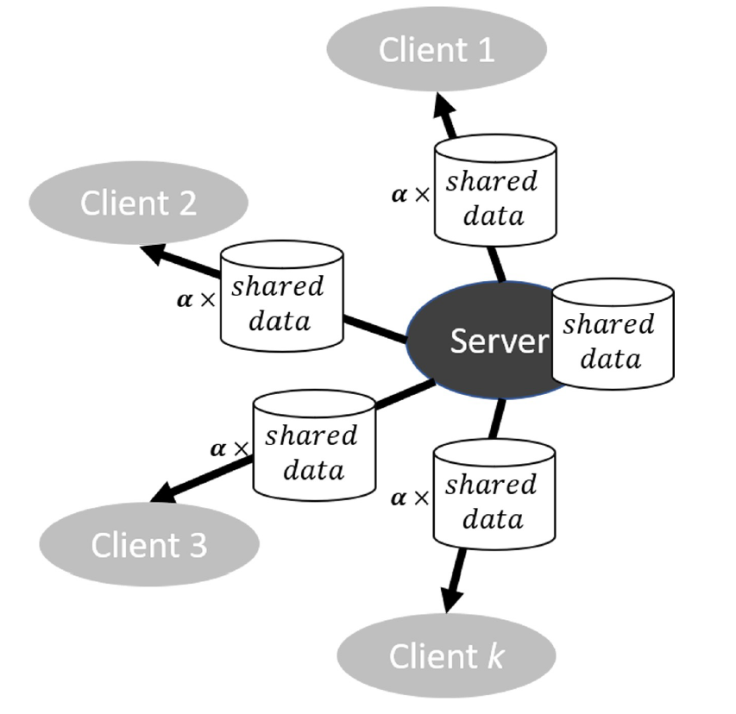
Data shared concept
Share a small subset of training data
Send these data to client and balance non-iid
Little effect about communication and distribution
Random fraction α，ratio of the globally-shared data size to the total client data size β

Slide 6
Loss function （binary cross-entropy）
X ：drug feature vector
Y ：binary label （survival or die）
N ：total number of example
f ：model
Target ： minimize above loss function

Slide 7
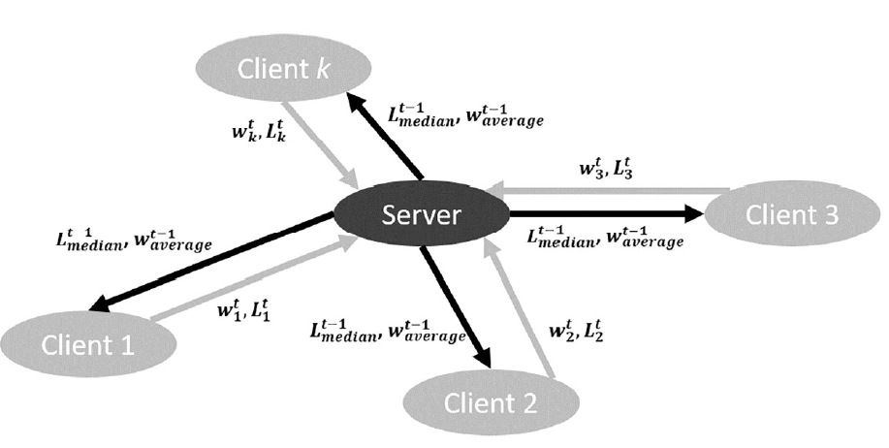
Main algorithm Description
Client send weight and loss
to server
Server send median loss and
FedAvg weight to client
At $t^{th}$ iteration , after E/2 epochs, if ${loss}^{t}$ < ${loss}_{median}^{t−1}$ , continue training E/2 epochs.
(Upper bound is 3E/2 epochs)

Slide 8
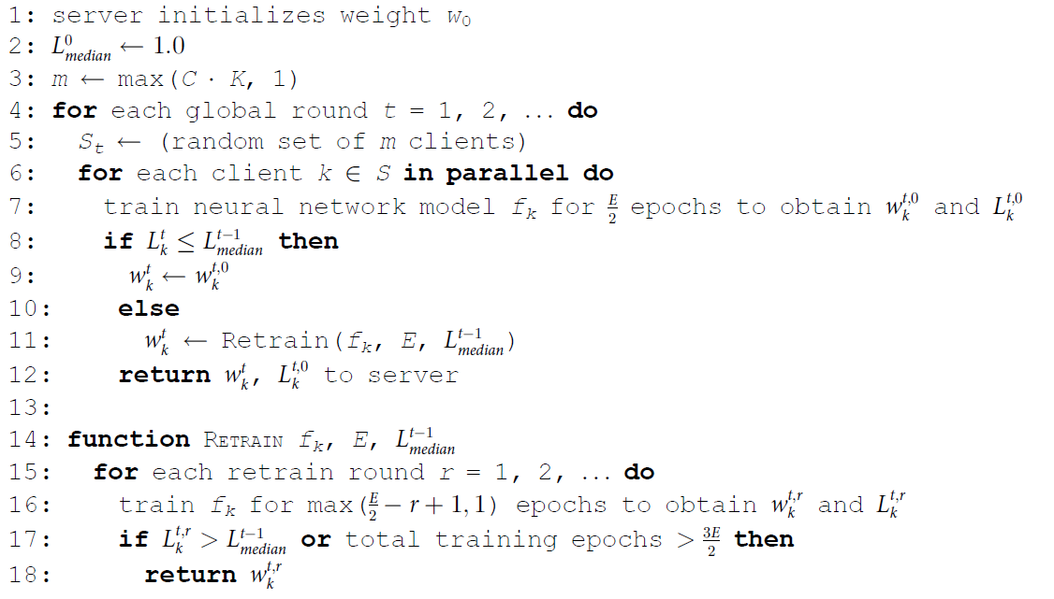
Main algorithm Shadow code
Ensure most client’s loss lower than prior iteration

Slide 9
Experiment settings Data
MIMIC-III database
Drugs vector table

Slide 10
Experiment settings Parameter sets
Three hidden layers with 20, 10, 5 units
ReLu activation function
Adam optimizer
n = 0.001, β = 1%, 2%, 3%, α = 10%, 20% ,30%
Epoch = 5，10, 15
Clients selection = 10%, 20%, 50%, 100%
Cross validation

Slide 11
Experiment settings Evaluation metrics
Model accuracy
Average epochs
T : global round, m: clients participate

Slide 12
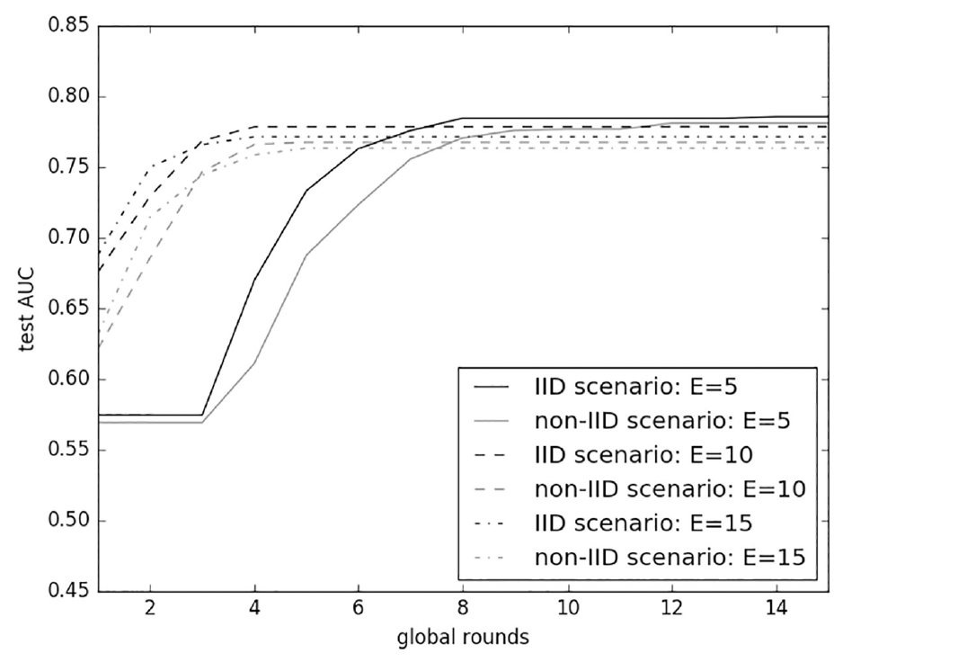
Experiment result FedAvg with data-shared

Slide 13
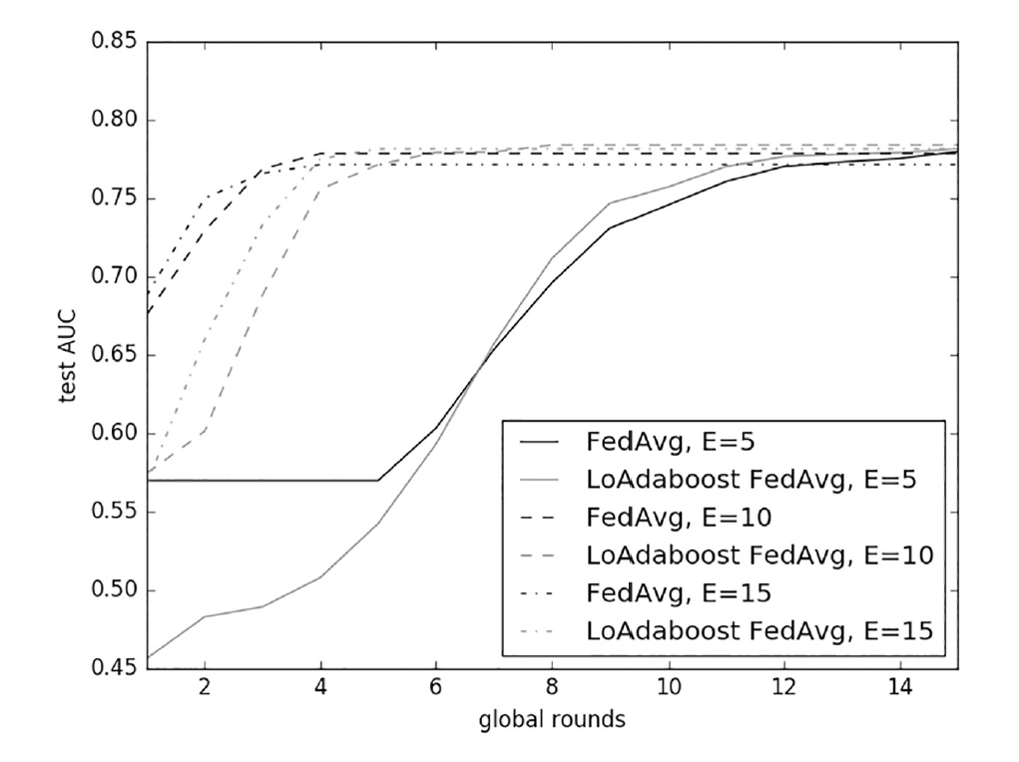
Experiment result LoAdaboost with iid setting
At start, FedAvg training
full epochs, converge
faster than LoAdaboost
Prevent overfitting by
training less epochs

Slide 14
Experiment result LoAdaboost with iid setting
Achieve less average epochs

Slide 15
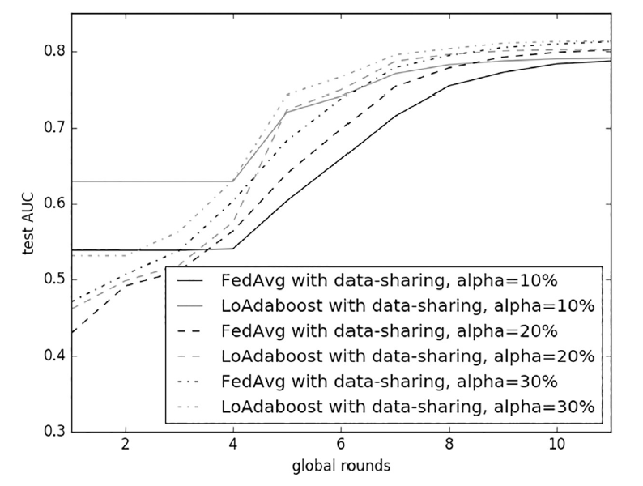
Experiment result LoAdaboost with non-iid setting
Distribution α = 10%, 20%, 30%
Globally shared data size β = 1%
Client fraction = 10%, epoch E = 5
Learning on non-iid data become
more difficult

Slide 16
Experiment result LoAdaboost with non-iid setting and different α, β, C

Slide 17
Experiment result eICU dataset description
Non-iid dataset
Hard to converge (need more epochs)

Slide 18
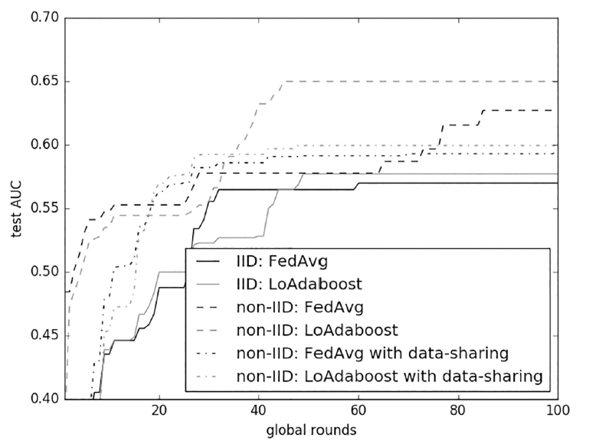
Experiment result eICU dataset
50 or more global rounds
Lower accuracy than MIMIC
C = 10%, E = 5

Slide 19
Conclusion
Dynamic epochs (E) can fit different client’s data distribution
LoAdaBoost FedAvg converged to slightly higher AUCs and fewer average epochs of clients than FedAvg
Federated learning with IID data does not always outperform that with non-IID data.
In non-iid setting , LoAdaBoost may also lose its competitive advantage

