Slide 1
Real-time 6DoF Video View Synthesis using Multi-Sphere Images April 14 2021
Benjamin Attal, Selena Ling, Aaron Gokaslan, Christian Richardt, James Tompkin, “MatryODShka: Real-time 6DoF Video View Synthesis using Multi-Sphere Images” (European Conference on Computer Vision 2020, pp.441-459)
(https://arxiv.org/abs/2008.06534)
(https://visual.cs.brown.edu/matryodshka)

Slide 2
Outline
Introduction
Related Work
Method
Experiments
Discussion and Conclusion
A delimited physical surface so processed that it yields a sheaf of light rays to a given which is the same as would be the sheaf of rays of rays from the original scene to a given point. – J.J.Gibson, A theory of pictorial perception (1954)

Slide 3
Introduction
A approach is to simultaneously learn depth and disocclusions via a multi-sphere image (MSI) representation, which can be rendered with correct 6DoF disparity and motion parallax.
- A multi-sphere image scene representation for omnidirectional view synthesis
- A method to recover the MSI representation from omni-directional stereo (ODS) imagery
(via a learning-based soft spherical 3D reconstruction method)
- A real-time inference and VR rendering engine for MSI from ODS input
Some problems with these formats:
- motion parallax is missing from stereo 360° imagery
- equirectangular projection (ERP) formats have incorrect disparity everywhere but in one direction
- ODS formats have diminished disparity as the view approaches the zenith or nadir
Notes:
Stereo 360° imagery aims to increase this immersion by providing binocular disparity as a depth cue in all directions, and video provides depiction for dynamic scenes
There are problems with this format:
- motion parallax is missing from stereo 360° imagery
- side-by-side equirectangular projection (ERP) formats have incorrect disparity everywhere but in one direction
- omnidirectional stereo (ODS) formats [21, 37] have diminished disparity as the view approaches the zenith or nadir[1]

Slide 4
Introduction
A approach is to simultaneously learn depth and disocclusions via a multi-sphere image (MSI) representation, which can be rendered with correct 6DoF disparity and motion parallax.
360° imagery
Stereo 360° imagery
- valuable tool for virtual reality
- aims to provide binocular disparity cues
(immerse user in captured environment)
- ODS imagery
- equirectangular projection (ERP)
approximates required rays
(each pixel map to directions on the unit sphere)
via multi-camera systems
fixed baseline binocular perspective
360 degree ο
360 degree ο
binocular stereo ×
binocular stereo ο
motion parallax ×
motion parallax ×
Notes:
360° imagery is a valuable tool for virtual reality (VR) as the viewer is immersed in a captured real-world environment

Slide 5
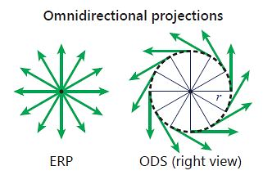
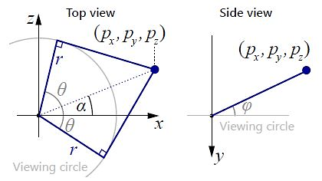
Projection scheme
Equirectangular projection (ERP)
ODS projection
disadvantage: depth cannot be determined due to disparity is zero along the camera baseline.
ODS encodes is richer input for view-synthesis tasks due to disparity in all azimuth directions.
Matzen et al, ACM Trans. Graph. 36(4), 148 (2017).

Slide 6
Related work to produce 6Dof video
Approaches
Dense depth with mesh rendering
Layer-based decompositions
Challenges
Occluded content
Camera and object motion assumptions
A. P. Pozo et al., An Integrated 6DoF Video Camera and System Design, ACM Transactions on Graphics, 216 (2019).
Ana Serrano et al., Motion parallax for 360° RGBD video, IEEE Transactions on Visualization and Computer Graphics, 25(5), 1817 (2019).

Slide 7
Method
Goal: to enable real-time 6DoF view synthesis in the vicinity of an input stereo 360° video
Representations
Represent and render content included ≧ 1 view
Inference
Real-time from ODS video
(an image for each eye given a position in the world)
(viewpoints for the left and right eyes of the user)
Notes:
an open-source system, with mono (ERP) and stereo 360° (ODS) renderers to generate synthetic training data, TensorFlow models, real-time TensorFlow and TensorRT inference within Unity that outputs to GPU textures, and a real-time multi-sphere video renderer in Unity.
a given database of synthetic ODS image pairs, and then an approach trains a network to generate a multi-sphere image (MSI) representation of the scene
an MSI for each ODS video frame of an input video, and render it from novel headset viewpoints for the left and right eyes of the user

Slide 8
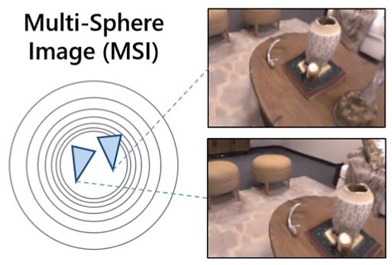
Multi-Plane Image vs. Multi-Sphere Image
Multi-Plane Image
- perspective view synthesis
- RGB + alpha layers
- inferred from plane sweep volumes
Multi-Sphere Image
- 360-degree view synthesis
- RGB + alpha layers
- inferred from sphere sweep volumes
advantage: permission to fast and dense rendering of views
(MSI are omnidirectional and thus enable view synthesis for any camera orientation and position within the innermost sphere)
Notes:
What I’m try to realize the difference between MPI and MSI
MSIs represent a scene as concentric spheres with color and transparency (RGBA) at each point on a sphere

Slide 9
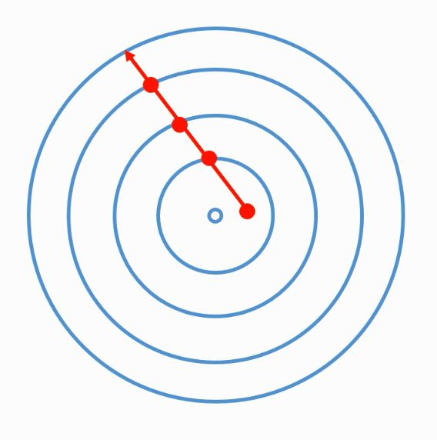
Multi-Sphere Image Rendering
Intersect ray with each layer of MSI
Over composite color c and alpha α of intersection points
Net opacity of layer i
- ray is intersected with the concentric spheres of the MSI
- producing intersection points with spherical layers 1 to N
- each intersection point is converted from Cartesian to spherical coordinates
- sampling the RGB colors and alphas (opacities) corresponding to these points from MSI layer i
Notes:
views can easily be rendered from MSIs for a range of projections, including perspective, ERP and ODS.

Slide 10
Inference
an ODS image has been given
generate left/right sphere sweep volumes (SSV)
input to a fully-convolutional neural network
(with V-coordinate convolution)
predict blending weights and alpha ERPs per MSI layer
enable real-time 6DoF view synthesis

Slide 11
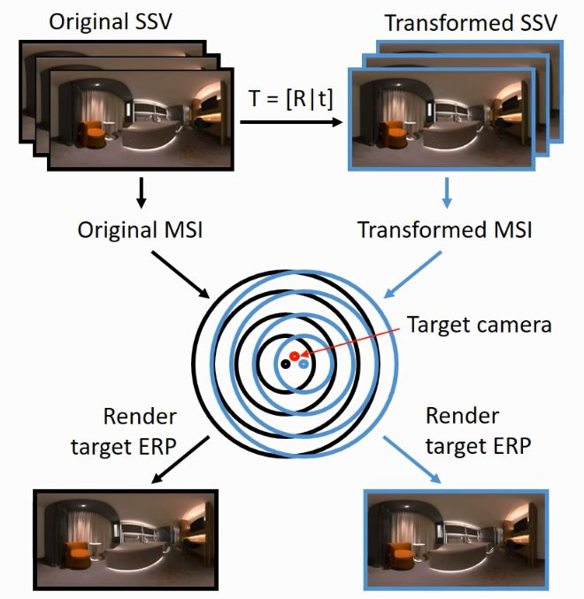
Transform-inverse MSI regularization
Motivating idea:
predict an image under a small transformation of target view
transform it back to the original target view
(only incur a small difference in appearance)
ensure the minor frame-to-frame differences in a video
* Note input to network is 3D, and output is also a 3D representation of a scene
↓better
↑better
↑better
Quantitative results
Gabriel Eilertsen et al., Single-frame Regularization for Temporally Stable CNNs, CVPR 2019.

Slide 12
Baseline Comparisons
Zhou et al., SIGGRAPH (2018).
Lai et al., IEEE VR (2019). [ODS-Net]
Serrano et al., IEEE Trans. Vis. Comput. Graph. (2019).
Tinghui Zhou, Richard Tucker, John Flynn, Graham Fyffe, and Noah Snavely. Stereo Magnification: Learning view synthesis using multiplane images, ACM Transactions on Graphics. 37, 4, Article 65 (2018)
Po Kong Lai, Shuang Xie, Jochen Lang, and Robert Laganière. Real-Time Panoramic Depth Maps from Omni-directional Stereo Images for 6 DoF Videos in Virtual Reality, IEEE Conference on Virtual Reality and 3D User Interfaces (2019)
Ana Serrano, Incheol Kim, Zhili Chen, Stephen DiVerdi, Diego Gutierrez, Aaron Hertzmann, and Belen Masia. Motion parallax for 360° RGBD video, IEEE Transactions on Visualization and Computer Graphics, 1817 - 1827 (2019)

Slide 13
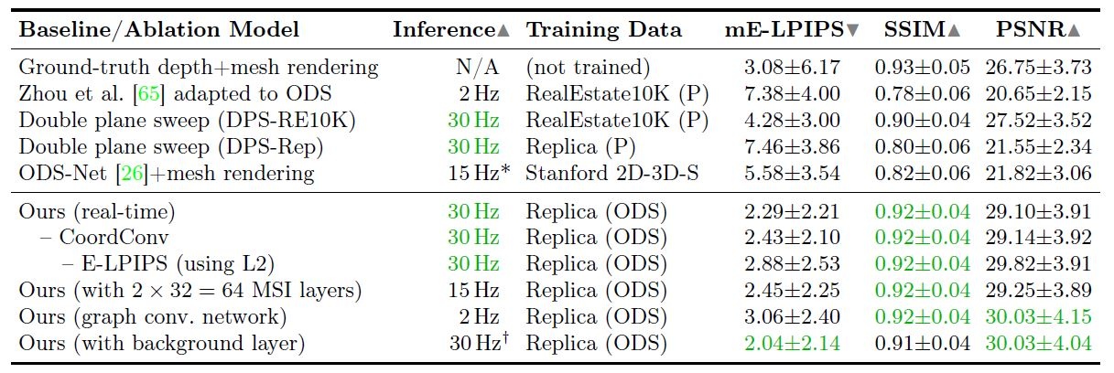
Comparison-part 1
↓better
↑better
↑better
Perspective baseline:
Zhou et al., SIGGRAPH (2018).
- To take as input a plane sweep volume for each of the two views, and produces a multi-plane image.

Slide 14
Comparison-part 2
↓better
↑better
↑better
Learning-based baseline:
Lai et al.,IEEE VR (2019). [ODS-Net]
- To infer depth from side-by-side ERP video, and use meshed-based renderer for view synthesis.

Slide 15
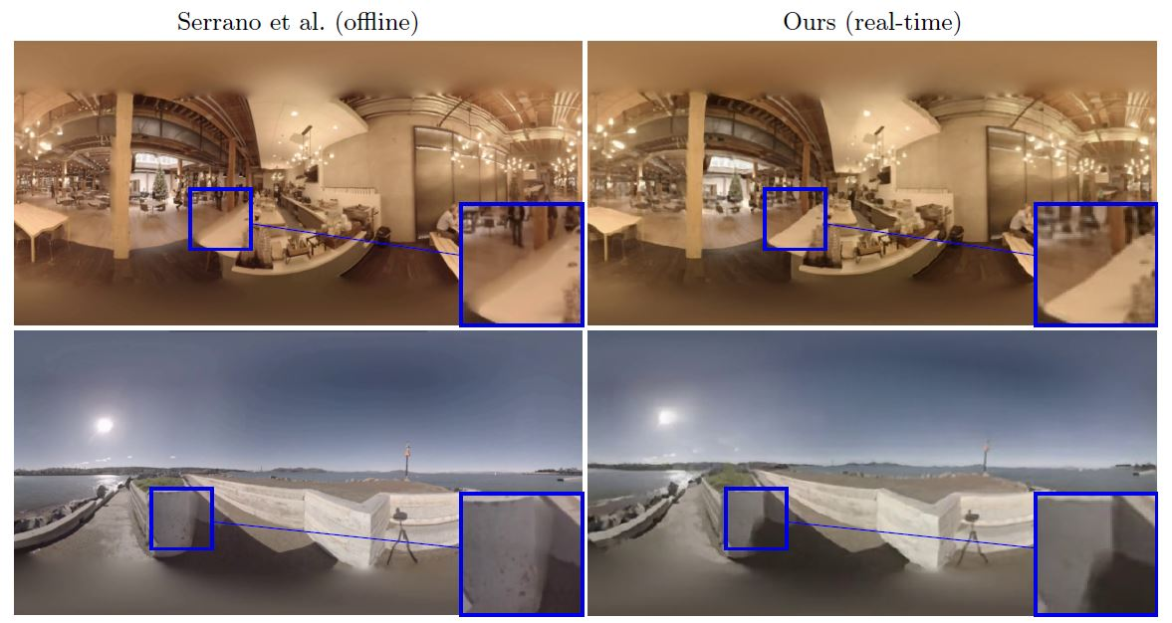
Comparison-part 3
Offline optimization-based baseline:
Serrano et al.,IEEE Trans. Vis. Comput. Graph. (2019).
- To use RGBD ERP video as input via static camera (high-resolution inference)
Notes:
A method shows improved synthesis of occluded content (first row). To compare with method of RGBD input with a depth preprocessing step, it predicts disparity with higher accuracy, especially in challenging textureless regions (second row).

Slide 16
Limitations
Number of MSI layers (N=32)
Resolution
Explicit spherical convolution
- limited view extrapolation range
- struggle with thin structures
- rather than coordinate convolution
- approach with almost rotation-equivariant graph convolutional network (GCN)
Notes:
The quality at larger extrapolations is currently limited by computational trade-offs both during training and in real-time application. First, our per-layer ODS blending for re-rendering could be improved by flow-based interpolation methods [3], which would be required during both training and inference. Second, inferring higher-resolution MSI representations is possible at a slower speed with a network with more layers [6, 17, 49] and so a larger receptive field. Third, an explicit spherical convolution approach may improve quality, but current approaches are too expensive for real-time applications. Further, stereo 360° video is a nascent format, and there is insufficient training data available.
MSI depth discretization limits the range of non-aliased views, beyond which the layered nature of the MSI becomes noticeable [49]. Increasing only the spatial resolution of the RGB for each MSI layer via the high-resolution input video increases this effect. However, this approach to VR rendering can be a better trade-off in terms of quality and comfort than keeping low-resolution imagery.
inference times are slow and currently cannot be accelerated to real-time with TensorRT due to its lack of sparse matrix support for graph convolutions.

Slide 17
Summary
- To take 360° omnidirectional stereo video as input
- To predict multi-sphere images that enable 6Dof 360° view synthesis in real time
estimating content for unseen regions
view synthesis to happen quickly, preferably in real time when camera feeds
(motivation)
competitive quality + fast inference
real-time no-preprocess application
(benefit)
Notes:
1. To decompose a scene into multi-sphere images (MSI), each with RGB and alpha (RGBA) values.
2. This is created by a network architecture which supports stereo 360° input in the omnidirectional stereo format, uses spherically aware convolutions and losses, and maintains temporal consistency for video without additional network parameters via spherical single-image transform inverse regularization

