Slide 1
Deep Learning Based Scene Text Reading for Cloud Audit Information Extraction
Hezhong Pan; Chuanyi Liu; Shaoming Duan; Peiyi Han; Xinyi Zhang; Binxing Fang
2019 IEEE Fourth International Conference on Data Science in Cyberspace (DSC)

Slide 2

Introduction
Safety issues come behind when cloud computing become popular
Exceed authorized access
Misoperation
Abuse of resources
Malicious destruction
Building a supervision and auditing system is a challenge
Notes:
This security threats are mainly triggered by internal users themselves

Slide 3
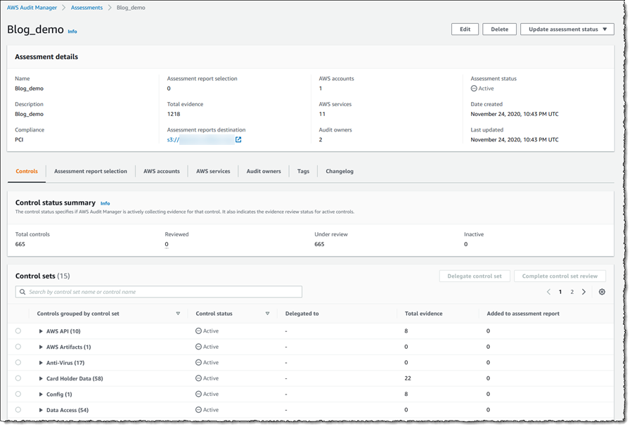
Audit of Remote Graphical System
Host-Based Audit (HBA) :
Collect log files of cloud hosts
Network-Based Audit (NBA) :
Collect audit information from network traffic
Both method need effective information extraction method
Paper’s Goal : Apply scene text reading in cloud audit system
Notes:
That is, the author extract audit information from the session images of remote desktop

Slide 4
Challenge and Proposed Solution
The images of cloud scene contain lots of small icons
The images contain incomplete characters after transmission
-> The author proposed their modified deep neural network model (CNN + RNN)
The deep learning models are data-thirsty
-> The author build up their generation model

Slide 5

Scene text reading model
Text detection model + Text recognition model
locate text regions
Transform text to editable characters
Text detection model : sequentially and locality
Notes:
The text detection is similar to object detection, but texts show sequentially and locality
The modern text detection methods detect only components of part of the text and then assemble them at last

Slide 6
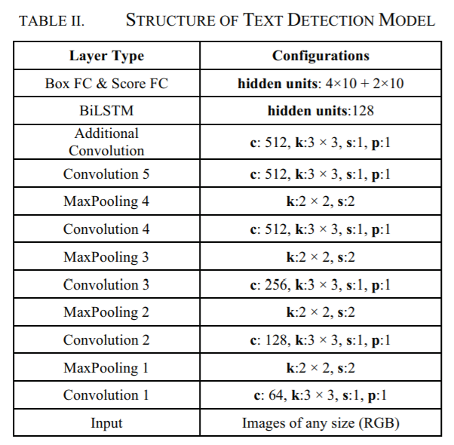
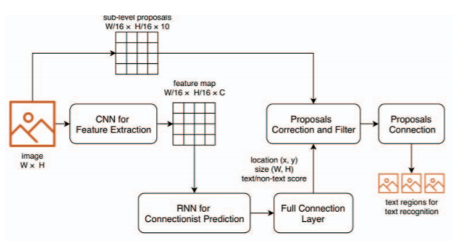
Text Detection Model
Feature extraction -> Recurrent connectionist prediction
Notes:
The input image can be arbitrary size, they first use 5 convolutional layers of VGG16 network to extract a feature map from input images
After that, a 3x3 convolution kernel is used to slide the feature map to generate sequential context information

Slide 7
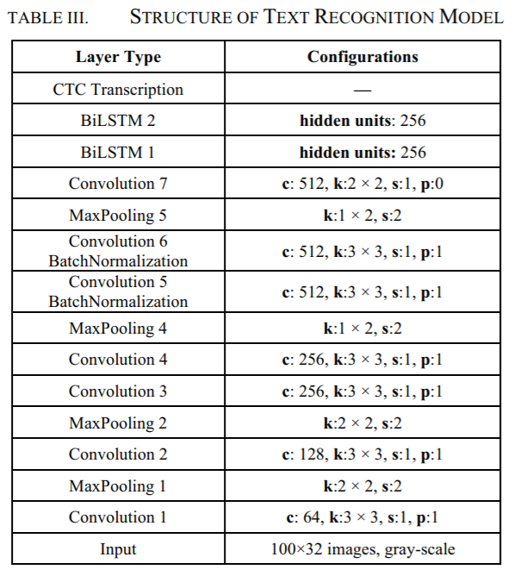
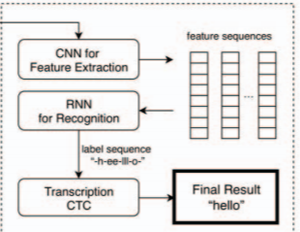
Text Recognition Model
Feature extraction (CNN) -> label prediction (RNN)
-> transcription (Connectionist temporal classification)
Notes:
First they use CNN to extract the features and transform the feature map into sequential vector representation
Then RNN is used to generate the label sequence
Finally the CTC is used to transform label sequence into final result
It’ s popular method used in speech recognition, hand-writing recognition even hand gesture recognition

Slide 8
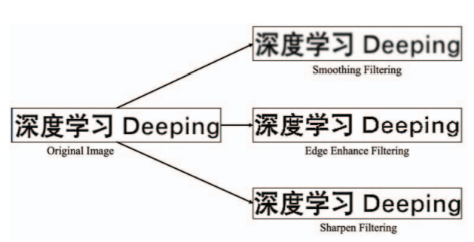
Synthetic Data Method
They provide a generation method to make the synthetic images similar to scene data
Get text and image in corpus and background library
Use gPb-UCM to segment the background image in several uniform color regions
Assign the color to the text and put it to the image
Notes:
Text reading models are data-thirsty
The main idea is to embedded text in real scene images
Challenge is to find the suitable text placement area

Slide 9
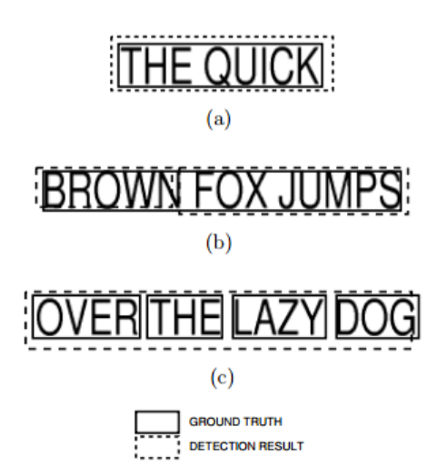
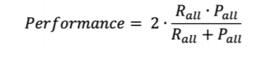
Evaluation of Text Detection
Recall = #True Positive / #Ground Truth
Precision = #True Positive / #Detected Items
DetEval algorithm (Evaluation in ICDAR2013)
Notes:
For the evaluation of text detection, we care about how to calculate the precision and recall
And the basis is how the two bounding boxes match
As you can see, there are three matching types between ground truth rec. and detected rec.
We need to consider these three matching types

Slide 10
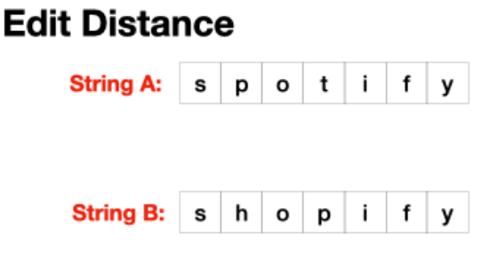

Evaluation of Text Recognition
Evaluation of Text Recognition is based on Edit Distance
Test data sets : real scene screenshots (cloud hosts、cloud app、remote browsers)
Notes:
L = label string
S = predictive string

Slide 11
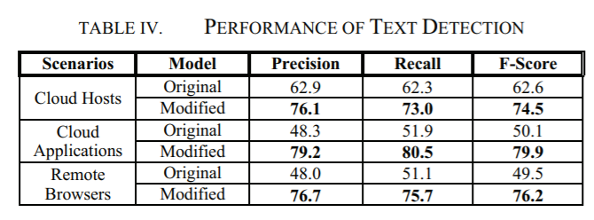
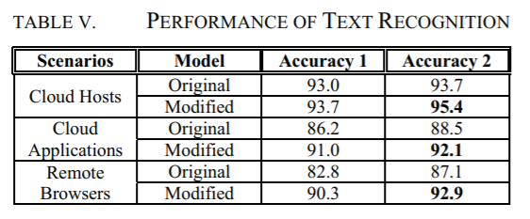
Results

Slide 12
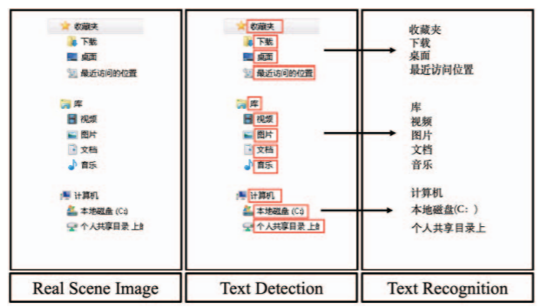
Example of the results

Slide 13
Conclusion
The paper proposed their own deep neural network method (CNN + LSTM) in scene text reading
Their data set is related to cloud platform’s GUI
The accuracy is high and the evaluation metric is reasonable

