Slide 1
Screen Recognition: Creating Accessibility Metadata for Mobile Applications from Pixels
ACM Human Factors in Computing Systems (CHI’21)

Slide 2
Introduction
Mobile accessibility means to make app accessible to people with disabilities
All of the 100 most-downloaded Android apps had basic accessibility issues
The lack of appropriate metadata needed for accessibility features
Developers may be unaware of accessibility
Third-party UI toolkits that have limited built-in accessibility support

Slide 3
Goal
Introduce a new method for providing accessibility metadata automatically from the mobile screens
1. They collected, annotated, and analyzed 77,637 screens (from 4,068 iPhone apps)
2. Trained an object detection model to extract UI elements from screenshots
3. Do some post processing to create metadata to iOS VoiceOver

Slide 4
Supporting Mobile Accessibility
Traditional solutions:
1. Encouraging developers to fix accessibility problem -> slow
2. Manually labeling UI elements and forming a shared repository of such information for runtime repair -> need volunteer

Slide 5
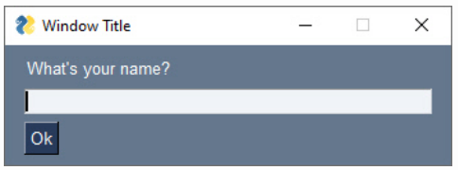
UI Detection from Pixel
API based GUI detection
Visual based GUI detection:
Non-intrusive
Leverage computer vision
Commonly used for testing interactive software systems
Traditional image processing methods
(edge/contour detection, template matching)
Deep learning models trained on large-scale GUI data

Slide 6
Understanding UI Semantics
UI type, state, navigation order, grouping, image and icon descriptions
It is important for accessibility services to know the state of an element
“Home Button, Clickable”

Slide 7
IOS App Screen Dataset
Created a dataset of 77,637 screens from 4,068 iPhone apps
Captured screenshots and extracted information of their accessibility trees
(ii) Manually annotating the visual UI elements
The collected metadata has the same limitations in terms of completeness and correctness

Slide 8
Screen Annotation
Forty workers annotated all visually UI elements in the screenshots
Segmentation
Classification
In segmentation, workers determined a bounding box for each UI element
In classification, workers assigned attributes to the identified UI elements
12 common UI types

Slide 9
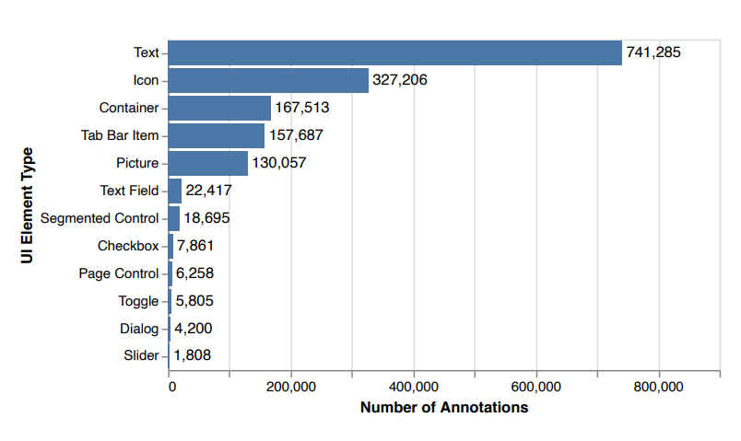
Dataset Composition Analysis
Dataset’s biases between different UI types

Slide 10
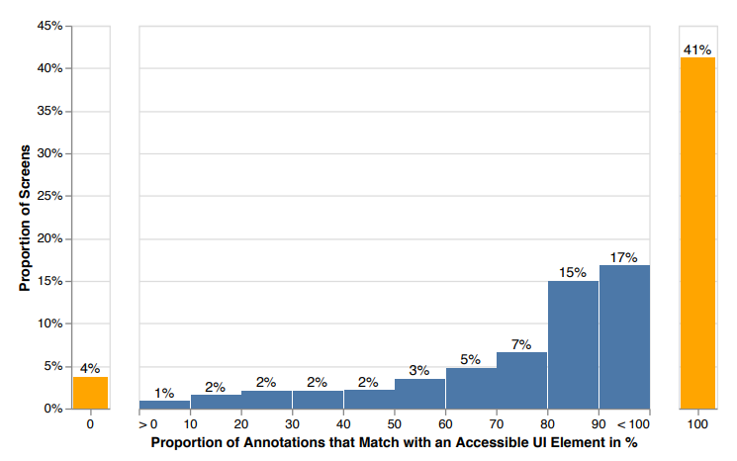
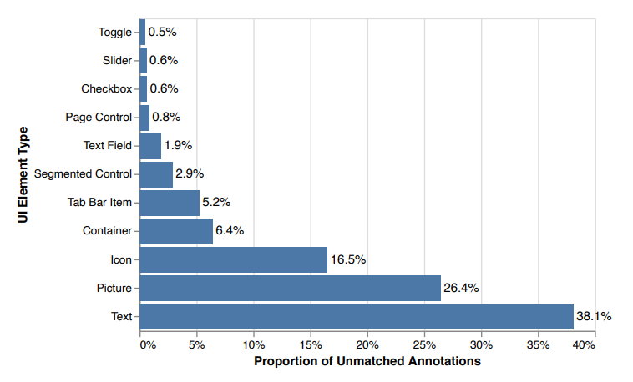
Discrepancies between annotations and UI element metadata
Estimate how many UI elements were not available to accessibility services

Slide 11
UI Detection Model
They trained an object detection model to extract UI elements from pixels
Started by experimenting with Faster R-CNN
takes more than 1 second for each screen and more than 120 MB memory
TuriCreate Object Detection toolkits
Turi Create is an open source toolset for creating Core ML models
Faster R-CNN
Single Shot MultiBox Detector

Slide 12
Detecting small objects
UI elements are relatively small in object detection tasks
Feature Pyramid Network
To improve accuracy and speed when detecting objects in different scales
Data augmentation
To handle class-imbalanced data
Notes:
A Feature Pyramid Network, or FPN, is a feature extractor that takes a single-scale image of an arbitrary size as input, and outputs proportionally sized feature maps at multiple levels, in a fully convolutional fashion

Slide 13
Other Configurations
Checkbox and Toggle:
The visual appearance of “Selected” and “Unselected” Checkboxes are quite different
Tab Bar Item:
Tab Bar Item class had good recall but low precision
Split the Tab Bar Item annotations into Text and/or Icon classes

Slide 14
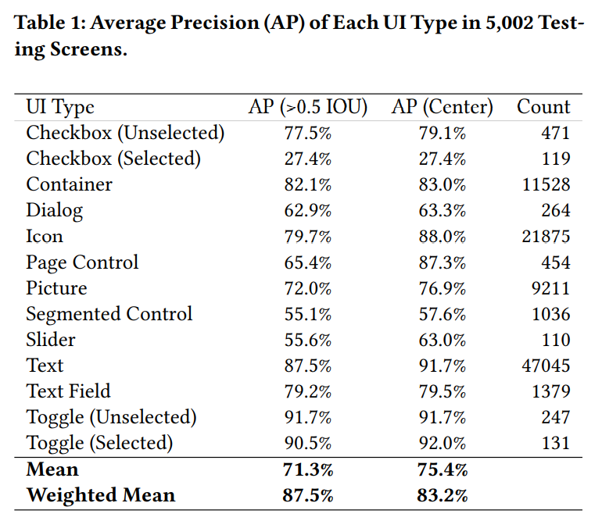
Evaluation and AP Result
For each UI type, they evaluated model performance using Average Precision (AP)
They choose a threshold of > 0.5 IoU
Model achieved the lowest AP for the Checkbox (Selected)

Slide 15
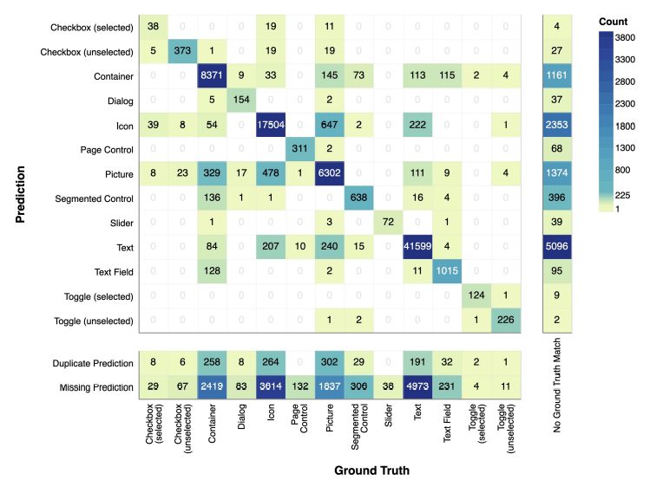
Confusion matrix
See how much the model misclassifies

Slide 16
Improving From UI Detection Results
Even when the detections are perfect, simply presenting them to screen readers will not provide an ideal user experience as the model does not provide comprehensive accessibility metadata

Slide 17
Finding Missing UI Elements
Missing data

Slide 18
Removing Extra Detections
Non-Max Suppression algorithm to remove duplicate detections within these visually similar UI types
Algorithm only removes spatially similar detections when IoU > 0.8

Slide 19
Recognizing UI Content
We leverage some iOS built-in features to recognize content in these UI detections
For Text: iOS built-in OCR engine, which provides a tight bounding box and accurate text result with a reasonable latency (< 0.5s)
For Icon: Icon Recognition engine in iOS 13 (and later) VoiceOver to classify 38 common icon types
For Picture: Image Descriptions feature in iOS 14’s VoiceOver to generate full-sentence alternative text

Slide 20
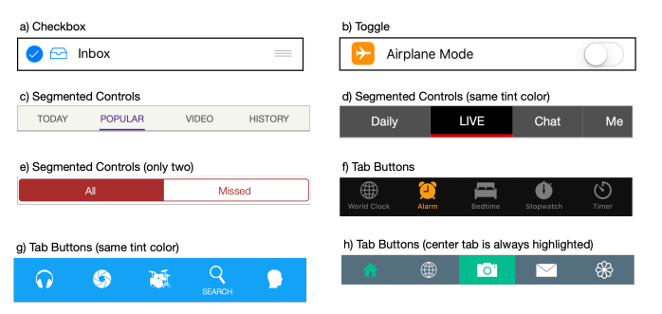
Determining UI Selection State
Several UI types also have selection states, such as Toggle, Checkbox, Segmented Control, and Tab Button
For Segmented Control and Tab Button, the most common visual indicator is the tint color
They extract the most frequent color as the background color, and the second most frequent color as the tint color

Slide 21
Conclusion
1. An analysis of the characteristics (e.g., UI distribution, accessibility issues) of a large dataset of 77,637 screens (from 4,068 iPhone apps)
2. A robust object detection model to extract UI elements from raw pixels in a screenshot
3. Augmentation of UI detections for a better user experience

