Slide 1
AirSim-W: A Simulation Environment for Wildlife Conservation with UAVs
Elizabeth Bondi1, Debadeepta Dey2, Ashish Kapoor2, Jim Piavis2, Shital Shah2, Fei Fang3, Bistra
Dilkina1, Robert Hannaford4, Arvind Iyer4, Lucas Joppa2, Milind Tambe1
Proceedings of the 1st ACM SIGCAS Conference on Computing and Sustainable Societies
2018

Slide 2
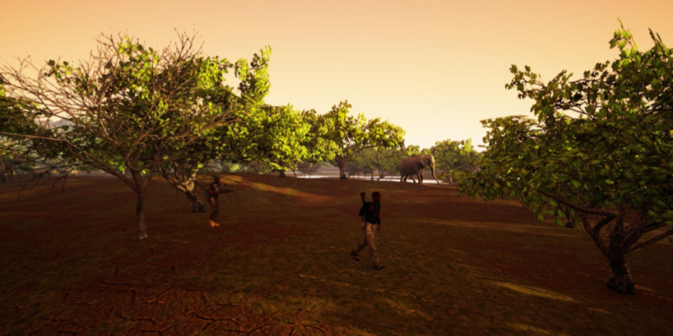
Motivation
Solve the problem of wildlife poaching
Why AI + UAVs? AI can assist park rangers in:
Planning their patrols
Creating strategies to detect poaching or signs of poaching activities
Unmanned aerial vehicles (UAVs) play a role in patrolling by:
Deterring poaching through the use of signaling
serving a lookout for park rangers
acting as a seperate patroller with the ability to detect objects of interest (OOI)

Slide 3
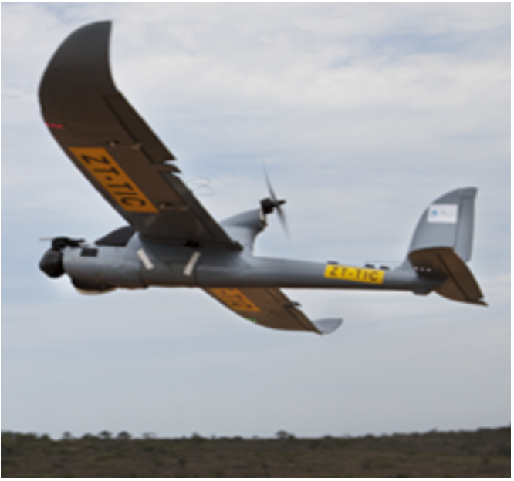
Motivation (Cont.)
Why UAV + thermal?
The size of humans and animals in UAV is small
Poaching often happens at night
Hard to collect real dataset
Previous work: Air Shepherd + Thermal camera → 70 2 hr-videos Fly on the pre-programmed paths, fly manuaaly when finding OOI Problem:
Additional process time before labeling:
Do not have OOI in most videos
Cannot detect OOI
800 hours to labeling
Money-consuming to fly UAVs
Notes:
Air Shepherd:
flying at night
pre-programmed paths
follow OOI manually
do not have many IIO

Slide 4
Motivation (Cont.)
Why simulation?
Need more data
SPOT: tranind by the collected frames → detect poachers or animals
Problem
Detecting results are not good enough
Can not follow OOIs automatically
Costly to test autonomous flights
With simulation:
Augment dataset of labeled thermal infrared videos efficiently
Provide a testing environment for future autonomous flight

Slide 5
Unreal Engine + AirSim
Unreal Engine
Support hardware-in-the-loop (ex. Xbox controller) or Python API for moving
AirSim
Veheicle model for the UAV
Environment model made of gravity, magnetic field, and air pressure
Density model, a physics engine for the linear and an- gular drag, accelerations, and collisions
A sensor model for the barometer, gyroscope and accelerometer, magnetometer, and GPS.
Scene, segmentation, and depth images can be collected

Slide 6
Related Work
Automatic detection of wildlife and humans in UAVs videos
RGB images in high resolution
Do not consider real-time detection → SPOT won!
Data augmentation → more data
Do not account for thermal infrared imagery
Do not consider the physical process that are involved in image capture
Simulation → more data Train models with simulated data, test models with real data → improve semantic segmentation
Few radiometric models for thermal simulation

Slide 7
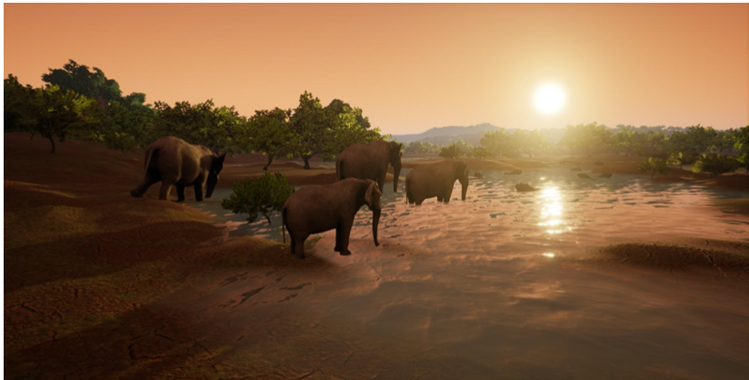
What they did
Creation of an African savanna environment
Integration of a new thermal infrared model based on radiometry
API code extensions to follow objects of interest or fly in zig-zag patterns to generate simulated training data
Demonstrated detection improvement using simulated data generated by AirSim-W

Slide 8
Africa Savana Environment
Representative biome: wide-open space, dense forest, a mid-density area, a water feature, road access, and poachers and appropriate animals
Creating step:
Get the model of the correct plants, animals, and humans
Create a terrain, and sculpt it in hills and depressions for water
Spline-based movement of the actors
Dress the scene (textures → real-time video cpature)
Three generic areas of vegetation density
Three sets of poachers
3 characters/set
Follow a spline in a large loop
Intersected the poacher loops with elephants on spline loops
Zebras were scattered across the environment
Animals were clustered around the watering hole
Notes:
3 week $5000 180 hours
transfer learning
UE with models
relatively low cost based on this environment

Slide 9
Expansion from RGB to Thermal Infrared

Slide 10
Physical Modeling Assumptions
For thermal imagery
Sources of thermal infrared photons (TIP) to the camera on a UAV:
Upwelled: direct from atmosphere
Downwelled: TIP from atmosphere reflected by the target
Direct: direct from the target
Background radiance: TIP from nearby objects reflected by the target
To simplify model in Africa savanna:
Clear, dry, cool atmosphere → X Upwelled, downwelled
Flat terrain → X Background radiance
Dominant contribution: Direct → Modeled by Planck’s Law
Assumptions:
Objects emit energy uniformly
Camera lens has perfect transmission and no falloff

Slide 11
Planck’s Law
How they simulate the thermal sensor
L: radiance
T: temperature
ε_{avg}: avg emissivity over the bandpass
R_{λ}: peak normalized camera spectral response
h: Planck’s constant
c: the speed of light
λ: the wavelength
k: the Boltzman constant
Get the pixel locations of OOI
Measure the temperature and emissivity of OOI
Use Planck’s Law to estimate the resulting radiance at the sensor
Normalize the result to create an 8-but thermal image

Slide 12
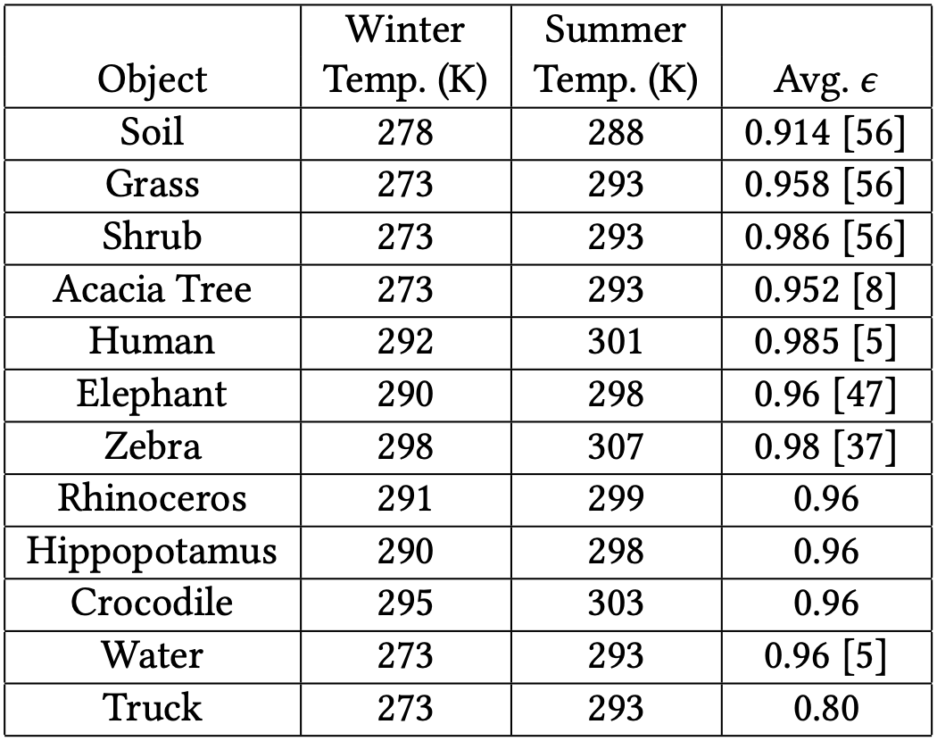
Database
How they estimate the temperatures and emissivities of OOI
Emissity: apply in all seasons
Human and animals: skin
Truck: oxidized steel
Plant: from some studies
Temperature: depend on the air temperature
Winter vs. Summer
Temp. in Winter is more accurate than Summer
External temp. in Winter from studies → Find a linear fit for the increasing temp in Summer.

Slide 13
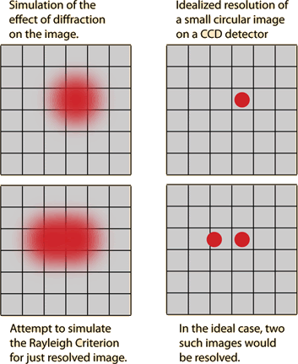
Blur and Noise
Blur
The image system will be diffraction-limited
Point spread function (PSF): describe the response of an imaging system to a perfect point of radiance → Gaussian distribution (can be replaced to real model)
Noise
Johnson noise: the resistor nature → white Gaussian noise
Flicker noise: flaws in the material surface
Thermal noise: heat exchange with the environment → white Gaussian noise → Gaussian 1/f noise
Fixed pattern noise (FPN): each microbolometer has a slightly different resistance for the same incoming thermal infrared photons → uniform random noise

Slide 14
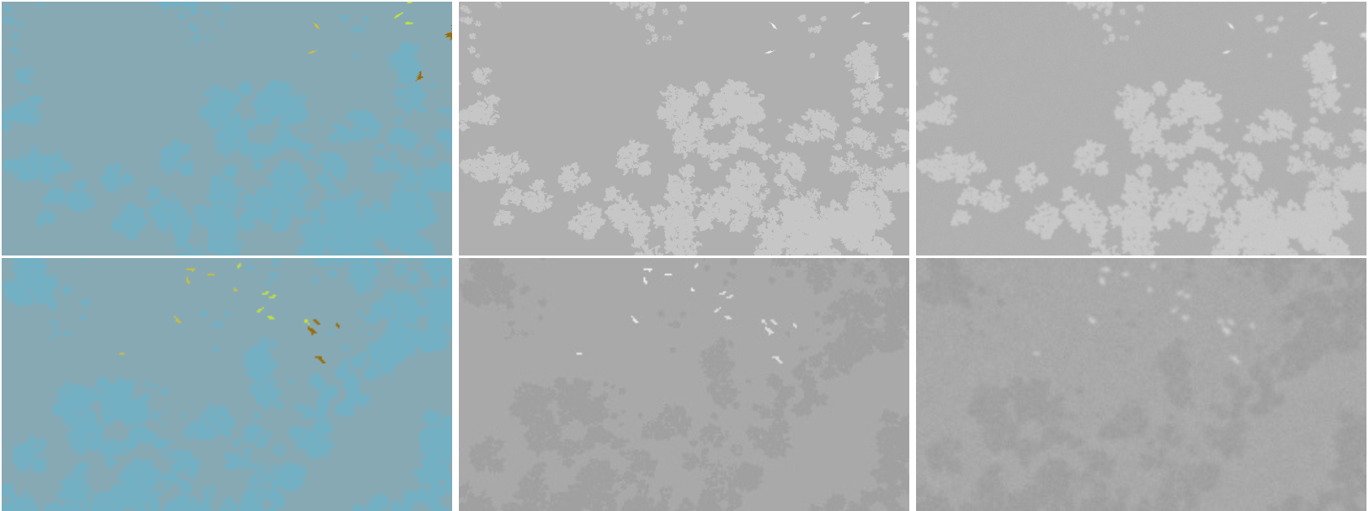
Process
A segmentation map from the RGB simulation
A thermal infrared digital count associated with all of the objects
A simple model for blur and noise
Segmentaion
thermal infrared
noise, blur
Summer
Winter

Slide 15
Utilizing AirSim-W for Poacher and Animal Detection

Slide 16
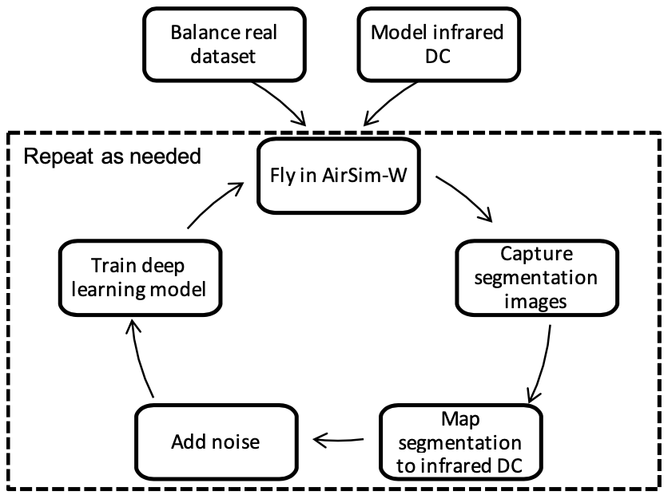
Generating Training Dta with AirSim-W
Set up parameters
Adjust flight altitude and look angle using Computer Vision Mode
Adjust the season to determine which digital counts should be used
Balance real dataset
Fly
Zig-zag pattern
Following an object of interest
Capture the segmentation image in each time step.
Convert this image into the thermal infrared image for the time step
12 flights, 6 summer, 6 winter
30 min/flight

Slide 17
Balancing Data (real data)
Class: {small, medium, large} x {animal, poacher}
Cannot randomly sample full videos for use in traning set
Full videos to stay consistently
Individual frames that may contain multiple OOI from different classes
Mixed-integer linear program (MILP)
Targets:
Use as many different train videos as possible
Provide the algorithm with samples with more variety
Frame types: a six-dimensional vector, indicating the number of objects from each class, ex. (1, 0, 0, 2, 0, 1)
Method: Randomly select the specified # of frames from each frame type in each video → Balanced dataset

Slide 18
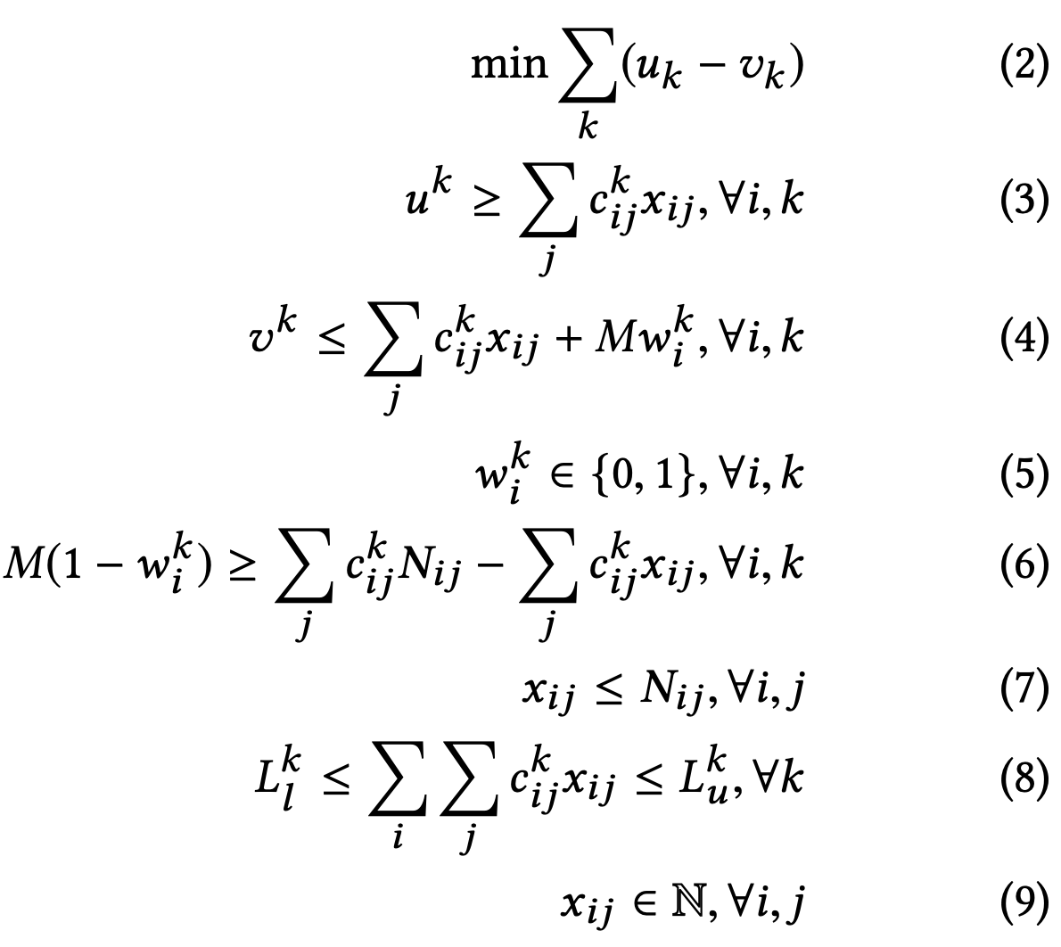
Parameters Definition
i: the index of the video j: the index of the frame type k: the index of the label type
c_{ij}^{k}: # of the k label in the j frame in the i video
N_{ij}: # of the j frame in the i video
L_{l}^{k}, L_{u}^{k}: the lower and the upper bound of the desired # of the k label
x_{ij}: # of the j frame in the i video that are sampled or selected
u^{k}, v^{k}: max and min of the k label among videos (X videos without k, k from the videos are all selected)
w_{i}^{k}: binary indicator, if all k labels in video i are selected

Slide 19
Formulations of Data Balancing
(2) Objective function: minimize the difference in the # labels of each type selected from videos
(3), (4): the definition of the variables in (2)
(5), (6): for M w_{i}^{k}
(7): ensure that the # of sampled frames <= # of frames in a video
(8): ensure that we are within the desired # of samples based on our frame choices
(9): ensure the # of frames sampled is integer
Min (2) → ↑ v_{k} → w_{k} = 1
# of selected label k in video i

Slide 20
Evaluation --- Qualitative tests
Real frames
thermal infrared simulated frames
noisy simulated frames
Summer
Winter
Winter

Slide 21
Evaluations --- Quantitative Tests
Scenario: detect animals and poachers
The effects of balancing the real data
Initialize using pre-trained ImageNet weights for Faster RCNN
Fine-tune using the 651 balanced frames
The effects of adding simulated data
Types of simulated data: i) regular, and ii) + blur and noise
Initialize using pre-trained ImageNet weights for Faster RCNN
Fine-tune using the simulated data (only with small-medium OOI)
Fine-tune with the real data
balanced real dataset
SPOT unbalanced dataset
Baseline: SPOT, trained with various model and selected the best one
SA, MA, LA: fine-tuned by the SPOT animal model
MP, LP: fine-tuned by the SPOT poacher model
Testing set: 6 real videos (X SP)

Slide 22
Evaluations --- Discussion
Using simulated data:
the best recall in 4 classes and avg
+ SPOT: the best precision on avg
SPOT Without simulated data:
Best precisions: SA, MA, LA
Selected the best animal models in SPOT
Large amounts of real data (18480 frames)
Lack of large simulated animal examples
With noise:
Good to have perfect images for initial training
Necessary to have a more sophisticated noise model
Recall
Precision

Slide 23
Evaluations --- Discussion
Balanced data (651) performed comparably to SPOT (22663)
Variety → less data
Label only a few frames per video in the future
Consider different distinctions
Simulate + Real is comparable to real only →
Generate large amounts of simulated data
Reduce labeling burden
Better collection, less costly
Recall
Precision

Slide 24
Conclusion
Creation of an African savanna environment
Integration of a new thermal infrared model based on radiometry
API code extensions to follow objects of interest or fly in zig-zag patterns to generate simulated training data
Demonstrated detection improvement using simulated data generated by AirSim-W

