Slide 1
Federated Machine Learning: Concept and Applications
QIANG YANG, Hong Kong University of Science and Technology, Hong Kong YANG LIU and TIANJIAN CHEN, Webank, China YONGXIN TONG, Beihang University, China

Slide 2
Index
Introduction
Overview
Methodology
Experiments
Results
Related Works
Conclusions

Slide 3
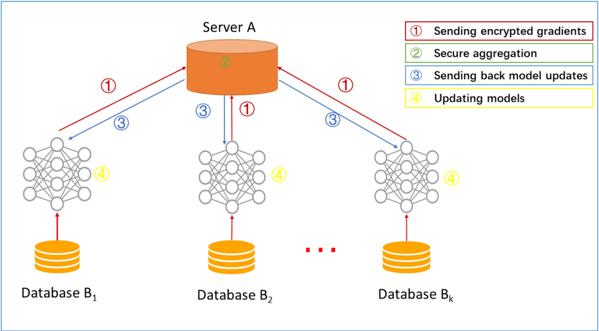
Horizontal Federated Learning
Step 1: Participants locally compute training gradients and send masked results to the server
Step 2: The server performs secure aggregation without learning information about any participant
Step 3: The server sends back the aggregated results to participants
Step 4: Participants update their respective model with the decrypted gradients.

Slide 4
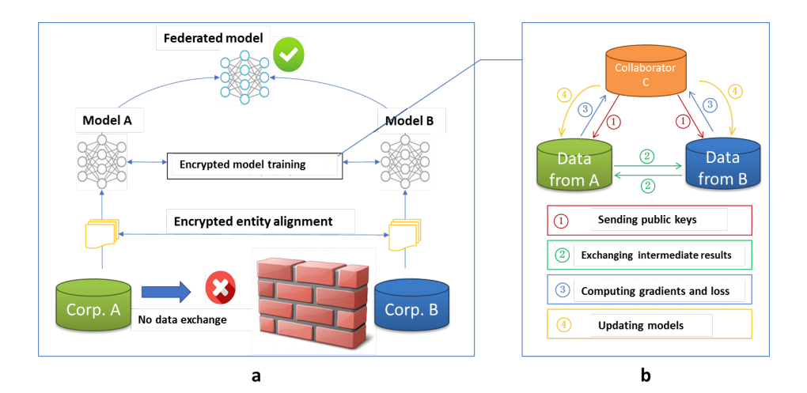
Vertical Federated Learning
Step 1: Collaborator C creates encryption pairs and sends a public key to A and B
Step 2: A and B encrypt and exchange the intermediate results for gradient and loss calculations
Step 3: A and B compute encrypted gradients and add an additional mask, A and B send encrypted values to C
Step 4: C decrypts and send the decrypted gradients and loss back to A and B. A and B unmask the gradients and update the model parameters accordingly

Slide 5
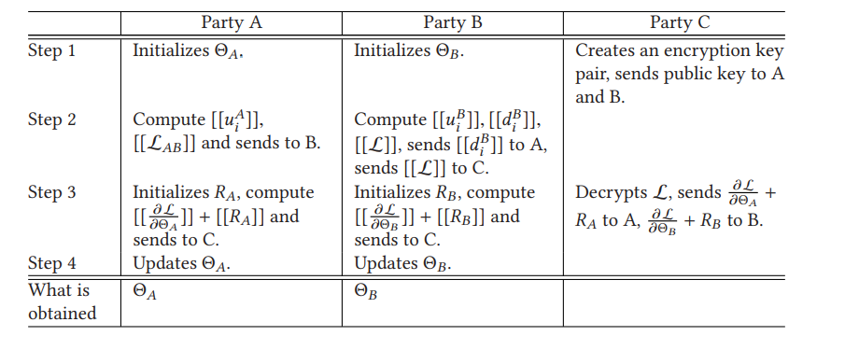
Training Steps for Vertical Federated Learning: Linear Regression

Slide 6
Hybrid Federated and Centralized Learning
Ahmet M. Elbir1 , Sinem Coleri1 and Kumar Vijay Mishra2 1 Department of Electrical and Electronics Engineering, Koc University, Istanbul, Turkey 2 United States CCDC Army Research Laboratory, Adelphi, MD 20783 USA E-mail: ahmetmelbir@gmail.com, scoleri@ku.edu.tr, kumarvijay-mishra@uiowa.edu

Slide 7
Centralized Learning vs Federated Learning vs Hybrid Federated Learning (1/4)
Centralized Learning (CL)
Artificial Neural Network (ANN) is trained at a Parameter Server (PS)
Transmitting the collected data to the PS:
Limitations
Expensive in terms of energy and bandwidth
Delays
Infringements of client privacy
CL-based techniques require huge bandwidths and communications overhead during training

Slide 8
Centralized Learning vs Federated Learning vs Hybrid Federated Learning (2/4)
Federated Learning (FL)
Clients send the model updates (gradients) instead of dataset to collaboratively train the learning model
The collected model updates are aggregated at the PS and then sent back to the clients to further update
Devices with different computational capabilities this requirement cannot be truly fit

Slide 9
Centralized Learning vs Federated Learning vs Hybrid Federated Learning (3/4)
Hybrid Federated Centralized Learning (HFCL)
The devices incapable of sufficient computation power deploy CL while the rest use FL
A client selection algorithms take care collaboration of all the devices
Only the trusted clients or the ones with sufficient computational resources are selected for FL-based training

Slide 10
Centralized Learning vs Federated Learning vs Hybrid Federated Learning (4/4)
The challenge for HFCL is the wait required by the active clients
Sequential dataset transmission (SDT) approach where the passive clients do not send the entire local dataset at once

Slide 11
CL-based training considers a learning model
For the optimization problem, Define D_{k} to be the local dataset of the k-th client so that the whole dataset is D = ⋃_{k∈K} D_{k}, where k = {1, . . . , K}. Denote the input and output tuple Di of the i-th element of the dataset D by Xi and Yi , respectively, such that Di = (Xi , Yi) and D = |D| is the number of input-output pairs.
minimizing the empirical loss F(θ) over the learnable parameters θ
Loss function mean-squared error (MSE)
Loss function J (·) between the label data Y_{i} and the prediction f(X_{i}|θ)

Slide 12
Optimization problem Notation in FL-based training

Slide 13
Iteratively through Gradient Descent (GD)
F(θ) is carried out iteratively through gradient descent (GD). Denote the model parameters at the t-th communication round/iteration as θ_{t}, t = 1, . . . , T, where T denotes the number of iterations to reach the convergence (t+1) iteration

Slide 14
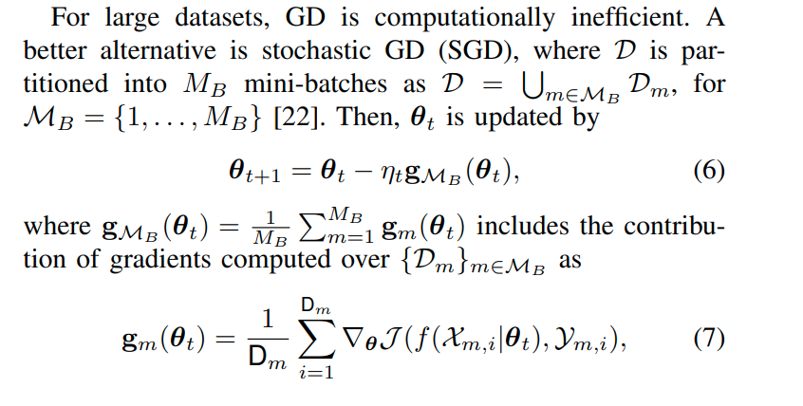
Minibatch for large dataset

Slide 15
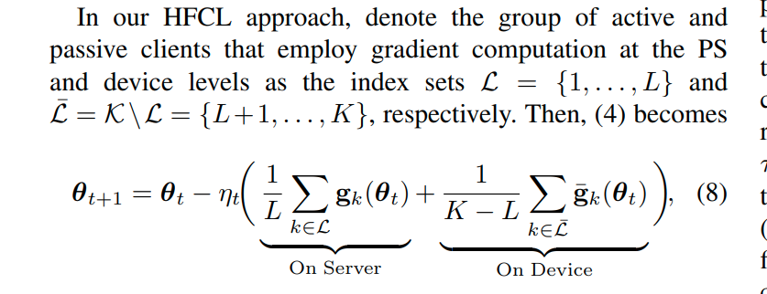
HFCL calculation

Slide 16
Quantization operation
Quantization
noise

Slide 17
Communication Delay During Model Training

Slide 18
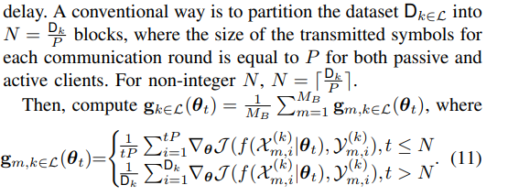
HFCL with Sequential Data Transmission

Slide 19
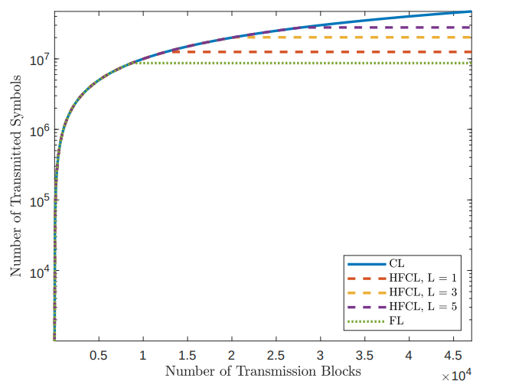
Results - Communication Overhead Comparison
Communication overhead of CL, FL and HFCL for L = {0, 1, 3, 5, 7, 10}.
Training: 1000 data symbols are transmitted at each transmission block
47×103 transmission blocks to complete CL-based training
FL approximately 8.5×103 data blocks (approximately 6 times lower than that of CL)
The communication overhead of HFCL (as well as HFCL-SDT) lies between CL and FL because it depends on the number of passive clients L and approaches to TCL as L → K.

Slide 20
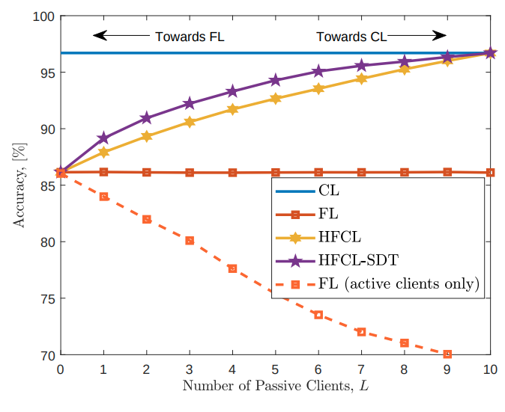
Results- Classification accuracy versus L
classification accuracy with respect to number of passive clients, L when B = 5 quantization bits are used and SNRθ = 20 dB
HFCL and HFCL- SDT perform better than FL for 0 < L < K because the collected gradients from the active clients are corrupted by wireless channel and quantization whose effects reduce as L → K

Slide 21
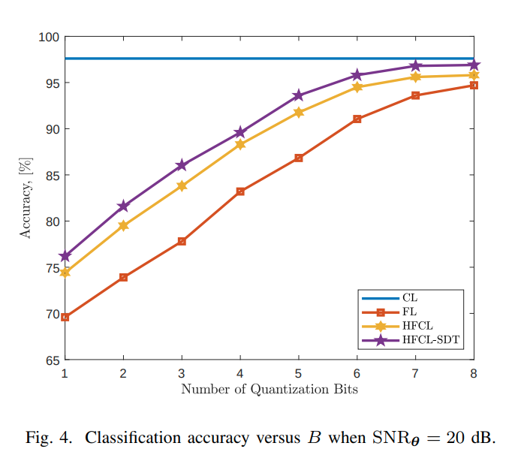
Results- Classification accuracy versus B
For quantization levels
for B ∈ [1, 8] when SNR_{θ} = 20 dB shows that both HFCL approaches perform better than FL and approach to CL as an increase in B improves the resolution of the quantization operation

Slide 22
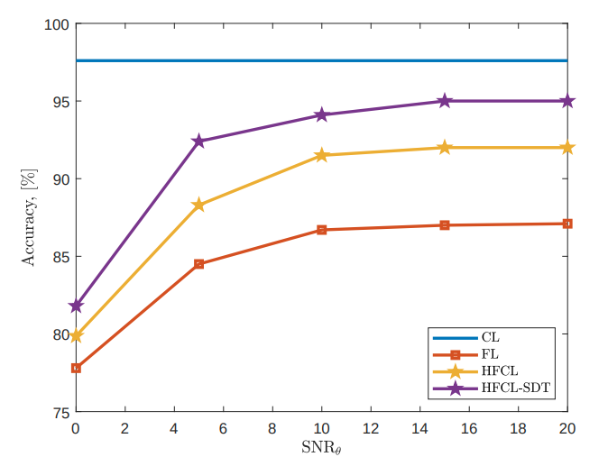
Results- Classification accuracy versus SNR_{θ}
The classification performance with respect to the noise level on the model parameters, i.e., θ and g_{k}(θ) compares the competing algorithms for SNRθ ∈ [0, 20] dB. at least 10 dB noise level is required for reliable model training for all approaches

Slide 23
Conclusions
The proposed approach is helpful if a part of the edge devices lack computational capability for gradient computation during model training
Only active devices with sufficient computational capability perform gradient computation on their local datasets whereas passive devices transmit their local datasets to the PS
The delays arising from the transmission of local datasets during training of the size of the passive clients are large, mitigated by HFCL-SDT

