Slide 1
Human Activity Recognition from Multiple Sensors Data Using Multi-fusion Representations and CNNs
FARZAN MAJEED NOORI, Department of Informatics, University of Oslo, Norway
MICHAEL RIEGLER, Simula Metropolitan Center for Digitalization and Kristiania University College, Norway
MD ZIA UDDIN, Department of Informatics, University of Oslo, Norway
JIM TORRESEN, Department of Informatics and RITMO, University of Oslo, Norway

Slide 2
Index
Introduction
Overview
Methodology
Experiments
Results
Related Works
Conclusions

Slide 3
Human Activity Recognition (HAR)
To identify daily life activities such as sitting, standing, running, walking, and so on.
Scopes
HAR in health monitoring systems
Ambient assisted living
Detecting activities during sports
Surveillance

Slide 4
What is Data Fusion
Data Fusion is the combining of sensory data or data derived from sensory data such that the resulting information is in some sense better when these sources were used individually
Elmenreich, Wilfried. "An introduction to sensor fusion." Vienna University of Technology, Austria 502 (2002): 1-28.

Slide 5
Why Sensors Data Fusion
When the sensor cannot measure all relevant attributes
Single sensor modality to detect human actions is not very robust
Health or activity monitor systems having several sensors can be more useful to discriminate complex activities

Slide 6
Multi-modal Sensor Fusion (1\2)
The combination of how to combine data from multiple (and possible diverse) sensors in order to make inferences about a physical event, activity, or situation
OR
Multiple sensors measuring different aspects to increase reliability and decrease vulnerability

Slide 7
Multi-modal Sensor Fusion (2\2)
Data-level-fusion: raw data from several modalities would be fused before putting into the classifier
Feature-level-fusion: Combined the features of gyroscope and accelerometer to make the system more robust to recognize human activities
Decision-level-fusion: Random Forest classifier was used after extracting classification results form each representation of data

Slide 8
Single sensory data/baseline & Data-level fusion
Single Sensor Data
Pre- Processing
CNN
Output
Multi-sensors
Pre- Processing
Data-Level Fusion
CNN
Output

Slide 9
Feature-level Fusion & Decision-level fusion
CNN 1st
Representation
Multi-sensors\
Multi-
Representations
Pre- Processing
Output
CNN nth
Representation
Feature Level Fusion
Hidden Layers
CNN 1st
Representation
Initial
Classifier
Multi-sensors\
Multi-
Representations
Pre- Processing
Output
CNN nth
Representation
Initial
Classifier
Decision-level
fusion

Slide 10
Methodology (Distance Matrices and Image Representations)
RPs as a tool:
A recurrence of a state at time i at a different time j is marked within a two-dimensional squared matrix with ones and zeros where both axes represent time:
A distance matrix D contains the distance between each pair of points, and used as the first image type representation
second image representation, the data extracted from x, y, and z axes of the accelerometer was stacked to generate the images

Slide 11
Datasets and Metrics
Three datasets:
Wireless Sensor Data Mining (WISDM) versions 1.1 and 2.0
Context-Awareness via Wrist-Worn Motion Sensors (HANDY)

Slide 12
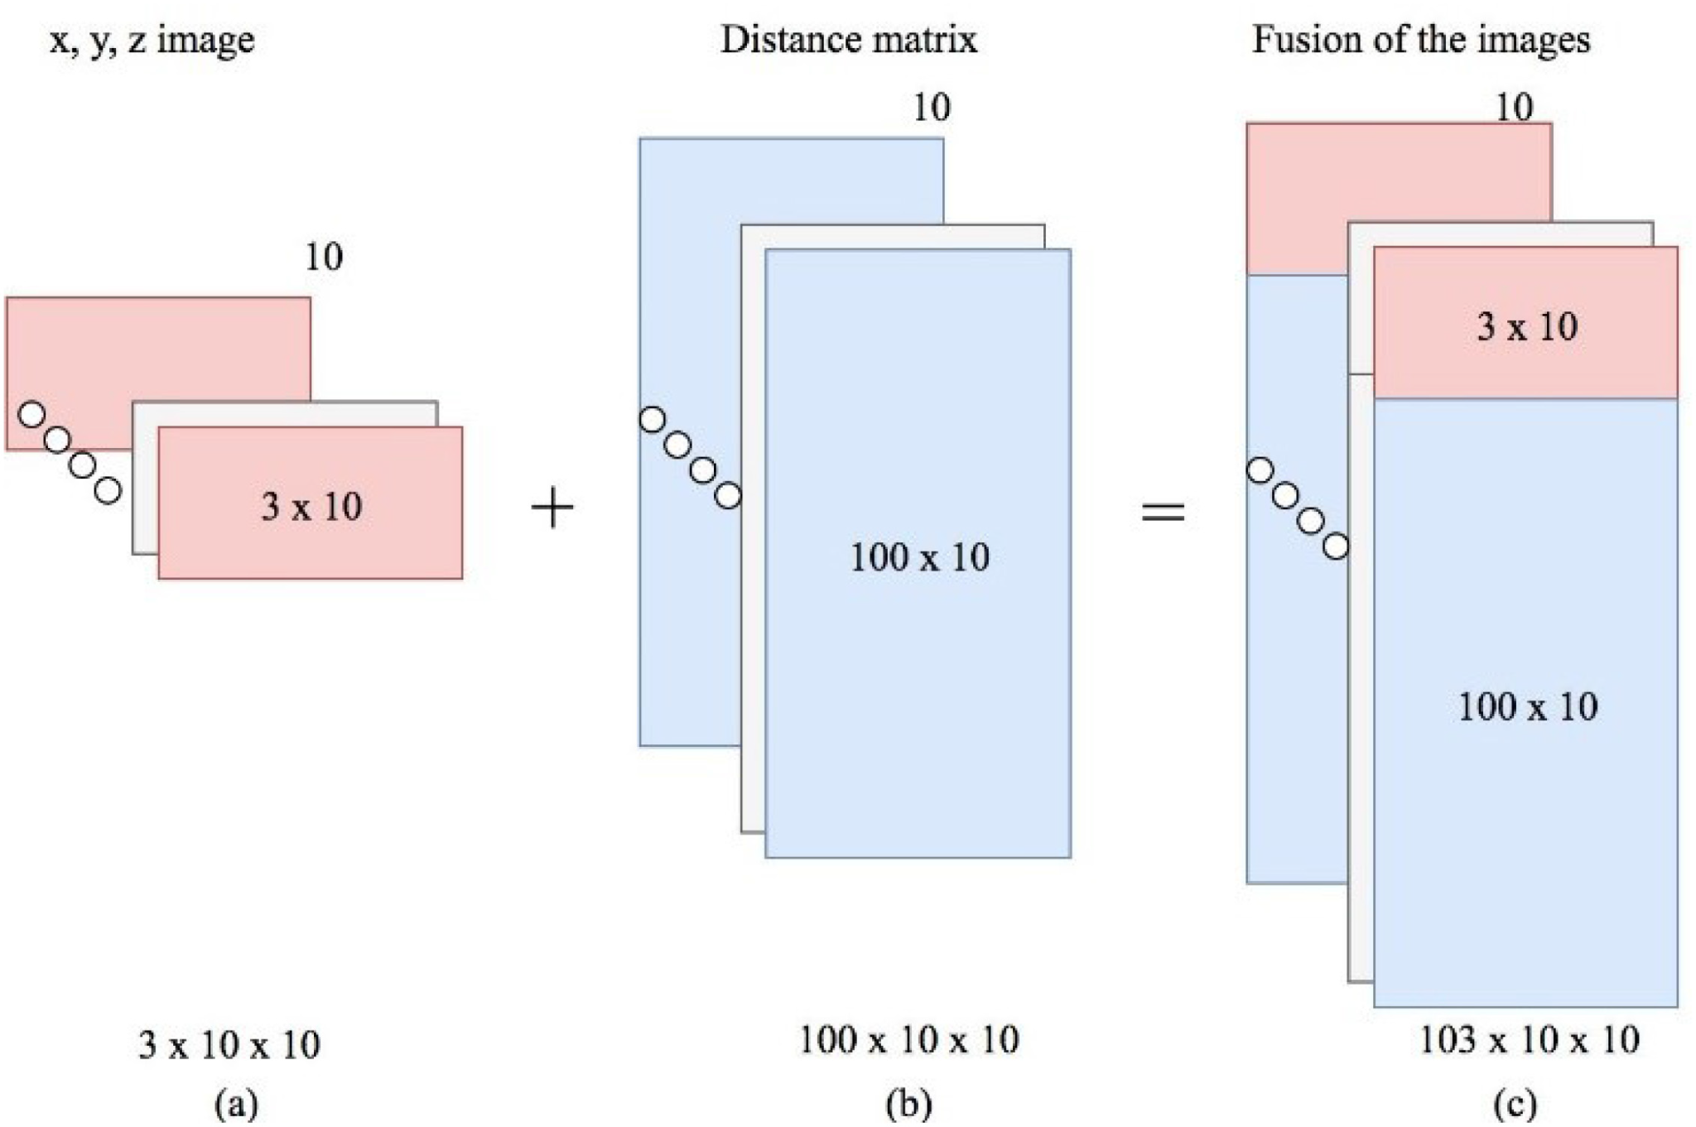
Datasets and Metrics (Data Level Fusion)

Slide 13
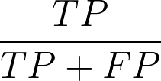
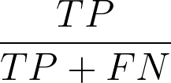
Datasets and Metrics
Measure the performance:
Accuracy=
Precision=
Recall=

Slide 14
Datasets and Metrics (HANDY Dataset Analysis)
Experiments using accelerometer data and magnetometer data for different representations
xyz images of accelerometer and magnetometer data
distance matrices of accelerometer and magnetometer data
xyz images and distance matrices of accelerometer data
xyz images and distance matrices of magnetometer data
Combination of all four representations

Slide 15
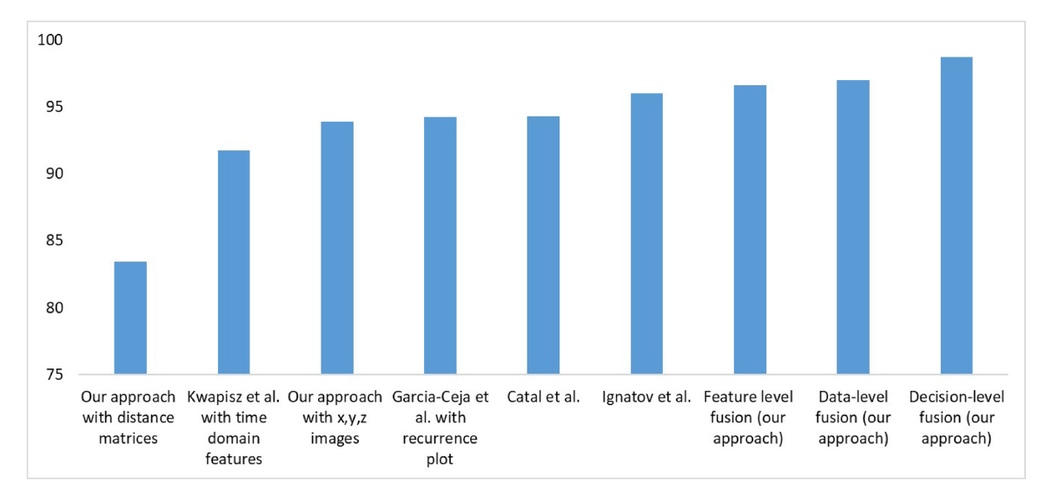
Results (Comparison with previous studies )

Slide 16
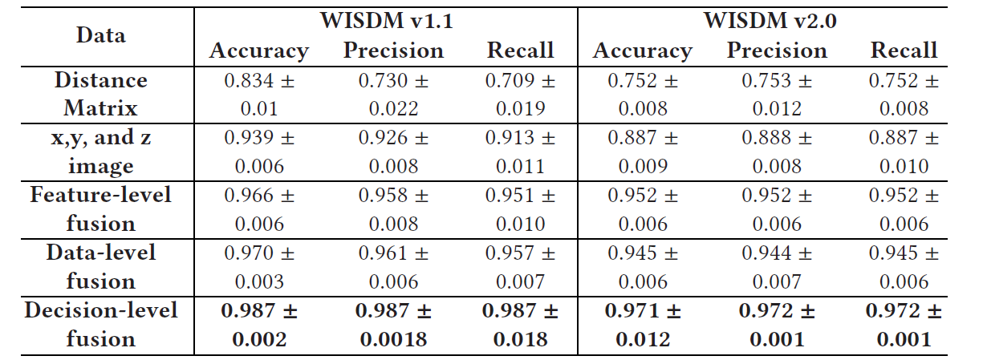
Results (Precision and Recall of All Fusion Approaches for Individual Activities of WISDM Version 1.1 )

Slide 17
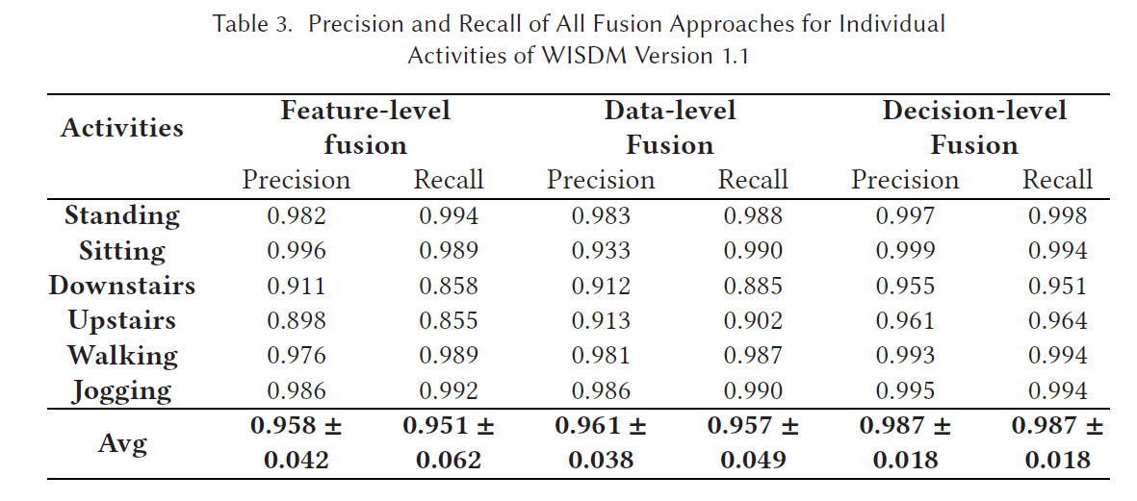
Results (Precision and Recall of All Fusion Approaches for Individual Activities of WISDM Version 1.1 )

Slide 18
Results

Slide 19
Results

Slide 20
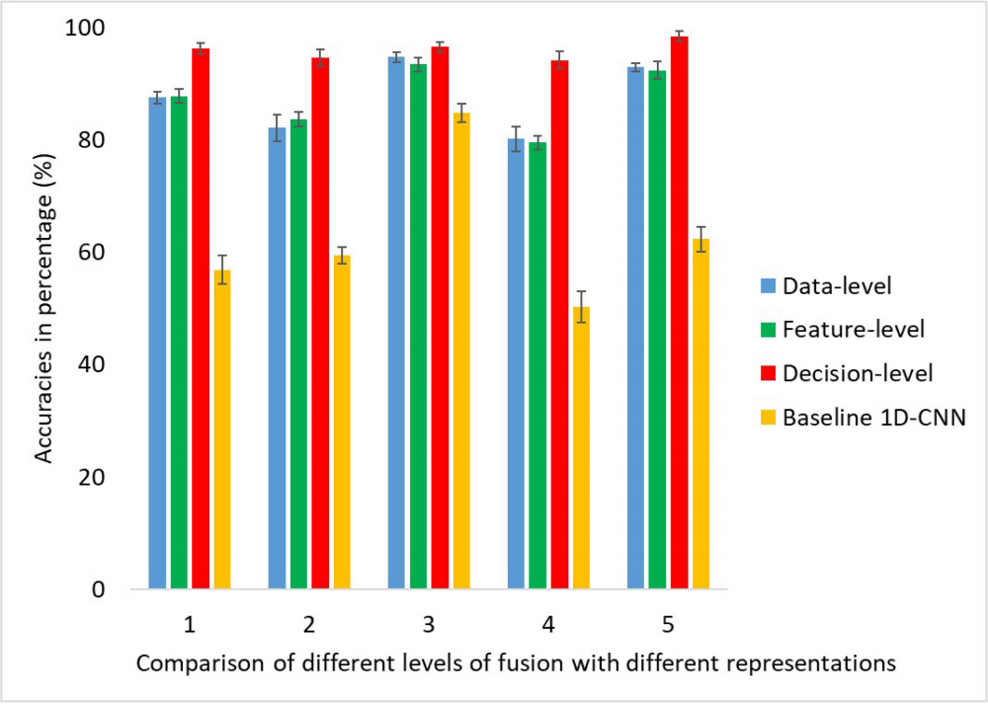
Results

Slide 21
Conclusions
Two Matrix representation present Distance matrix representation, image representation (the raw x,y, and z axes values)
The paper examined three data fusion approach Data level fusion, Feature Level fusion, Decision-level fusion
Three different datasets (collected using smartphones and wristwatches) were used to validate the novelty and performance
Two different representations were fused using data-level-fusion, feature-level-fusion, and decision Level-fusion
Our approach also showed significant results in an uncontrolled environment (i.e., WISDM version 2.0 dataset)

Slide 22
Motivation and
Step 3
Step 2
Step 1

