Slide 1
A Design Space for Privacy Choices: Towards Meaningful Privacy Control in the Internet of Things
Proceedings of the Conference on Human Factors in Computing Systems (CHI). ACM, 2021.
Yuanyuan Feng, Yaxing Yao, and Norman Sadeh

Slide 2
OUTLINE
INTRODUCTION
CONTRIBUTIONS
DEFINE MEANINGFUL PRIVACY CHOICES
PRIVACY CHOICE AS A PROCESS
A DESIGN SPACE FOR PRIVACY CHOICES
USE CASE: A PRIVACY CHOICE PLATFORM FOR THE INTERNET OF THINGS - IoT Assistant(IoTA)
CONCLUSION

Slide 3
INTRODUCTION
Privacy notice
Privacy choices
Privacy notice and choice in real-world systems often fall short in protecting people’s data privacy
Making privacy notice and choices more usable is important
Notes:
“Notice and Choice” has become the de facto model for privacy protection around the world
Privacy notices inform people about existing or potential data collection, use, and sharing practices regarding their personal data
privacy choices provide people actual control over certain aspects of such data practices.

Slide 4
INTRODUCTION
Existing research on designing privacy choices is scattered
Most prior work focused on Web and mobile privacy scenarios, with limited research conducted in the context of the IoT environments
Construct a comprehensive conceptual framework for privacy choices whose applicability extends to IoT contexts
Provide design guidelines to help researchers and practitioners to implement meaningful privacy choices in real-world systems

Slide 5
INTRODUCTION
Analyze how users interact with privacy notices and choices provided by real-world systems
Further examine the design space for privacy choices, organizing it around five dimensions
Present a use case of designing a privacy choice platform for IoT

Slide 6
CONTRIBUTIONS
Their user-centered analysis of privacy choices contributes a conceptual framework that considers privacy choice as a process and articulates its relationship with privacy notices in real-world systems
The constructed design space supports the development of practical design guidelines organized around the different design dimensions they identify

Slide 7
DEFINE MEANINGFUL PRIVACY CHOICES
Effectiveness
Efficiency
User awareness
Comprehensiveness
Neutrality

Slide 8
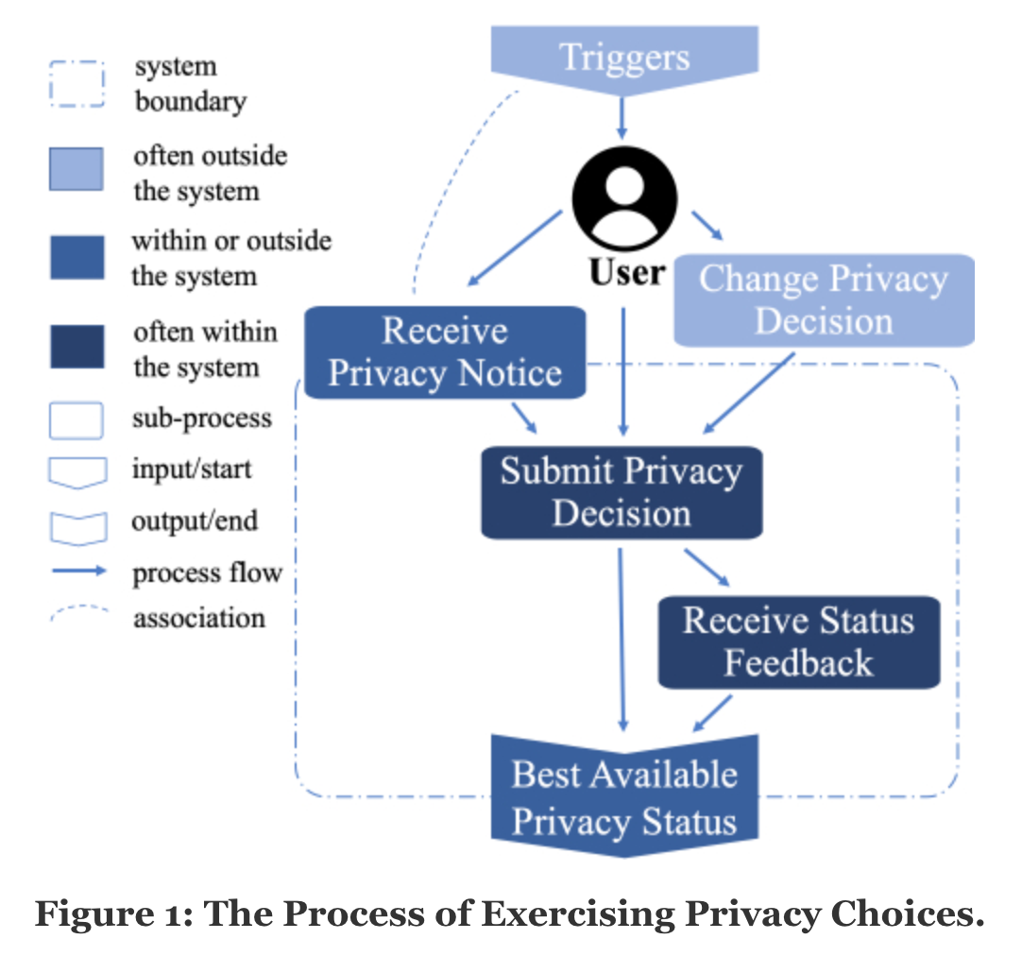
PRIVACY CHOICE AS A PROCESS
The Process of Exercising Privacy Choices

Slide 9
PRIVACY CHOICE AS A PROCESS
The Relationship between Notice and Choice as Experienced by Users
Decoupled
Integrated
Mediated

Slide 10
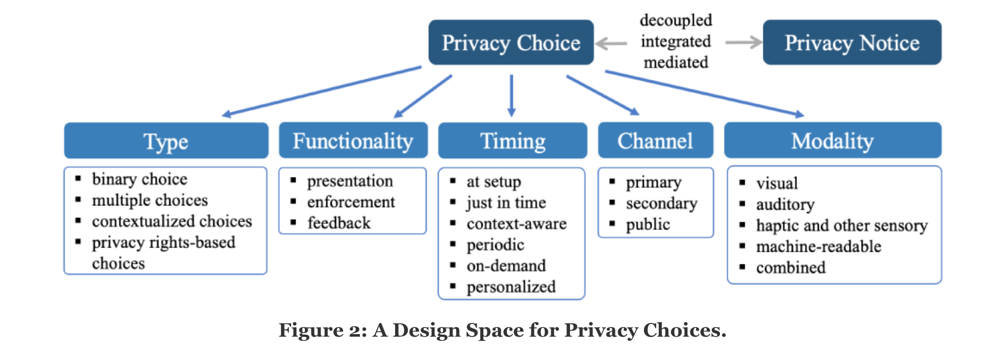
A DESIGN SPACE FOR PRIVACY CHOICES
Design space can help for better understanding the key dimensions to be considered when designing privacy choices
Five dimensions:
Type
Functionality
Timing
Channel
Modality

Slide 11
A DESIGN SPACE FOR PRIVACY CHOICES
Type: What kinds of choices are offered
Type is a unique innate dimension in the design space for privacy choices
Different types of privacy choices in this dimension are often build upon one another

Slide 12
A DESIGN SPACE FOR PRIVACY CHOICES
Type
Binary choice
User have to choose one out of two options
“Notice and consent”
“Opt-in/out”

Slide 13
A DESIGN SPACE FOR PRIVACY CHOICES
Type:
Multiple choices
Provide more than one privacy options to choose from
Sum of binary choices
Non-binary choices

Slide 14
A DESIGN SPACE FOR PRIVACY CHOICES
Type:
Contextualized choices
Contextualized choices is a context-specific privacy choices that are often implemented as a combination of binary and multiple choices in context
It can better align people’s diverse privacy preferences

Slide 15
A DESIGN SPACE FOR PRIVACY CHOICES
Type:
Contextualized choices
Challenges:
The system should support fine-grained contextual attributes
Trade-off between sacrificing certain data privacy and gaining more granular privacy control
Are likely to overwhelm users with countless privacy decisions
software privacy agents could mitigate such user burden

Slide 16
A DESIGN SPACE FOR PRIVACY CHOICES
Type:
Privacy rights-based choices
Privacy rights: access, rectification, erasure, portability, etc.
Often require additional communication between users and systems in the form of various user requests

Slide 17
A DESIGN SPACE FOR PRIVACY CHOICES
Functionality: What capabilities are offered to support the privacy choice process
Three items: Presentation, Enforcement, and Feedback

Slide 18
A DESIGN SPACE FOR PRIVACY CHOICES
Functionality
Presentation (of privacy choices)
A system must present available privacy choices to users
May contain multiple components, which are often integrated with related privacy notices
Other dimensions should be thoroughly considered to decide how to effectively present privacy choices to users

Slide 19
A DESIGN SPACE FOR PRIVACY CHOICES
Functionality
Enforcement (of users’ privacy decisions)
Includes several sub functions:
Authentication
Fully automated or mediated by humans
Record any changes to users’ privacy decisions and enforce them in a timely manner

Slide 20
A DESIGN SPACE FOR PRIVACY CHOICES
Functionality
Feedback (of privacy choice status)
It is crucial for the system to provide accurate feedback in accordance with user actions
Provides timely feedback indicating users’ privacy settings have been adjusted based on their most recent actions
Provides the current status of the request and update the user with new statuses

Slide 21
A DESIGN SPACE FOR PRIVACY CHOICES
Timing: When the choice is provided
Impacts the effectiveness of privacy notice
Affects how users engage in privacy decision making
To choose appropriate timing, lots of contextual factors should be considered

Slide 22
A DESIGN SPACE FOR PRIVACY CHOICES
Timing
At setup (often integrated)
Privacy choices be provided when the user interacts with the system for the first time
Two potential benefits:
User review privacy notices and make privacy choices regarding the system before using it
System can front-load obtaining user consent to meet applicable legal requirements
Has similar drawbacks with “notice and consent”

Slide 23
A DESIGN SPACE FOR PRIVACY CHOICES
Timing
Just-in-time (often integrated)
When the specific data practice is about to happen
“ask on first use” (AOFU) model
Allows users to make privacy decisions in the actual context
Interruption to the user's task at hand and potential privacy fatigue

Slide 24
A DESIGN SPACE FOR PRIVACY CHOICES
Timing
Context-aware (often integrated)
Use the specific temporal, spatial, or social context that the user is in to determine the timing of privacy choices
More relevant to the user's situation
Difficult to detect relevant contexts

Slide 25
A DESIGN SPACE FOR PRIVACY CHOICES
Timing
Periodic (integrated or decoupled)
When a system's data practices change, or when users change minds about previous privacy decisions
Can also be delivered periodically according to other criteria
Privacy choices can be integrated with or decoupled from privacy notices
May increase user burden
Users should have a say in the frequency of periodic privacy choices

Slide 26
A DESIGN SPACE FOR PRIVACY CHOICES
Timing
On Demand (integrated or decoupled)
People's privacy decisions can be affected by triggers outside the system
Privacy choices can be integrated with or decoupled from privacy notice depending on the user's actual interactions with notice and choice
Users should be able to easily locate available privacy choices

Slide 27
A DESIGN SPACE FOR PRIVACY CHOICES
Timing
Personalized (integrated, decoupled, or mediated)
Allow users to choose the preferred timing for privacy choices or more sophisticated context-aware solutions
Introduces a higher user burden
privacy choices can be integrated with or decoupled from privacy notices
Supports the mediated relationship

Slide 28
A DESIGN SPACE FOR PRIVACY CHOICES
Channel: How the choice and user's privacy decision of the choice are communicated
Privacy choices must consider channels for two-way communication between systems and users
Systems may choose the most appropriate channel or leverage multiple channels

Slide 29
A DESIGN SPACE FOR PRIVACY CHOICES
Channel
Primary
The same platform or device the user interacts with the system
Usually preferred for privacy choices between systems and users
Are limited in the IoT context

Slide 30
A DESIGN SPACE FOR PRIVACY CHOICES
Channel
Secondary
When systems are limited in their primary channels
Amazon Echo smart speakers
Websites and mobile apps are suitable for privacy choices in the IoT context

Slide 31
A DESIGN SPACE FOR PRIVACY CHOICES
Channel
Public
Physical signage
Point users to available privacy choices delivered through other channels
Fill the privacy gap when the data subjects are not the users of the system
Require support from other channels due to the limited size
Efficiently communicate users’ privacy decisions to systems with low user burden

Slide 32
A DESIGN SPACE FOR PRIVACY CHOICES
Modality: What interaction modes are used to deliver the choice and record user's privacy decision of the choice
Different modalities can be leveraged to facilitate the two-way communication of privacy choices between systems and users
It is ideal to use multiple modalities to support different functionalities

Slide 33
A DESIGN SPACE FOR PRIVACY CHOICES
Modality
Visual
Often in the form of text, images, icons, signage, or a combination among the rest
Text-based
Image-based and icon-based
Visual methods can also be used to communicate users’ privacy decisions back to the system

Slide 34
A DESIGN SPACE FOR PRIVACY CHOICES
Modality
Auditory
Provides an accessible option for the blind and visually impaired community
Serve as alerts or reminders
Use sounds that are familiar to users or widely accepted
Auditory privacy choices are promising in the IoT context

Slide 35
A DESIGN SPACE FOR PRIVACY CHOICES
Modality
Haptic and Other Sensory
Highly abstract and difficult to convey a large volume of information
Be used in addition to other modalities
A textual user guide is often needed to define what a particular gesture or body motion means

Slide 36
A DESIGN SPACE FOR PRIVACY CHOICES
Modality
Machine-readable
System's data practices and available privacy choices are encoded in a machine-readable format
The foundation for software agents that help reduce users’ privacy management burden
Machine-readable format is the premise for the mediated relationship between notice and choice
Machine-readable modality coupled with privacy agents may be appealing in IoT context

Slide 37
A DESIGN SPACE FOR PRIVACY CHOICES
Modality
Combined
Systems can leverage multiple modalities to provide meaningful privacy choices
Provide users with more smooth, less burdensome experiences

Slide 38
USE CASE: A PRIVACY CHOICE PLATFORM FOR THE INTERNET OF THINGS - IoT Assistant(IoTA)
Towards Meaningful Privacy Control in IoT
Most of the providers of IoT applications and services have limited resources to develop full-fledged privacy choice components
They aim to build a privacy choice platform for deployed IoT systems to support meaningful privacy control in IoT

Slide 39
USE CASE: A PRIVACY CHOICE PLATFORM FOR THE INTERNET OF THINGS - IoT Assistant(IoTA)
Towards Meaningful Privacy Control in IoT
Privacy infrastructure provides a mechanism for stakeholders of IoT to register deployed IoT systems.
Stakeholders can easily describe an IoT system's information in a machine-readable format
IoTA communicates with the privacy infrastructure and delivers available notices and choices of these registered IoT systems to users.

Slide 40
USE CASE: A PRIVACY CHOICE PLATFORM FOR THE INTERNET OF THINGS - IoT Assistant(IoTA)
Requirements, Advantages, and Constraints
Requirements
To help stakeholders navigate and potentially achieve compliance with new data privacy regulations
To support users in exercising their privacy choices through the different paths shown in Figure 1
To integrate with various IoT systems to deliver their available privacy choices to the platform users and communicate users’ privacy decisions back to the IoT systems

Slide 41
USE CASE: A PRIVACY CHOICE PLATFORM FOR THE INTERNET OF THINGS - IoT Assistant(IoTA)
Requirements, Advantages, and Constraints
Advantages
Have access to the growing amount of structured information about deployed IoT systems
The privacy infrastructure helps the platform handle the two-way communication

Slide 42
USE CASE: A PRIVACY CHOICE PLATFORM FOR THE INTERNET OF THINGS - IoT Assistant(IoTA)
Requirements, Advantages, and Constraints
Constraints
The platform relies on the information provided by stakeholders of IoT systems
The privacy choices available to users on the platform are managed and enforced by stakeholders of the IoT systems
They are constrained by their resources to implement advanced functionality

Slide 43
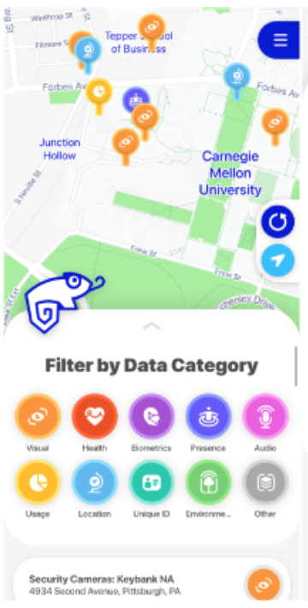
USE CASE: A PRIVACY CHOICE PLATFORM FOR THE INTERNET OF THINGS - IoT Assistant(IoTA)
Design Decisions for the IoT Assistant
High-level Design Decisions
A location-aware mobile app with a map-based main interface

Slide 44
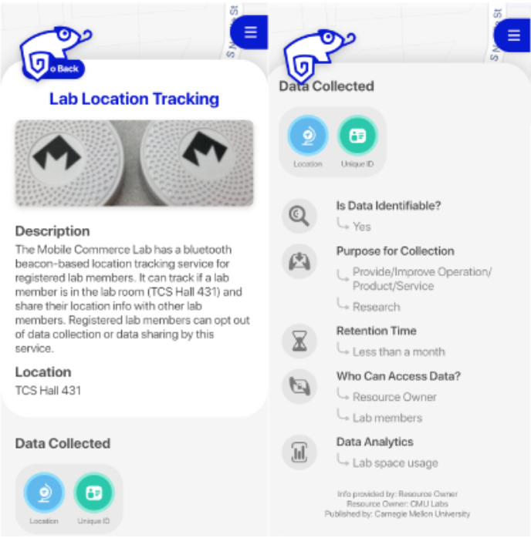
USE CASE: A PRIVACY CHOICE PLATFORM FOR THE INTERNET OF THINGS - IoT Assistant(IoTA)
Design Decisions for the IoT Assistant
High-level Design Decisions
Rely on the privacy infrastructure for IoT
Implement integrated notice and choice

Slide 45
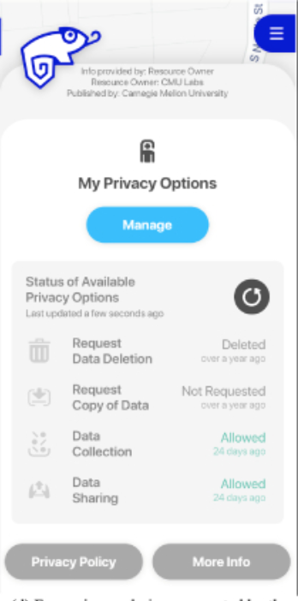
USE CASE: A PRIVACY CHOICE PLATFORM FOR THE INTERNET OF THINGS - IoT Assistant(IoTA)
Design Decisions for the IoT Assistant
Detailed Design Decisions by Dimension
Type: multiple choices and privacy rights-based choices
Multiple choices: data collection and data sharing
Privacy rights-based choices: request copy of data and request data deletion

Slide 46
USE CASE: A PRIVACY CHOICE PLATFORM FOR THE INTERNET OF THINGS - IoT Assistant(IoTA)
Design Decisions for the IoT Assistant
Detailed Design Decisions
Functionality: presentation and feedback
Presentation: IoTA presents available privacy choices of an IoT system to users in a machine-readable format along with a concise privacy notice
Feedback: IoTA can fetche the latest status from the IoT system to provide users timely feedback

Slide 47
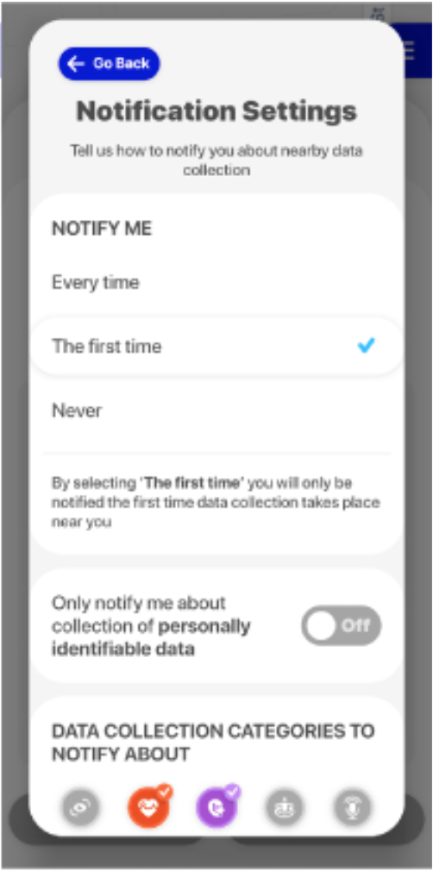
USE CASE: A PRIVACY CHOICE PLATFORM FOR THE INTERNET OF THINGS - IoT Assistant(IoTA)
Design Decisions for the IoT Assistant
Detailed Design Decisions
Timing: context-aware, personalized, and on demand
Context-aware and personalized: Choice via notifications on their mobile devices
On demand: Users can configure any available privacy options on demand for IoT systems remotely

Slide 48
USE CASE: A PRIVACY CHOICE PLATFORM FOR THE INTERNET OF THINGS - IoT Assistant(IoTA)
Design Decisions for the IoT Assistant
Detailed Design Decisions
Channel: Secondary and Public
Secondary: IoTA is a secondary channel for deployed IoT systems
Public: implemented the initial QR code functionality for easy discovery of individual IoT systems

Slide 49
USE CASE: A PRIVACY CHOICE PLATFORM FOR THE INTERNET OF THINGS - IoT Assistant(IoTA)
Design Decisions for the IoT Assistant
Detailed Design Decisions
Modality: Combined
Interface level: text, icons
Notifications level: Users can customize the notifications on their mobile devices to be haptic or auditory
Technical level: The privacy choices provided by the IoTA are machine-readable format in nature

Slide 50
USE CASE: A PRIVACY CHOICE PLATFORM FOR THE INTERNET OF THINGS - IoT Assistant(IoTA)
Evaluation
Five facets of “meaningful privacy choices”:
Effectiveness
Efficiently
user awareness
Comprehensive
neutral

Slide 51
CONCLUSION
Constructed a comprehensive design space for privacy choices
Presented a use case of how to navigate the design space to design a privacy choice platform for IoT
Their constructed design space contributes a user-centered conceptual framework
Offering a taxonomy to understand meaningful privacy control, particularly in the IoT context
The design space for privacy choices provides practitioners comprehensive design guidelines

