Slide 1
End-to-end congestion control approaches for high throughput and low delay in 4G/5G cellular networks

Slide 2
Introduction
5G Cellular Networks
Enhanced Mobile Broadband (eMBB)
3D and Ultra High Definition (UHD) videos
Cloud Gaming
Augmented Reality
Ultra Reliable and Low Latency Communications (URLLC)
Self-driving Cars
Industrial Automation
Massive Machine-type Communications (mMTC)
Sensor Networks
Smart City
Home Applications

Slide 3
Introduction
Common congestion control algorithms (CCAs)
Packet loss as a congestion signal
Queuing delay (bufferbloat)
New cellular CCAs are developed under two main assumption:
Content moving closer to the cellular access link
reduce the cost of transferring across expensive long-haul links (WANs)
make the radio link become the bottleneck
Reduced cross-traffic effect due to per-user queues
Place different users flows in separate queues

Slide 4
Related Work

Slide 5
The potential impact of 4G/5G technologies and use cases on congestion control
Link adaptation
An evolved Node B (eNodeB) selects the modulation and coding scheme to be used in the communication based on the reported signal quality
mmWave
Higher data rates
High propagation loss
Easily affected by blocking entities
Small cells
Increase capacity
Increase the scale and number of load variations
Increase the handovers and state reconfigurations frequency

Slide 6
The potential impact of 4G/5G technologies and use cases on congestion control
MIMO (Multiple Input Multiple Output)
Enable multiple antenna transmissions
Higher data rates and/or better transmission reliability
Carrier aggregation
Use multiple carriers simultaneously to obtain a larger bandwidth for transmission
Primary component carrier (PCC) - only changed during handovers
Secondary component carriers (SCC)

Slide 7
The potential impact of 4G/5G technologies and use cases on congestion control
Dual connectivity (DC)
Connect to two access networks at the same time
Higher peak data rate
High fluctuations in data rate
Dynamic network slicing and resource allocation
Network slicing - divide the physical network infrastructure into multiple separate logical network entities
Dynamic resource allocation
Converged heterogeneous services
Could add extra delay

Slide 8
Conventional end-to-end congestion control in current cellular networks
End-to-end congestion control in the Internet
In transport layer – TCP, QUIC, SCTP
Outside transport layer - Real time media streaming (on UDP)
Loss or delay for detecting congestion
Additive increase multiplicative degrease (AIMD)
Slow-start
Start from an initial value and double the congestion window (CWND) every round-trip time (RTT) until its threshold (ssthresh) is reached or a packet loss is experienced
Congestion avoidance
TCP NewReno : sets the ssthresh to half the latest CWND and update the CWND to the ssthresh value
TCP CUBIC : records the current CWND as the maximum window size(Wmax), then decreases its CWND to a value determined by a multiplicative decrease factor

Slide 9
Conventional end-to-end congestion control in current cellular networks
Congestion control issues and in-network solutions in cellular networks
Network access layer issues and solutions
Non-congestion packet loss
Radio link control (RLC) and medium access control (MAC)
Hide the random packet losses from the data sender
Internet layer issues and solutions
The large buffers delay the detection of congestion at the end nodes
Active queue management (AQM)
Multi-layer solutions
Performance enhancing proxies (PEPs)

Slide 10
Challenges in designing new end-to-end CCAs for cellular networks
Avoiding underutilization in an environment with high bandwidth variability.
Achieving full utilization without creating large queueing delays in the large buffers provided to improve the utilization of the highly variable capacity by popular loss-based CCAs.
Being able to differentiate between delay variations caused by traffic competition and delay variations caused by radio channel events, e.g., interference, multi-path fading, etc.

Slide 11
Challenges in designing new end-to-end CCAs for cellular networks
Tracking the highly variable bandwidth
probing
Avoiding large queueing delay
Large buffers
Insensitivity to non-queuing delay variability
Wrong congestion decision

Slide 12
Classification of CCAs for cellular access

Slide 13
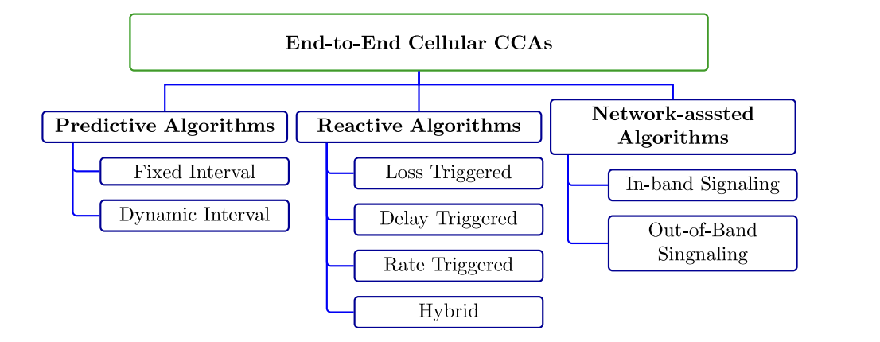
Classification of CCAs for cellular access
Reactive algorithms
Predictive algorithms
Network-assisted algorithms

Slide 14
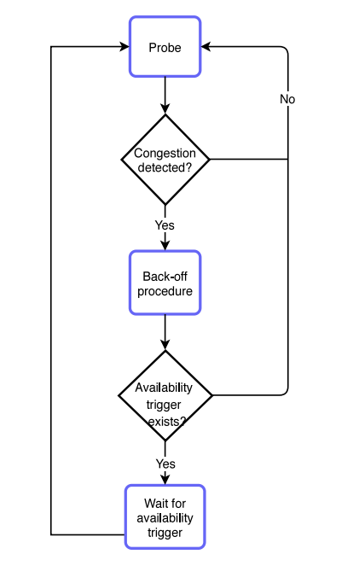
Reactive algorithms

Slide 15
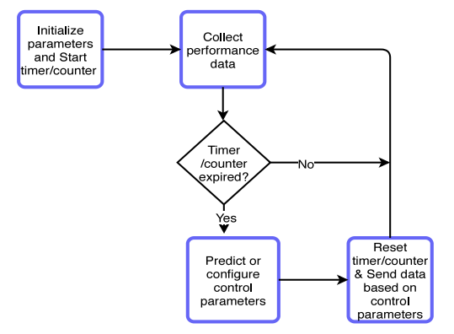
Predictive algorithms

Slide 16
Network-assisted algorithms

Slide 17
Deployment factors
Downlink/uplink asymmetry
Specificity of design
Required modifications
TCP friendliness
Performance tradeoff
Cross-layer dependency

Slide 18
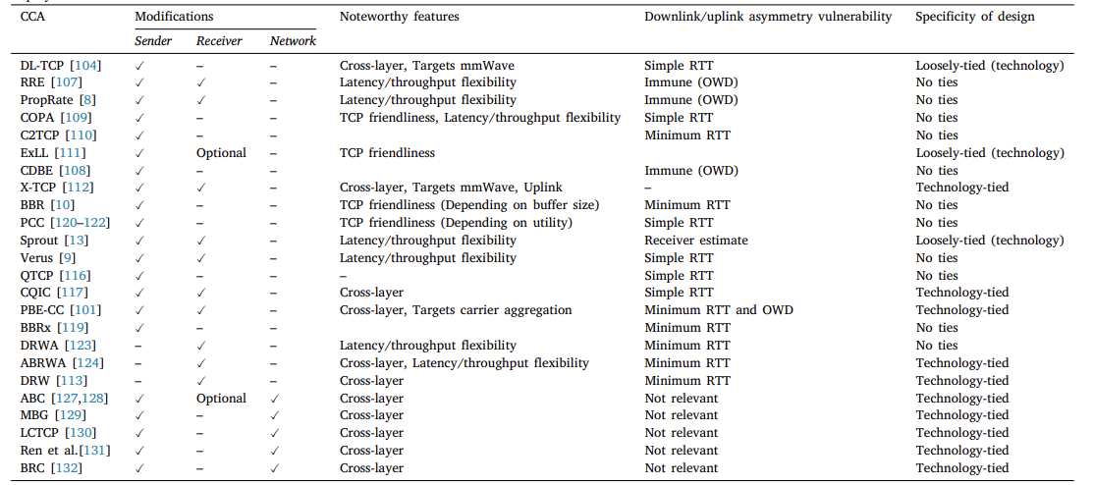

Slide 19
Opportunities and outstanding issues
Integration and interaction with SDN/NFV
Leveraging edge/fog computing and ICN
High utilization as the peak rate and variability increases
Improving fairness between flows
Applying multi-domain congestion control
Minimizing flow interactions
Evaluating CCAs through independent testing and benchmarking

Slide 20
Summary and conclusions
Focus on transport-layer, end-to-end algorithms
Three broad groups of CCAs
Future works

