Slide 1
CUCKOOGUARD: A Memory-Efficient SYN Flood Defense Architecture for SmartNICs
Presentation for Master’s Thesis Defense by
Tristan Döring
Wednesday 11th June, 2025
Notes:
welcome to the presentation…

Slide 2
Motivation – DDoS Attacks
Common Cyberthreat: DDoS (Distributed Denial of Service) attacks
Taiwan ranks #3 as attack target worldwide
2022 Nancy Pelocy visits Taiwan -> Ministry of Foreign Affairs website received over 8.5 million access requests within one minute
➥ Denial of Service: server overloaded - website goes offline
DDoS Attacks
  Target governments
  Target companies
  Are expensive (e.g. 300,000 USD/ hour)
Notes:
I think everybody is familiar with the term DDoS attacks, it mean distributed denial of service attacks, and it’s the type of attack we talk about today and its one of the most detrimental attacks that server operators want to defend themselves from. so here I want to establish why I think they are relevant, especially in Taiwan. Taiwan ranks as number 3 target worldwide, attacker can be state-actors, criminal groups or competitors. e.g. could be competitors in the semiconductor industry. A special event that happened just recently was the state visit of nancy pelocyy from the USA and as a response to her visit a load of ddos attack was launched, e.g. the website of the MOFA was attak with over 8.5 millioon acces requests within one miiniute. this of course overloaded the webserver and rendered the website unusable for users. hence a denial of service. This example doesnt directly cause damage besides reputational damage. but e.g. for companies whose services are targeted one figure that comes up is taht each hour of denied service costs the company 300,000 USD. So obviously there are many reasons wanting to build networks that are resilient to these kind of attacks.

Slide 3
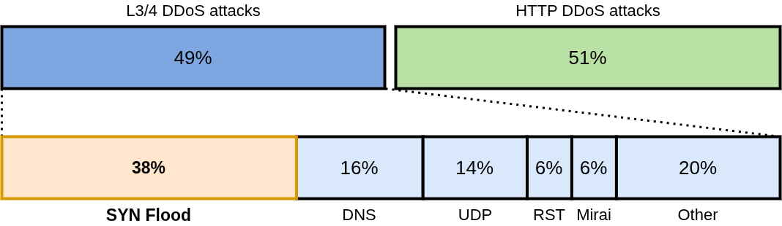
Motivation – SYN Flood Attacks
SYN Floods are the most common network layer attack in 2024
(based on statistics collected by Cloudflare, a major network security company)
Notes:
In particular we are going to tak about SYN Flood attacks today which are a specific type of DDoS attack. According to cloudflare SYN Flood attacks consistently rank as the most common attack at a network protocol level with 38% of all of thse attacks, see the figure.

Slide 4
Goal
Develop an effective SYN Flood Defense
What does “effective” mean?
cheap
successful protection
fast
Notes:
So the main goal of the thesis is do develop an effective SYN Flood Defense
But, what exactly does effective mean? Before we are able to develop the defense we have to clarify that.

Slide 5
Agenda
High-Performance Network Functions deployed in modern datacenters
General SYN Flood Defense Architecture Requirements
How to protect against SYN Floods
  Technical Background
  Related Work
The CUCKOOGUARD Architecture
  Overview
  Cuckoo Filters for flow filtering
CUCKOOGUARD Experimental Evalutation
Conclusion
Future Work
Notes:
This is the overview over what I will cover in this talk
First, we will have a look on how high-performing network functions are deployed in modern data centers, once we know that we can define the requirements for the SYN Flood Defense Architecture
having the requirement we take a deep-dive into how the different methods on how one can protect servers from SYN Floods
After that I will explain my CUCKOOGUARD architecture which utilizes the most effective approach
I will show some experimental results of the implementation and round of the talk with a conclusion and future work

Slide 6
Main Contributions
Improved CPU Offload: Decreasing server-side CPU overhead by 79% and more
A Novel Memory-Efficient and Precise TCP-Connection Tracking Scheme using Cuckoo filters

Slide 7
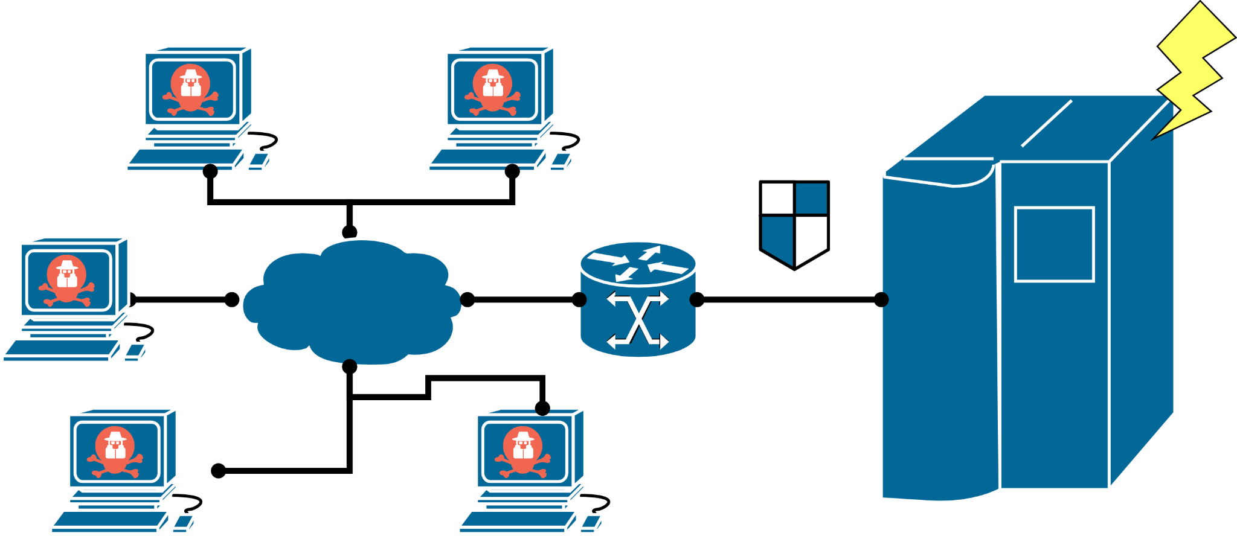
Background – Network View
SYN Flood Defense
Internet
Notes:
the goal is to develop a syn flood defense. and here you an roughly see where it would be located in a rough network topology. on the left side you have a distributed set of attackers which send their attacks through the internet to the server, so we need some kind of defense which shield the server from such attacks. before the attack can reach the server.

Slide 8
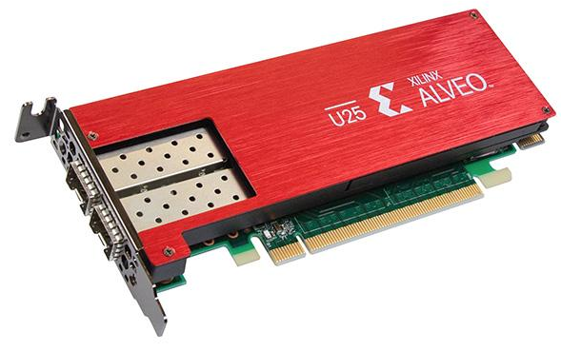
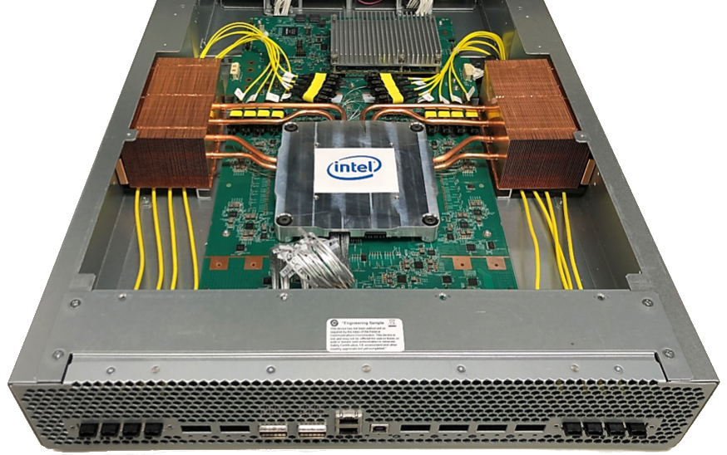



Background – Hardware Accelerated Network Functions
Programmable Hardware
Programming Paradigms (discussed later)
SmartNICs
Programmable Switches
Notes:
in order to deploy network functions there are several options, one can run them in software on a server. But in this thesis we will focus on hardware deployment of network functions. This means we will cover programmable hardware devices that allow for high performance. There are two classes which are viable for us
the SmartNIC which is basically an extension card for a server with specialized network processing capabilities much like a GPU
the other type is Programmable Switches, they are deployed in the center of a network much like a switch is. However we are going to focus on SmartNICs today.

Slide 9
Background – FPGA-based SmartNICs
Advantages (compared to software):
Line-rate performance (e.g. 25 Gbit/s)
Low latency
Full programmability
Often include hardware accelerations
Limitations:
Limited on-chip memory (e.g. ~8.8 MB)
On-board RAM is too slow for line-rate per-packet access
Multiple network functions must share resources
E.g. XILINX Alveo U25 SmartNIC
Notes:
In particular I’ve chosen FPGA-based SmartNICs as the main deployment target for my architecture since they offer the most suitable characteristics for network functions such as SYN Flood Defense.
As you can see they look basically like a GPU with PCIe, with the difference of having network interfaces.
They offewr line-rate performance, low latency all while offering full programmabilitity and in general they have high computational capabilities which means we can run complex algorithms at line-rate speeds.
However there are some limitations we have to consider if we want to take full advantage of these SmartNICs. Their on-chip memory is limited to only a couply of Megabytes. Here this Alveo U25 only has 8.8 MB of on-chip memory, it also implements RAM, but as RAM access is in general too slow for our purposes today, where we need memory access for every network packet processed we can ignore it completely.

Slide 10
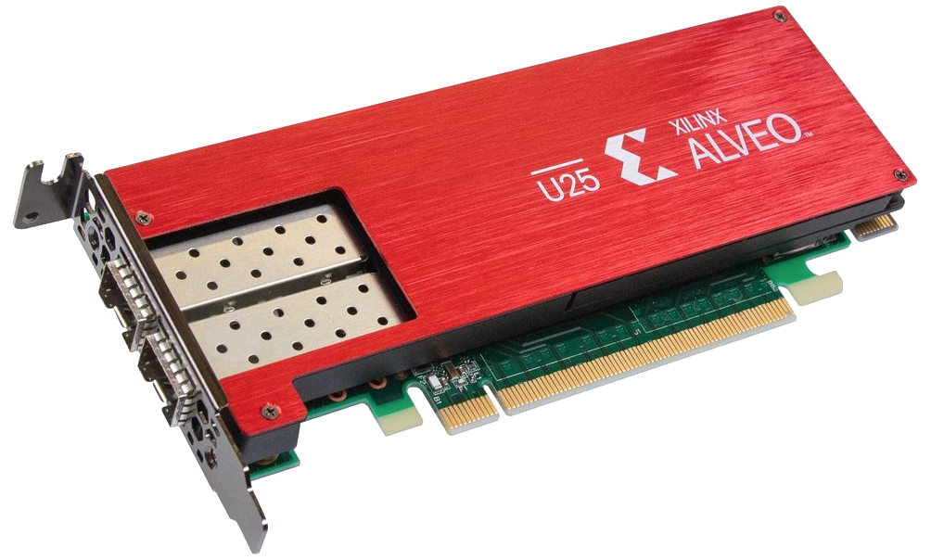
CUCKOOGUARD Architecture Requirements
Requirements
SYN Flood Defense
R1 –
MEM
R2 –
LAT
Internet
R3 –
THR
R4 –
TRP
R5 –
OFF
R2 — Low Latency (LAT)
R3 — High Throughput (THR)
R4 — Transparency (TRP)
R5 — Server Offloading (OFF)
R1 — Low Memory Consumption (MEM)
Notes:
So here we have our network view again, but this time we have our SmartNIC here.
Now based what we know about SmartNICs and general knowledge about network functions we can derive a set of requirements that we later need our architecture to fulfill
Say that I derived these requirements myself from related work and my own literature review
The first is low memory consumptions which is of course linked to the rather low memory available on the SmartNIC
The second requirement is low latency, a typical requirement for network functions, since low ping is always desirable.
The third is high throughput, also logical since we want to operate our server at full speed even though we are using a SYN Flood Defense
The fourth one is also intuitive, we want to operate our SYN flood defense in a way that it doesn’t require any other systems to change for it, it should be completely transparent.
The last one is a bit more specific to how SYN Flood defense works and will become more clear throughput the talk. We want to reduce/ remove any kind of extra load that a SYN Flood attack would induce into our server

Slide 11
CUCKOOGUARD Architecture Requirements
R1 — Low Memory Consumption (MEM)
R2 — Low Latency (LAT)
R3 — High Throughput (THR)
R4 — Transparency (TRP)
R5 — Server Offloading (OFF)
R6 — High Churn Tolerance (CHN)
R7 — Connection Stability and Long-Term Robustness (STA)
Notes:
Here we have all of them summarized, you can see I excluded some of them for this talk, but you can read about it in the thesis.

Slide 12

TCP Handshake Basics
Client
Server
SYN
seq=x, ack=0
SYN/ACK
needs to remember half-open connection
seq=c, ack=x+1
ACK
seq=x+1, ack=c+1
Notes:
Now that we know what the general requirements are for our SYN Flood defense we must dive deeper into the theory on how exactly we can avoid them, for this we need to first understand how exactly SYN Flood attacks exploit the TCP handshake mechanisms as it is running on servers
the figure basically represents how e.g. our Linux kernel operates under normal operation

Slide 13
SYN Flood Attack Surface
Multiple Clients
Server
SYN
seq=x, ack=0
SYN
we need protection
seq=y, ack=0
SYN
seq=z, ack=0
SYN
seq=q, ack=0
memory exhaustion⚡
Notes:
now we’ve seen how it usually works, but what happens under an attack scenario?
we can see that our kernel is quite naive and will save information for every incoming SYN packet, and of course if we get millions of them eventually we will run out of memory

Slide 14
SYN Flood Protection in Programmable Data Planes
3 Architectural Approaches
Machine Learning
Computationally expensive
Slow reaction time
Classification errors
Rule-based
Rigid assumptions
High-memory overheads
Arbitrary thresholds
Limited scalability
SYN-Cookies
Precise
Scalable
Preserve memory
Protocol transparent
Notes:
In research several solutions to this problem were discussed, they can generally be categorized into three architectural approaches
Machine Learning:
for this we typically train a ML model on a set of packets
now the ML model for example derives some signatures/ rules which filter out attack packets
these are installed in some packet filter e.g.
Problems:
computationally expensive because we ideally need to run that ML model frequently to keep it up to date
depending on the implementation the reaction time is slow, as these systems need to react to changes in traffic analyze it in batches and then update the rules
as typical for ML-based approaches misclassification is always possible which would negatively impact the service quality
Rule-based:
e.g. assumption that attack packets will be similar to each other
this allows a signature based attack detection
but: this defense approach is easily mitigated/ avoided
these approaches in literature have often high-memory overheads, are based on arbitrary thresholds based on rigid assumptions
they are not fine-grained
in the end this limits their scalability
SYN-Cookies based approaches
this is a protocol level approach, which we will discuss shortly
it is precise, does not impact service quality
is scales well because
e.g. it preservers memory resources
it is protocol transparent which means user applications can’t tell that it is employed and therefore do not need to be altered in any way

Slide 15


SYN-Cookie Basics
Client
Server
SYN
seq=x, ack=0
compute cookie-hash
SYN/ACK
seq= ack=x+1
ACK
seq=x+1, ack= +1
Verify cookie
Establish TCP connection
Notes:
in the cookie we encode information such as the 5-tuple and a timestamp and together with a cryptographic hash we produce a hash-value which cannot be forged by others. So when we see an ACK packet with a legitimate cookie-value we assume they already sent a SYN before and start to establish

Slide 16
SYN-Cookies Attack Scenario
Multiple Clients
Server
Idea:
+
SYN
seq=x, ack=0
SYN
seq=y, ack=0
Offload SYN-Cookies from the server
SYN
seq=z, ack=0
SYN
seq=q, ack=0
computational exhaustion⚡
Notes:
now lets see what happens when syn-cookies are attacked
instead of a memory exhaustion we now get computational exhaustion because we need to calculate cookies for every incoming SYN
now this is also not ideal, but in practice this scales better than when the memory is exhausted
that’s why SYN Cookies are included in the Linux kernel at the moment and activated under attack conditions
But our goal is to make a server even more resilient beyond syn cookies in the kernel
as you remember we were talking about SmartNICs before and how they generally are very good for computation especially doing fixed functions such as hashing with their FPGA
Idea: combine these approaches: we get syn-cookie proxy

Slide 17

SYN(-Cookie) Proxy
Client
SYN Proxy
Server
SYN
seq=x, ack=0
SYN/ACK
seq= c ack=x+1
ACK
verify connection
seq=x+1, ack= c +1
SYN
seq=x, ack=0
SYN/ACK
seq=z, ack=x+1
ACK
seq=x+1, ack=z+1
HTTP GET
translate sequence number
seq=a, ack=b
HTTP GET
seq=a, ack=b + δ
send c bytes
HTTP 200 OK
HTTP 200 OK
seq=b + c, ack=a+1
seq=b + c + δ, ack=a+1
Notes:
The SYN-Cookie Proxy looks complex, but its simple actually
first the client tries to establish a connection with the server, the synproxy intercepts that and sends back a cookie, now the syn proxy is doing the cookie calculation instead of the server
client and syn proxy finish the handshake and just then the handshake is also performed between the syn proxy and the server
note that the server determines a random sequence number by themselve, which is standard tcp behavior
and then server and client can just communicate normally while the syn proxy translates the sequence numbers
Lets see what happens under an attack:
the syn proxy will calculate a bunch of syn cookies, which is fine since it can do that at line-rate

Slide 18
Problem Analysis
SYN-Cookie Proxy is very promising!
Let’s put it into the programmable data plane (SmartNIC)
Good:
SmartNIC is good at computing SYN-Cookie hashes
Only verified connection reach the server
Challenges:
Sequence number translation for every regular TCP packet
SmartNIC needs to keep connection state for every connection
  Connection identifier + sequence number difference δ
Deploying SYN-Cookie Proxy on SmartNICs is too memory expensive
E.g. ~9.9 MB needed vs. 8.8 MB available (579,600 flows)
Other network functions need memory resources
SYN Flood Defense often only secondary
Too expensive for server operators for one function only
R5 – OFF ✓
R2 – LAT ✓
R3 –THR ✓
R4 – TRP✓
R1 – MEM⚡
Notes:
5.372 MB for 316000 connnections. The problem the memory needs to be statically allocated, which means a SmartNIC basically can’t do anything else besides employing a SYN Flood protection,

Slide 19
CUCKOOGUARD Outperforms State-of-the-art Solutions
Approach | R1 – MEM | R2 – LAT | R3 – THR | R4 – TRP | R5 – OFF
Machine Learning | × | ✓ | ✓ | × | ◦
Rule-based | × | ✓ | ✓ | × | ✓
SYN-Cookie Proxy^{[1]} | × | ✓ | ✓ | ✓ | ✓
SMARTCOOKIE^{[2]} | ◦ | ✓ | ✓ | ✓ | ×
CUCKOOGUARD | ✓ | ✓ | ✓ | ✓ | ✓
✓: fully satisfies, ◦: partially satisfies, ×: does not satisfy.
^{[1]}Scholz et al., SYN Flood Defense, EuroP4 '20
^{[2]}Yoo et al., SmartCookie, USENIX Sec. '24
Notes:
quick comparison of the discussed approaches and how they perform given the architecture requirements layed out before:
we can see none of them seems perfect, syn-cookei proxy as discussed is promising but not viable on actual hardware
but our CUCKOOGUARD overcomes all of these limitations and how we do that will be discussed now

Slide 20
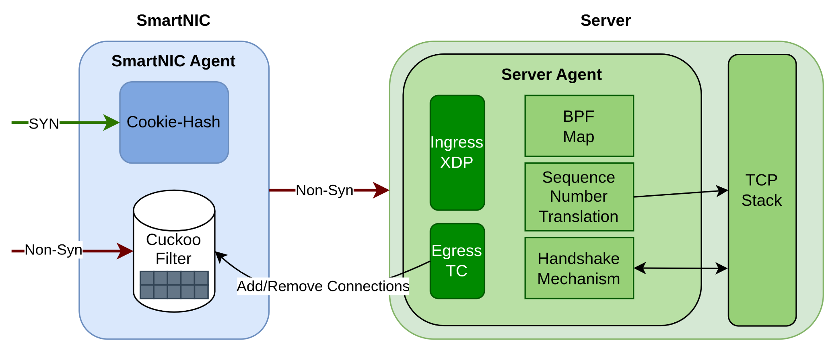
CUCKOOGUARD Architecture
SmartNIC
Server
Main Ideas:
Split-Proxy approach (originally from baseline: SMARTCOOKIE^{[2]})
Offload SYN-Cookie computation to SmartNIC
Offload connection state to the servers kernel
Memory-efficient line-rate packet filtering in the SmartNIC
Major Innovation: Deploy a Cuckoo filter for connection tracking
^{[2]}Yoo et al., SmartCookie, USENIX Sec. '24
Notes:
the cuckoo guard architecture acts as a SYN-Cookie Proxy
but we distribute it among the server and the SmartNIC in a smart way to circumvent the downsides
syn-cookie computation to the smartnic
connection state in the servers kernel (since it has abundant memory compared to the smartnic, a few MB won’t make a difference)
Another major innovation we achieve over available solutions is the utilization of Cuckoo filters, which make our architecture especially memory-efficient in the SmartNIC

Slide 21
CUCKOOGUARD Architecture
Must support three core operations:
Establish TCP Connection
Forward Regular TCP Traffic
Terminate TCP Connection
Notes:
look at the two components:
SYN packets are always catched by the SmartNIC just like the SYN-cookie proxy and ACK packets are filtered and then forwarded to the server
the key of this architecture lies in the filter which ideally only allows benign packets to reach the server
the challenge is to make this filter as memory-efficient as possible

Slide 22
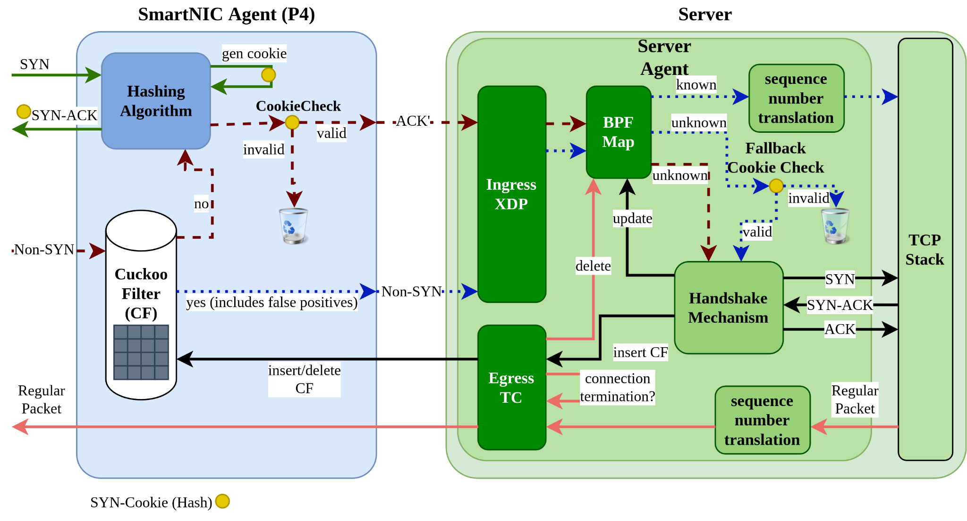
CUCKOOGUARD – TCP Client Connection
Notes:
SYN-Cookie Mechanism
here you can see the syn-cookie mechanism it works just like in the syn-cookie proxy with the only difference being that the ACK packets reaching the verification mechanism come from the cuckoo filter which identifies yet unknown packets
This is the handshake mechanism between the proxy and the server
you can see the cookiecheck flags the ack packets and forwards them to the server agent
this part is implemented on the server in the kernel as eBPF programs flagged packets are unknown to it and then initiates the handshake just like seen before
Flow Filtering in the SmartNIC
the main difference from the approach discussed before is in the following
once a TCP handshake was completed successfully the conneciton info is added to teh BPF map BPF map including the sequence number delta between the two tcp handshakes so it can be translated in the future
also the connection info is inserted into the cuckoo filter, this allows us to automaticallhy forward future packets of this connection to the server agent without it being caught up in the cookie mechanism

Slide 23
CUCKOOGUARD– Regular TCP Traffic

Slide 24
CUCKOOGUARD – TCP Connection Termination
Notes:
when a connection is terminated our egress eBPF programm can detect that and deletes it from the BPF map and the cuckoo filter: simple

Slide 25
CUCKOOGUARD – SYN Flood Attack Resistance
Notes:
now lets see what happens under an attack scenario: under SYN Flood attack or SmartNIC agent will calculate many cookie, nothing reaches the server: great

Slide 26
CUCKOOGUARD – ACK Flood Attack Resistance
R5 – OFF⚡
Cuckoo filters are probabilistic!
We need a fallback path for false positives
Probabilistic filters save memory:
E.g. ~1.2 MB instead of ~9.9 MB
(579,600 flows)
Notes:
Now lets see what happens under an ACK flood, an alternative attack type that we also have to be resilient against, because as you will see soon protecting our architecture from thath is a bit more complex
so as we discussed before our cuckoo filter will automatically filter out unknown ack packets and forwards them to the cookie check
these packets are no problem since the cookiecheck will filter them out since they are not legitimate
however there is one problem: our cuckoo filter is not perfect, it is a probabilistic data structure which allows us to safe significant amounts of memory
this means we also need protection from the few packets that will pass our cuckoo filter
weakpoint: cookie-check in the severs kernel
But as we will see our architecture is quite robust in practice to ACK floods as well

Slide 27
CUCKOOGUARD – An Argument for Cuckoo Filters
Filter Type | Insertion | Query | Deletion
Bloom Filter | O(k) | O(k) | Not supported
Cuckoo Filter | O(1) amortized | O(1) | O(1)
k = number of hash functions
Cuckoo filters support explicit entry removal
  We can utilize this to remove terminated TCP connections precisely
  Memory-efficient
Bloom filters need to employ workarounds
  Time-decaying (keep two filters, alternate between deleting one of them)
  Memory-hungry
Notes:
this requires us to deep dive into the cuckoo filter, the unique component of our architecture
previous approaches relied on the use of Bloom filters since they are more common in network applications and also their implementation is pretty simple
they are also probabilistic filters and behave similar to cuckoo filters, means they don’t have false negatives, but false positives
however one of the central findings of my thesis will be that Bloom filterare actually not ideal as a flow filter
as we remember from the last slide our archiltecture needs some kind of way to remove tcp connections flows from the flow filter, otherwise the filter will fill up over time rendering it useless
The specialty of cuckoo filters is that they support explicit removal of items
the only way to implement element removal behaviour in Bloom filters is by implementing a time-decaying mechanism, which requires to keep two bloom filters and in alternating fashion delete one of both
in this way old connections will be removed automatically over time
cuckoo filters prove to be way more memory efficient, we also verify this with experiments

Slide 28
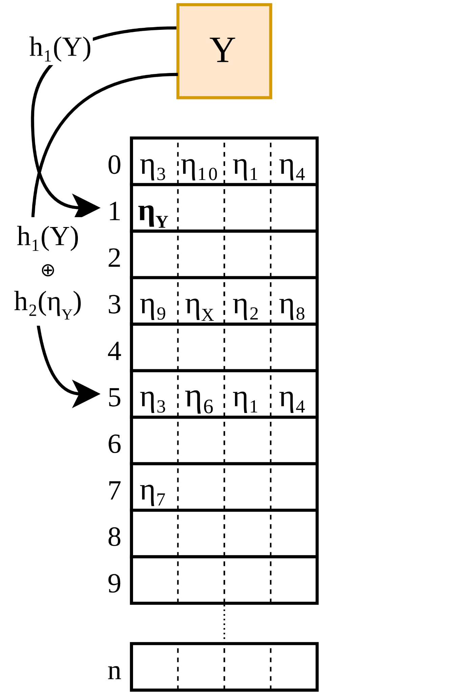
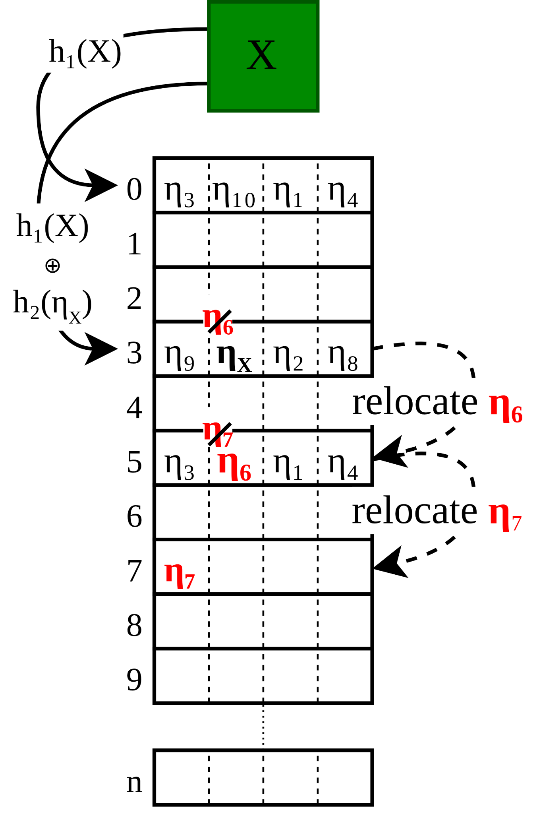
Cuckoo Filter Data Structure
General Idea^{[3]}:
Connection tuple X hashed to fingerprint η of length f
i₁, i₂ indices determined by Cuckoo Hashing
False Positives happened if connection tuples X and Z are hashed to the same fingerprint η
Increasing f decreases false positives
^{[3]}B. Fan et al. Cuckoo Filter. CoNEXT '14.
Notes:
before we go to the evaluation chapter, we have to quickly discuss how Cuckoo filters are implemented
here on the figure we can see a cuckoo filter, it consists of n buckets, with each bucket capable of holding 4 elements
to insert an element into the cuckoo filter we first need to calculate an elements fingerprint via hashing
now given the fingerprint and the original element we can determine two indices, these two indices point to buckets into either one we insert the fingerprint element
now if both buckets are full already we exchange the fresh fingerprint with one of the ones alreadyin the filter, now for this fingerprint we try to insert it into it’s alternate bucket
this works since every fingerprint automatically points to two buckets at all times
for insertion we repeat this relocation until an empty spot is found
you remember the false positives that I mentioned before, these happen when two elements are hashed to the same fingerprint, so when the filter is checked for existence of the fingerprint it will respond with yes
so of course if the fingerprints are larger we can reduce the false positive rate, but it needs more memory obviously
For implementing the cuckoo filter querying and deleting is straightforward, but the insertion process can be tricky since we need some kind of looping mechanism
lets remember this and see how we can implement network functions on programmable hardware such as SmartNICs

Slide 29
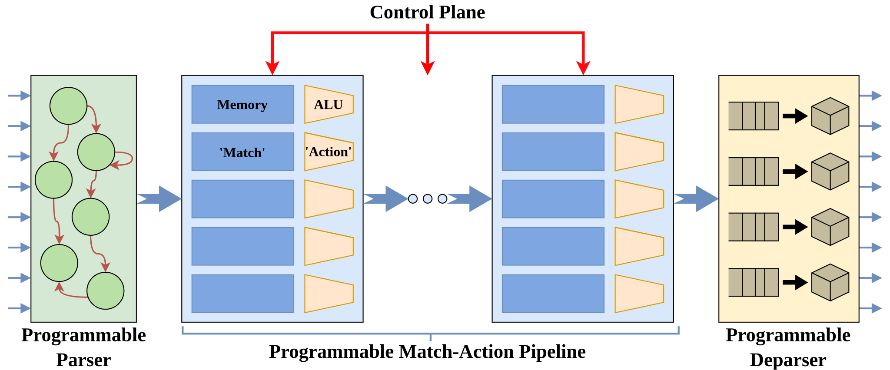
Match-Action Pipeline Programming
Advantages:
High-performance on hardware
Predictable latency
Limitations:
No loops (for, while, …)
…
Loops via Packet Recirculation
Notes:
in order to implement a network function in our programmable data plane SmartNIC we utilize P4 a domain-specific language especially for the programmable data plane
it is not suitable for network functions because:
protocol agnostic
efficient on hardware
predictable latency
However there is one major limitation:
P4’s match-action pipeline does not support loops of any kind
this makes sense since loops would lead to unpredictable latency among other side effects
We solve this restriction by recirculating packets
as you may already think this has some performance implications
This brings us to the experimental Evalutation

Slide 30
Evaluation – Experimental Setup
Linux-based Implementation Setup:
SmartNIC Agent emulated via BMv2 software running
Server Agent deployed in kernel as program
Goals:
Validate Architecture
Evaluate Cuckoo filter insertion overhead
Bloom filter vs. Cuckoo filter
CUCKOOGUARD vs. related work (SMARTCOOKIE)
Notes:
for the evaluation we actually implemented the architecture:
SmartNIC Agent: P4
Server Agent: eBPF kernel program

Slide 31
Validate Architecture: System Demonstation using iPerf
Setup:
Virtualized network using mininet
iPerf throughput test: 10 parallel TCP connections

Slide 32
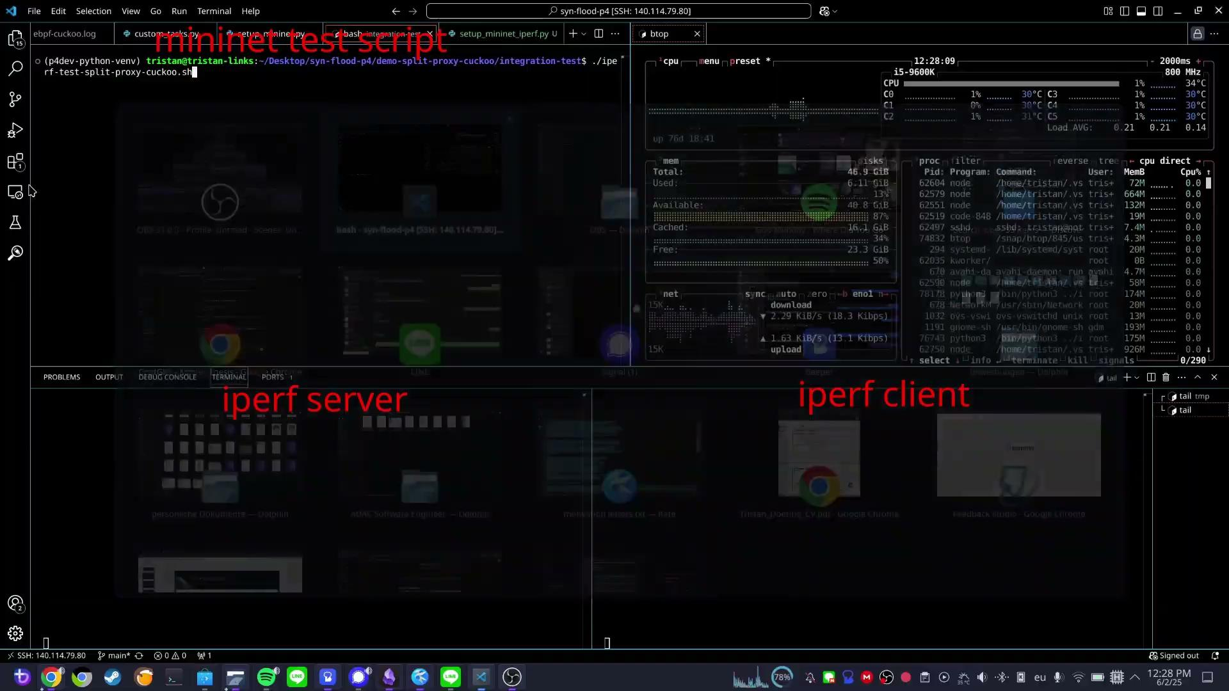

Slide 33
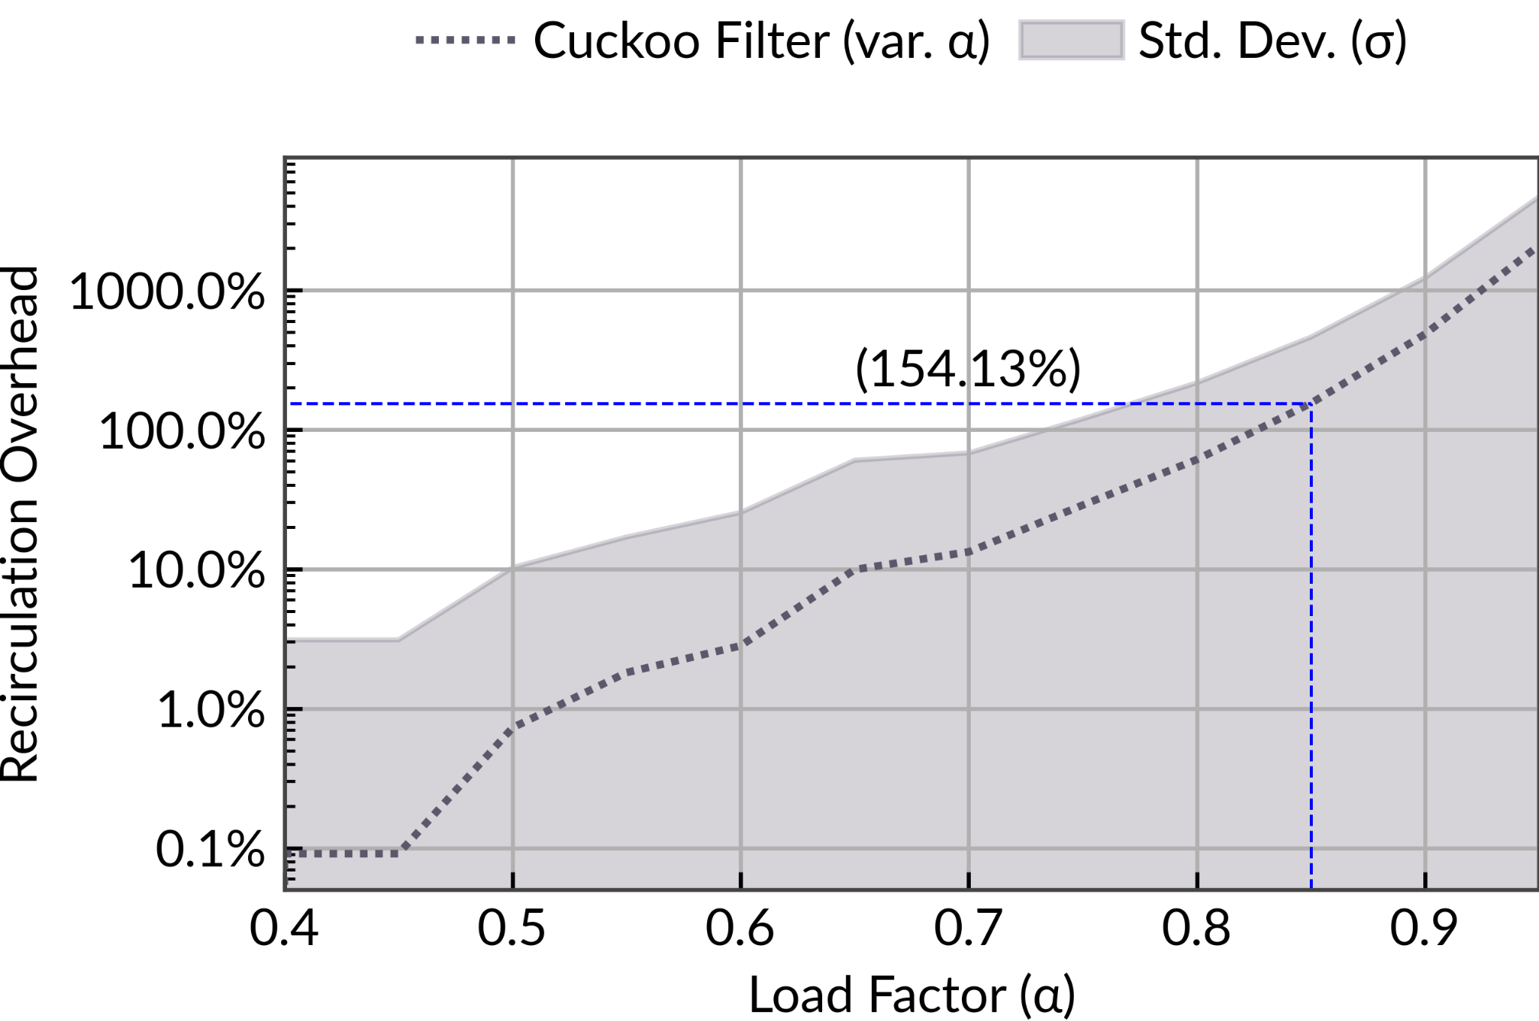
Cuckoo Filter Insertion Overhead Manageable
Experiment
Setup
Fix memory budget
Vary load factor α
Test inserting new connections
Notes:
the experiment setup is as follows:
we use our CUCKOOGUARD architecture with a Cuckoo filter
it is completely filled with ongoing TCP connections until a load factor of α
now we try to add one more connection and measure how many times it needs to be recirculated (looped)
we repeat this 1000 times for 30 experiment runs perc load factor α
Result:
you can see at a load factor of 0.95 the average packet insertion takes about 15 recirculations

Slide 34
Cuckoo Filter Insertion Overhead Manageable
Is Cuckoo filter insertion too slow?
No, because
Only once per connection
neglictible at α = 0.85
Notes:
Now does this make the Cuckoo filter insertion process too slow to be practical?
No, because
However at a load factor of 0.85 it is already vastly reduced to 1.5 recirculations, which is really not that much, considering for each established connection we only need to process 1.5 packets

Slide 35
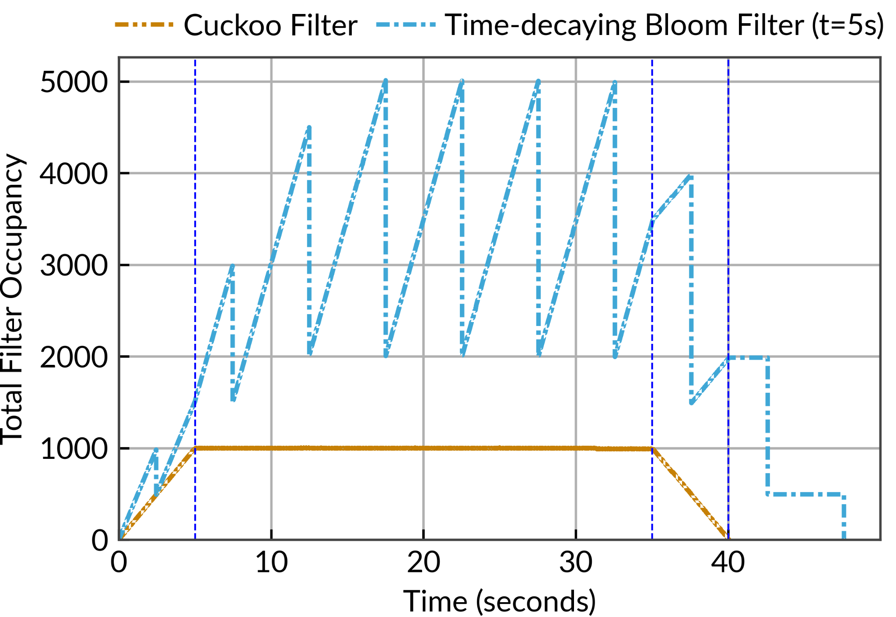
Cuckoo Filter enables Precise Connection Tracking
Experiment
Setup
200 new TCP connections per second
Each lasts for 5s
After 35s:
No new connections
Notes:
Now that we establishe that Cuckoo filters are actually feasible and practical in programmable data planes we need to quantify the exact advantage it has over Bloom filters considering its capability of element deletion
for this experiment we utilize cuckoo filtjer and time-decahing bloom filter als flow filters
the idea is to analyze the tracking behaviour for this we observe the total filter occupancy over time
the scenario is that 200 new tcp connecitons are established each second, each of these lasts for 5s and is then terminated
Observations:
the experiment can be dissected into 4 phases:
new connection establishment
normal runtime
decreasing active connections
no active connections
we can see the cuckoo filter exactly tracks the conneciton as they are alive since connection termination is detected and the element is directly removed from the cuckoo filter subsequently
the time-decayng bloom filter on the other hand is very different
since it implements two filters we can see the increase in tracked connections is double compared to cuckoo in the beginning
it is repeatedly decreased since one of the filters is completely emptied every 5 seconds
in this configuration the time-decaying bloom filter combined need to track up to 5000 elements
when looking at one fliter isolated each needs to be able to track 3000 connections

Slide 36
Cuckoo Filter enables Precise Connection Tracking
Result
Bloom filters display 6x overhead
Cuckoo filters avoid tracking overhead
Improved memory- efficiency
Notes:
Results
cuckoo filter only needs to track 1000 connections vs 6000 connections because it implements fine-grained connection tracking
in a real life scenario this effect can be better or worse depending on the scenario, but it is very clear that cuckoo filters are more efficient
since we determined that the implementation of cuckoo filters is efficient this is very promising

Slide 37
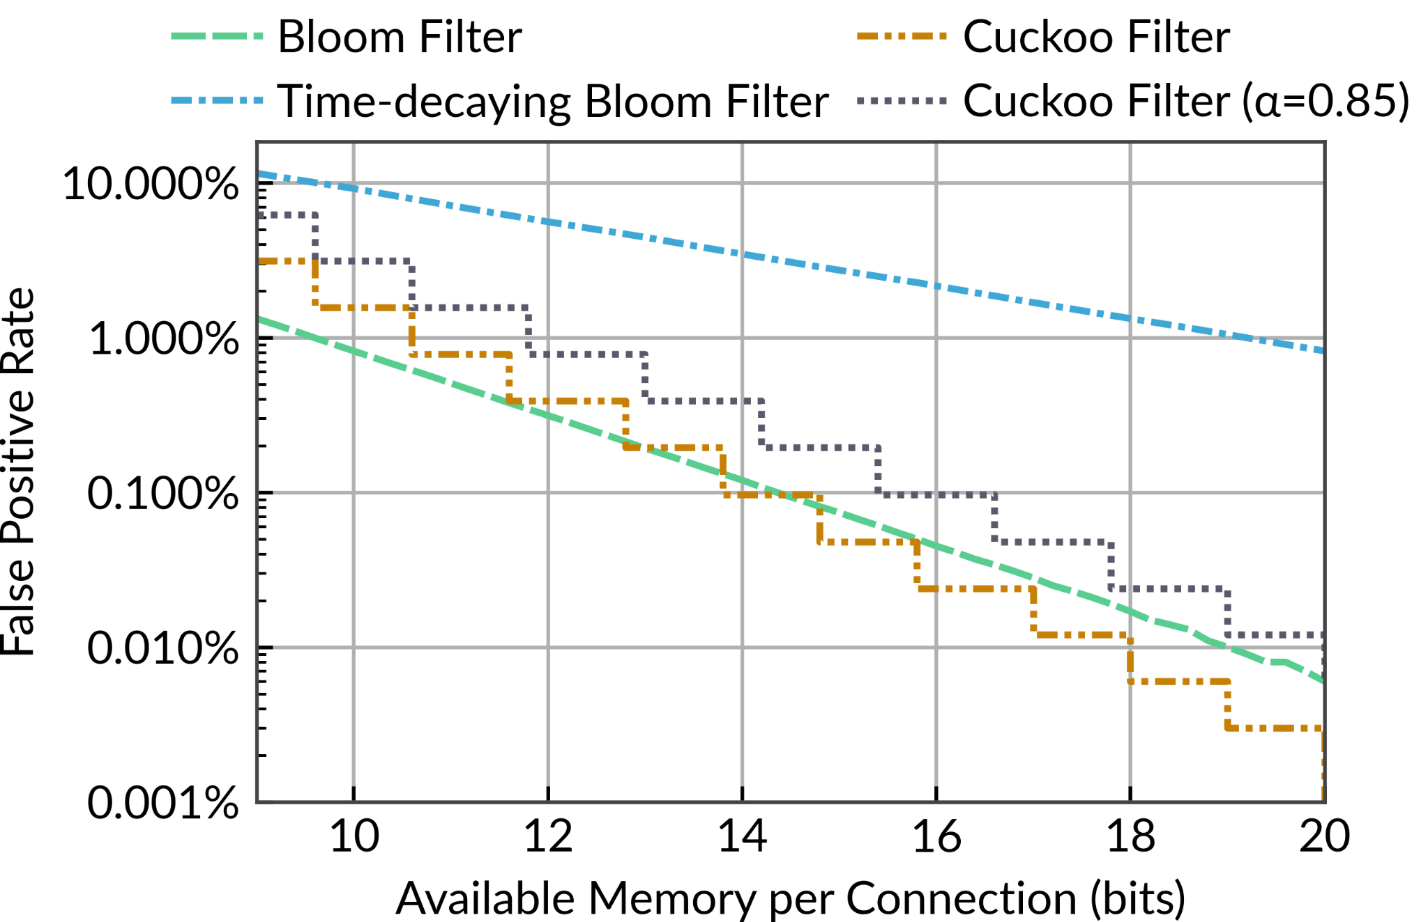
Filter Precision: Bloom Filter vs. Cuckoo Filter
Experiment
Setup
Vary available memory per connection
Compare false positive rate at max. capacity (worst case)
Low false positive rate important for R5 – OFF
Does not support connection removal
Optimized for low insertion overhead
Notes:
In this next experiment we want to compare the accuracy of bloom filter vs cuckoo filter in our architecture

Slide 38
Filter Precision: Bloom Filter vs. Cuckoo Filter
Result
Cuckoo filter ~100x more precise
(at 20 bits)
Server offloading improved by ~100x
R5 – OFF ✓

Slide 39
Evaluation – CUCKOOGUARD vs SMARTCOOKIE
Experiment
Setup
Results
This scenario highly favors the Bloom filters used in SMARTCOOKIE
10.85 bits per connection
Both track 579,600 concurrent TCP connections
786 KB of memory
ACK flood attack consisting of 100,000 packets
CUCKOOGUARD: 1.56% false positive rate
SMARTCOOKIE: 7.66% false positive rate
CUCKOOGUARD still improves server offloading by up to 79%
E.g. CPU Usage under 30 Mpps attack: 350 M Instr./s -> 73.5 M Instr./s

Slide 40
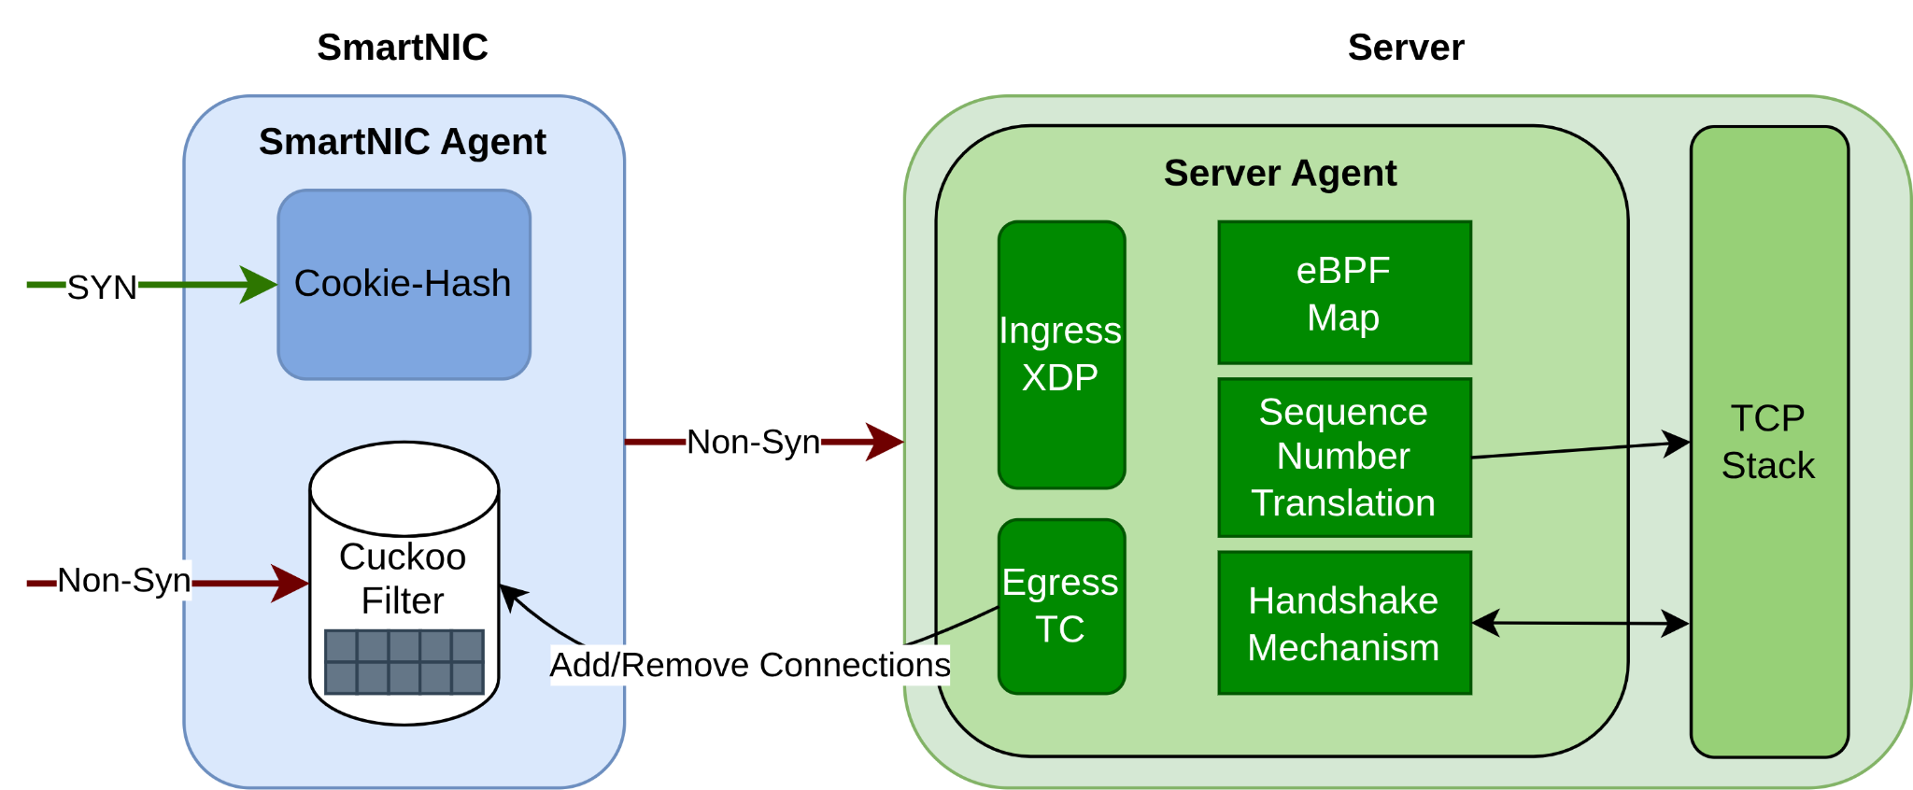
Conclusion
Goal: Develop an effective SYN Flood Defense
Achievements:
Architecture that achieves all requirements (R1-R7)
Protect any TCP server from SYN/ACK flood attacks
Utilize Programmable Hardware -> high performance
Improved protection compared to state of the art by at least 79%
Foundational work for the use of Cuckoo filters in programmable data planes
Implementations can be used for real deployments

Slide 41
Future Work
Evaluate Latency/ Performance using real hardware
Integration into multi-functional network function
architectures
Further optimization of Cuckoo filters by
implementing semi-sorting
(algorithmic complexity vs. memory-efficiency)
Analyze impact of TCP options

Slide 42
Thank you for listening
Thanks for the support with the
Paper Submission to IEEE Globecom 2025 CISS

Slide 43
Bibliography - Images
• Intel Tofino 2 image: GazetteByte – "Intel combines optics to its Tofino 2 switch chip"
https://www.gazettabyte.com/home/2020/3/19/intel-combines-optics-to-its-tofino-2-switch-chip.html
• P4 logo: P4.org – https://p4.org/wp-content/uploads/2024/06/p4-logo.svg
• eBPF logo: GitHub – https://github.com/goranvasic/svg-logos/blob/main/ebpf-dark-logo.svg
• DPDK logo: DPDK Project – https://fast.dpdk.org/download/logos/DPDK_logo_horizontal_tag.svg
• Xilinx U25N SmartNIC image: Xilinx (archived) –
https://web.archive.org/web/20200511172852im_/https://www.xilinx.com/content/dam/xilinx/imgs/kits/
alveo-u25-hero-of-card.jpg

Slide 44
Bibliography
[1] D. Scholz, S. Gallenmüller, H. Stubbe, and G. Carle.
SYN Flood Defense in Programmable Data Planes.
Proc. of the 3rd P4 Workshop in Europe (EuroP4 '20), pp. 13–20, 2020.
[2] S. Yoo, X. Chen, and J. Rexford.
SmartCookie: Blocking Large-Scale SYN Floods with a Split-Proxy Defense on Programmable Data Planes.
Proc. of the 33rd USENIX Security Symposium (USENIX Security '24), pp. 217–234, Aug. 2024.
[3] B. Fan, D. G. Andersen, M. Kaminsky, and M. Mitzenmacher.
Cuckoo filter: Practically better than Bloom.
Proc. of the 10th ACM CoNEXT, pp. 75–88, 2014.

Slide 45
Backup Slides

Slide 46
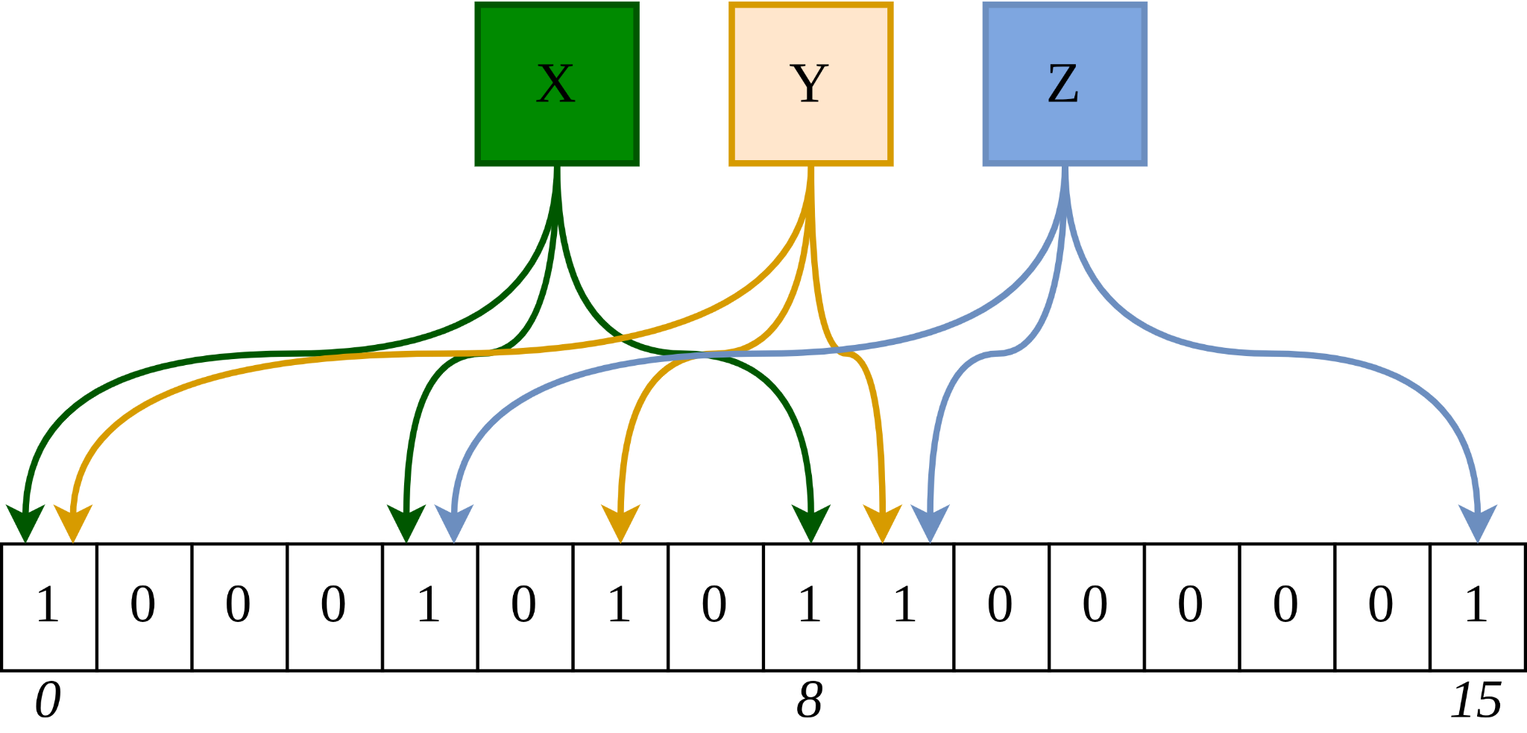
Background – Bloom Filter
Notes:
maybe skip this, it’s not essential

Slide 47
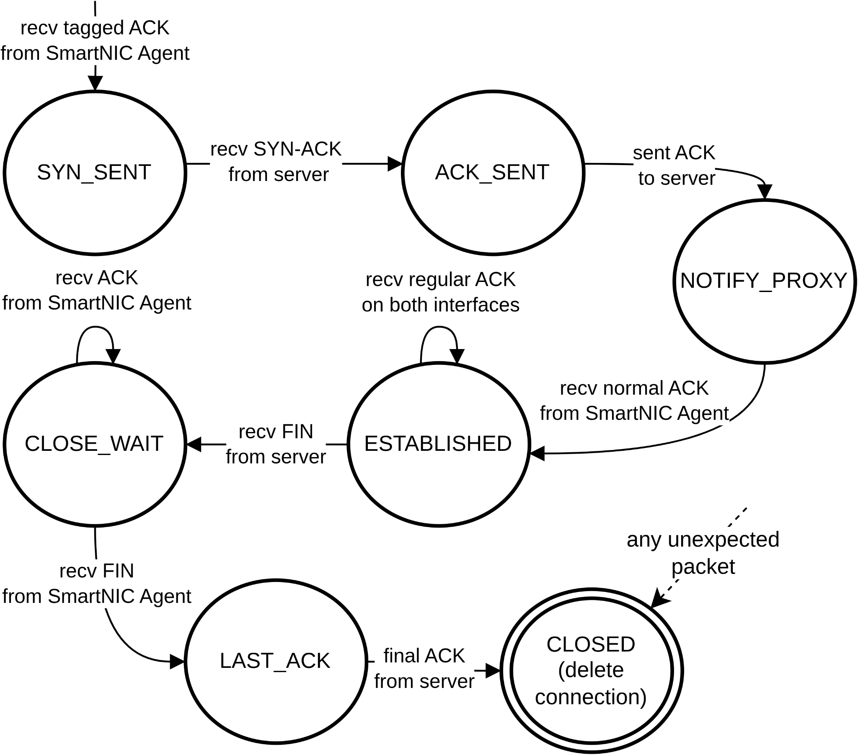
Implementation - Server Agent: Connection State Machine

Slide 48
– Match Action Pipeline Programming

Slide 49
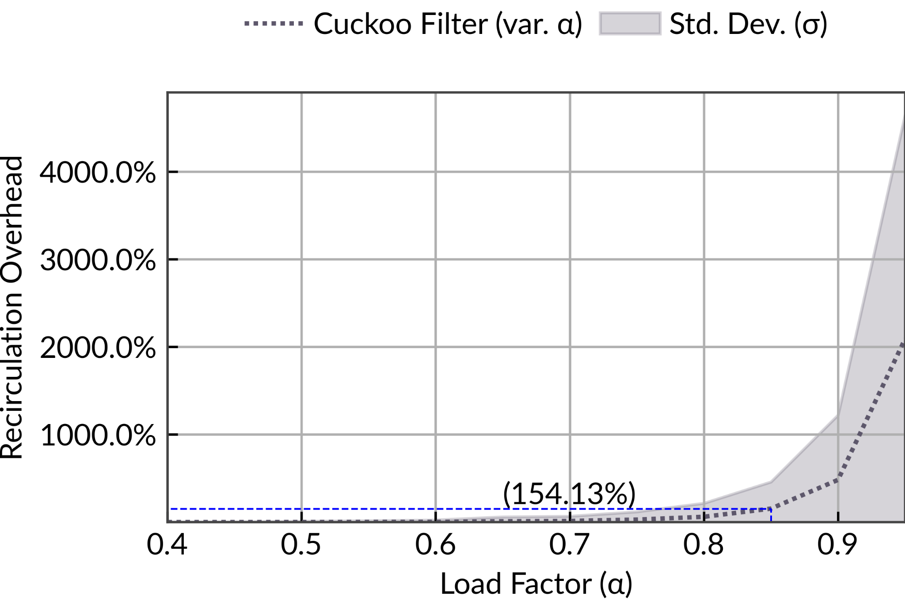
Cuckoo Filter Insertion Linear Scale
Experiment
Setup
Fix memory budget
Vary load factor α
Test inserting new connections
Notes:
the experiment setup is as follows:
we use our CUCKOOGUARD architecture with a Cuckoo filter
it is completely filled with ongoing TCP connections until a load factor of α
now we try to add one more connection and measure how many times it needs to be recirculated (looped)
we repeat this 1000 times for 30 experiment runs perc load factor α
Result:
you can see at a load factor of 0.95 the average packet insertion takes about 15 recirculations

Slide 50
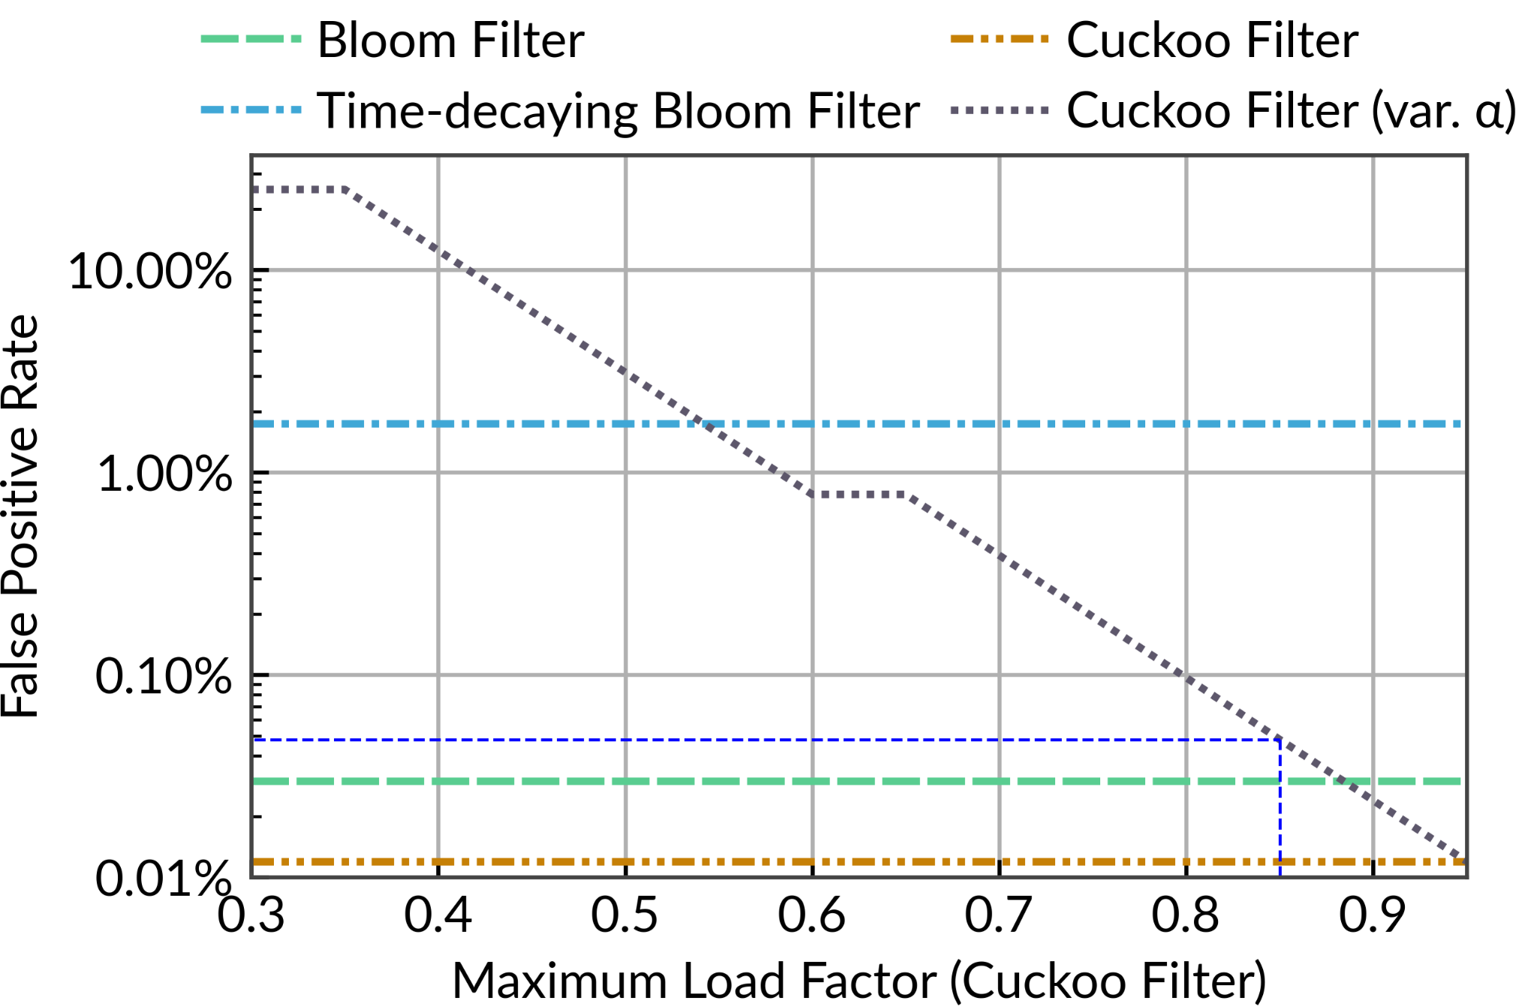
Evaluation – Bloom Filter vs. Cuckoo Filter
Setup
fixed memory per connection (16.85 bits)
Result
precision at α=0.85 only slightly decreased

Slide 51
Memory Usage Example Cuckoo Filter vs. Perfect Filter
Scenario: 579,600 flows
| Data Structure | Memory Usage | False Positive Rate |
| ---------------- | --------------------- | ------------------- |
| Connection Table | ~9,853 KB ~ 9.9 MB | 0% |
| Cuckoo Filter | ~ 1,236 KB ~ 1.2 MB | 0.01% |

